Slide 1
HIPAA for Law Enforcement Officers
Jane C. Drummond
General Counsel and Vice President of Legal Affairs

Slide 2
POP QUIZ
True or False:
If a law enforcement officer is requesting medical information for a legitimate reason, HIPAA does not apply
HIPAA does not allow any medical information to be released to law enforcement without a warrant or subpoena
HIPAA states that health care providers must release medical information when required to do so by law, so they must do so in response to a law enforcement request
HIPAA requires employees who disclose medical information without proper authorization be disciplined by their employer
HIPAA creates misunderstandings and conflict between investigators and health care providers

Slide 3
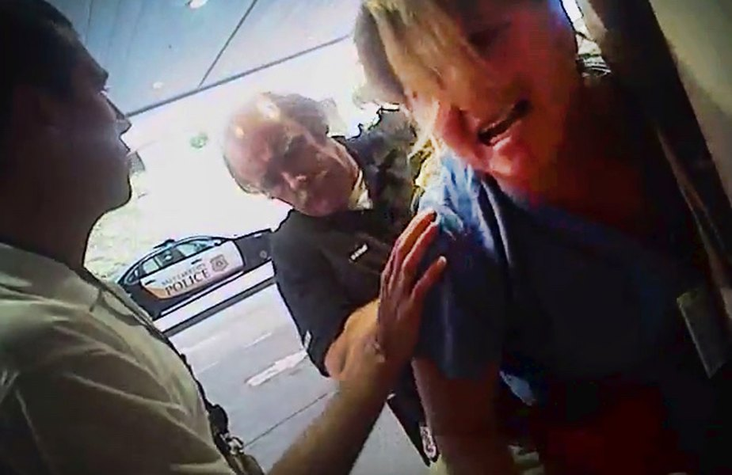
MISUNDERSTANDINGS MAKE BAD PUBLICITY

Slide 4
MISUNDERSTANDINGS MAKE BAD PUBLICITY
Alex Wubbels: “Help! Help! Somebody help me! Stop! Stop! I did nothing wrong!”
Detective Jeff Payne: “She was doing her job,” he said. “I was doing my job. And unfortunately, it conflicted.”
-- Miller, J. (2018, Nov. 5). Former Detective Jeff Payne isn’t sorry for arresting Alex Wubbels and he plans to sue for $1.5 million. The Salt Lake Tribune. Retrieved from https://www.sltrib.com/news/2018/11/06/former-detective-jeff/

Slide 5
HIPAA BASICS
Important Terms:
Covered Entity: Health care provider, health plan or health care clearinghouse
Protected Health Information (PHI): Information created/held by covered entity relating to a past, present or future physical or mental health condition, the provision/receipt of health care for that condition or payment for the provision of health care which identifies the individual

Slide 6
HIPAA BASICS
Important terms:
Privacy Rule: The HIPAA regulations that govern the use and disclosure of PHI
Breach: Acquisition, access, use or disclosure of PHI in violation of the Privacy Rule which compromises the security or privacy of the PHI
A health care provider is subject to fines for violating HIPAA

Slide 7
HIPAA BASICS
The Privacy Rule generally prohibits the release of PHI by a health care provider unless
the disclosure is for treatment, payment or health care operations
the patient specifically authorizes the disclosure
the disclosure is subject to an exception described in the rule for which an authorization is not required
Some of the exceptions still require that certain conditions be met before PHI can be disclosed

Slide 8
WHAT HAPPENED IN SALT LAKE CITY?
Blood draw results are protected health information under HIPAA. Certain conditions must exist before a health care provider can release PHI to law enforcement personnel (none of which were present):
As required by law
To identify/locate a suspect, fugitive, material witness or missing person
In response to law enforcement request about a crime victim
To alert law enforcement of a suspicious death
When reporting a crime occurring on the provider’s premises
To provide certain information about an off-premises crime

Slide 9
LAW ENFORCEMENT EXCEPTIONS
HIPAA permits the release of PHI under these law enforcement exceptions. However, there are conditions that must be met in most instances, which may include:
Patient consent
Notice to the patient
Court order/subpoena
Agreement of the health care provider

Slide 10
LAW ENFORCEMENT EXCEPTIONS
HIPAA has different requirements for releasing information to law enforcement, depending on the reason for the request. State law may impact what and to whom information can be released.
Disclosures about victims of abuse, neglect or domestic violence
Statutorily mandated reports
Information about crime victims
Information about criminal suspects
Crimes occurring on or off the premises

Slide 11
REPORTS OF ABUSE, NEGLECT OR DOMESTIC VIOLENCE
HIPAA Privacy Rule 45 C.F.R. § 164.512(c)
PHI may be disclosed:
As required by law (limited to the information required to be reported)
With the victim’s consent; or
Without the victim’s consent, but only if
The health care provider believes disclosure is necessary to prevent serious harm to the victim or others
The victim is incapacitated and law enforcement represents that it does not intend to use the information against the victim and immediate enforcement activity would be materially affected by delay

Slide 12
STATUTORILY MANDATED REPORTS – ELIGIBLE ADULTS
Required by Law: Missouri law mandates that certain individuals report suspected abuse or neglect of eligible adults
Section 192.2400, RSMo defines eligible adults:
Persons age 60 or older or disabled adult
Unable to protect his or her own interests
Unable to perform or obtain services needed to meet his or her essential needs

Slide 13
STATUTORILY MANDATED REPORTS – ELIGIBLE ADULTS
Mandated reports involving eligible adults – Section 192.2405, RSMo
Reported to Department of Health and Senior Services
Section 192.2410, RSMo says reports shall contain:
Name, age and address of eligible adult
Name and address of anyone responsible for their care
Nature and extent of victim’s condition
Other relevant information

Slide 14
STATUTORILY MANDATED REPORTS – ELIGIBLE ADULTS
Result:
Health care providers can release PHI regarding abuse or neglect of an eligible adult to the Department of Health and Senior Services
Reports can identify the individual, their caregiver and contain any other information that would be relevant to the Department’s ability to investigate the alleged abuse or neglect

Slide 15
STATUTORILY MANDATED REPORTS – ELIGIBLE ADULTS
Release of information to law enforcement
The “required by law” exception allows a health care provider to release PHI only to the agency authorized by law to receive the information and within the limits of what the state statute allows to be released.
How can law enforcement obtain the information?

Slide 16
STATUTORILY MANDATED REPORTS – ELIGIBLE ADULTS
Law enforcement can obtain PHI as follows:
From the Department of Health and Senior Services
With the consent of the victim
If the health care provider believes disclosure is necessary to prevent further harm to the victim or others
The individual is incapacitated and an investigation would be materially affected by a delay in obtaining the information
Officer must verify that information is not intended to be used against the victim
Court order/warrant/subpoena

Slide 17
STATUTORILY MANDATED REPORTS – CHILD ABUSE
HIPAA Privacy Rule 45 C.F.R. § 164.512(b)
In cases involving child abuse or neglect, PHI may be disclosed as follows:
To a public health agency or government authority authorized by law to receive reports of child abuse or neglect.

Slide 18
STATUTORILY MANDATED REPORTS – CHILD ABUSE
Section 210.115, RSMo requires certain individuals to report suspected child abuse or neglect to the Department of Social Services.
Section 210.145, RSMo requires the department to notify law enforcement of any case involving child abuse in which it believes an investigation is warranted and is required to disclose information in its possession to law enforcement

Slide 19
STATUTORILY MANDATED REPORTS – CHILD ABUSE
Law enforcement can obtain PHI as follows:
From the Department of Social Services
With authorization from a parent or guardian
Court order/warrant/subpoena.

Slide 20
CASE STUDY #1
The Cole County Sheriff’s Department is investigating a shooting. A witness informs deputies that a victim was shot and visibly bleeding. He was dragged to a private vehicle, which sped away. Naturally, the deputies assume that he was taken to a local hospital. They contact Capital Region Medical Center and inquire whether an individual with a gunshot wound was brought to the emergency department. What can hospital staff share with the sheriff’s department?

Slide 21
OBTAINING PHI ABOUT A CRIME VICTIM
HIPAA Privacy Rule 45 C.F.R. § 164.512(f)(3)
Unless the disclosure is required by law (mandated reports), HIPAA places some restrictions on the disclosure of PHI about a crime victim. These restrictions are similar to those imposed when the victim is an adult victim or abuse, neglect or domestic violence.

Slide 22
OBTAINING PHI ABOUT A CRIME VICTIM
A health care provider only can disclose PHI about a suspected crime victim at the request of law enforcement if:
The victim consents, or
The victim is incapacitated and the officer represents:
PHI is needed to confirm illegal activity (by someone other than the victim)
PHI is not intended to be used against the victim
immediate law enforcement action is dependent on the disclosure and will be materially and adversely affected by delay
The health care provider must also determine that the disclosure is in the best interest of the victim

Slide 23
CASE STUDY #1 (CONT.)
Based on additional information obtained from witnesses, the Cole County detectives are acting on the theory that the individual who was taken to the hospital was a drug dealer, and that the shooting occurred when he was targeted by robbers who had set up a drug deal with the intent to steal the drugs. What information can detectives obtain from the hospital?

Slide 24
OBTAINING PHI ABOUT A CRIMINAL SUSPECT
HIPAA Privacy Rule 45 C.F.R. 164.512(f)(2)
HIPAA allows the release of PHI for the purpose of locating a criminal suspect, fugitive, material witness or missing person, but limits the disclosure to:
Name, address, birthday, place of birth, SSN
Blood type and rh factor
Type of injury
Date and time of treatment/death
Distinguishing physical characteristics

Slide 25
CASE STUDY #1 (CONT.)
Based on conflicting information provided by witnesses, the Cole County detectives wish to conduct additional surveillance on the individual once he is released from Capital Region Medical Center. They contact the charge nurse and ask to be informed when the individual is released from the hospital. What information can the nurse or other hospital staff share about the individual’s release?

Slide 26
CASE STUDY #2
The Cape Girardeau County Sheriff asks the director of the emergency department at Saint Francis Medical Center to notify the sheriff’s department when an individual presents with an opioid overdose. The Sheriff represents that he does not intend to investigate the patient, but instead would like to interview the individual to determine where he or she is obtaining drugs. Can the hospital assist?

Slide 27
CRIMES OCCURRING ON A HEALTH CARE PROVIDER’S PREMISES
HIPAA Privacy Rule 45 C.F.R. § 164.512(f)(5)
A health care provider may disclose PHI it believes, in good faith, to constitutes evidence of criminal conduct that occurred on its premises.

Slide 28
REPORTING CRIMES IN EMERGENCIES
HIPAA Privacy Rule 45 C.F.R. § 164.512(f)(6)
A health care provider providing emergency medical care due to an emergency occurring off its premises may disclose PHI to law enforcement official as necessary to alert the officer to:
Commission and nature of a crime
Location of the crime or of victims
Identity, description and location of perpetrator

Slide 29
CASE STUDY #3
A detective from the Liberty Police Department presents a subpoena issued by the Circuit Court of Clay County and signed by the court clerk to the medical records department at Liberty Hospital, seeking records from a patient’s emergency department visit. The detective tells the clerk that police brought the individual in because he assaulted a police officer, and they are investigating whether the patient was under the influence of illegal narcotics or legally intoxicated. Can the hospital provide the records?

Slide 30
COURT ORDERS AND SUBPOENAS
HIPAA Privacy Rule 45 C.F.R. § 164.512(e) and (f)(1)
HIPAA permits law enforcement officers to obtain PHI pursuant to various legal processes. In some instances, certain conditions must be met. Generally, the Privacy Rule distinguishes between legal process issued by a court or administrative agency versus that issued by an attorney or party to a legal proceeding.

Slide 31
COURT ORDERS AND SUBPOENAS
A health care provider may release PHI pursuant to a court order, so long as the disclosure is limited to that expressly requested.
Includes warrant, subpoena or summons signed by a judicial officer, or a grand jury subpoena
Includes an administrative subpoena, summons or CID, if:
The information is relevant and material to a legitimate inquiry and
The request is specific and reasonably limited in scope and
De-identified information could not reasonably be used.

Slide 32
RELEASING PHI PURSUANT TO A SUBPOENA
HIPAA places additional restrictions on subpoenas that are not accompanied by a court order. To release PHI in response to a subpoena, one of two conditions must be met:
The provider receives satisfactory assurance that reasonable efforts have been made to notify the individual about the requested release; or
The provider receives satisfactory assurance that reasonable efforts have been made to secure a qualified protective order

Slide 33
RELEASING PHI PURSUANT TO A SUBPOENA
Satisfactory assurance of attempts to notify the individual means:
A written statement and accompanying documentation from the requesting party that:
A good faith attempt was made to notify the individual in writing
If the individual’s location is unknown, notice was mailed to his/her last known address
The notice included sufficient information about the proceeding to permit the individual to object; and
The time for the objections has passed and (1) the individual did not do so or (2) any objections were resolved by the court.

Slide 34
RELEASING PHI PURSUANT TO A SUBPOENA
Providers must document that the requirements for disclosing PHI have been met. To facilitate the release of information, the requesting agency should be prepared to provide:
A description of the actions taken to locate the individual and notify them that their records have been requested
The time frame the individual was given to object
An assurance that the time frame to object has lapsed; and
An assurance that the individual did not object or agreed to the disclosure, or a description of how any objections were resolved.

Slide 35
RELEASING PHI PURSUANT TO A SUBPOENA
Documentation to support a subpoena may include:
A copy of the notice provided to the individual
Any documents submitted by the individual objecting or agreeing to the disclosure
Copies of any documents filed with or issued by the court demonstrating the individual’s agreement with or objections to the disclosure and a description of how any objections were resolved

Slide 36
RELEASING PHI PURSUANT TO A SUBPOENA
Satisfactory assurance of efforts to secure a qualified protective order means:
The parties to the legal proceeding have agreed to a qualified protective order and have presented it to the judge; or
The party seeking the PHI has requested a qualified protective order from the judge

Slide 37
RELEASING PHI PURSUANT TO A SUBPOENA
A qualified protective order can be in the form of an order issued by the court or a stipulation between the parties to the legal proceeding. In either instance, HIPAA requires it contain:
A prohibition on using or disclosing the PHI for any purpose other than the legal proceeding
A requirement that the PHI and all copies be returned to the provider or destroyed at the end of the proceeding

Slide 38
DOCUMENTATION OF A QUALIFIED PROTECTIVE ORDER
To facilitate the release of PHI pursuant to a qualified protective order, the agency seeking the PHI should provide:
A copy of the order
If the order is in the form of a stipulation, a letter from one or both parties confirming their agreement, along with a copy of the stipulation and proof that it has been filed with the court.
Alternatively, the parties to the legal proceeding may provide a letter describing their efforts to obtain a qualified protective order from the judge, along with any documents that have been filed with the court that attempt to seek such an order.

Slide 39
ANY QUESTIONS?

Slide 40
CONTACT INFORMATION
Jane Drummond
General Counsel and Vice President of Legal Affairs
Missouri Hospital Association
jdrummond@mhanet.com
(573) 893-3700, ext. 1328
https://web.mhanet.com/

