Slide 1
Terrorism

Slide 2
Pathway to Violence
Ideation
Planning
Preparation
Implementation

Slide 3
Behavioral Warning Signs
The person has a major unresolved grievance or grudge and sees no alternatives to resolving it except by violence.

Slide 4
The person has made communications suggesting ideas or intent to attack.
The person has shown inappropriate interest in attacks, attackers, or weapons.

Slide 5
The person has engaged in attack-related behaviors, such as developing an attack idea or plan, acquiring weapons, testing access to potential targets, or rehearsing an attack.

Slide 6
The person appears to have the means and ability to carry out an attack plan.
The person is experiencing hopelessness, desperation, and despair.

Slide 7
The person sees violence as the acceptable, desirable, or only way to solve problems.

Slide 8
The Radicalization Process
Notes:
There has been much research, writing, and theorizing about what causes or motivates people to become terrorists. The one consistent finding based on extensive empirical research is that there is no "terrorist profile" that can be used to predict who or even what type of person might become a terrorist. Research clearly rules out the early theory that participation in terrorist actions is associated with some sort of personality or mental disorder, that only "crazy" people commit horrible acts of terrorism. Studies have shown that the prevalence of mental illness among incarcerated terrorists is as low or lower than in the general population. Although terrorists commit horrible acts, they rarely match the profile of the classic psychopath. They are also not necessarily from a lower socioeconomic status or less educated than their peers.

Slide 9
Vulnerabilities
Perceived Injustice or Humiliation
Need for Identity
Need for Belonging
Notes:
Perceived Injustice or Humiliation: Violent attack may be perceived as an appropriate remedy for injustice or humiliation.
Need for Identity: An individual's search for identity may draw him or her to extremist or terrorist organizations in a variety of ways. The individual may be searching for a purpose or goal in life that defines the actions required to achieve that goal. A violent act may be seen as a way to succeed at something that makes a difference. The absolutist, "black and white" nature of most extremist ideologies is often attractive to those who feel overwhelmed by the complexity and stress of navigating a complicated world. Without struggling to define oneself or discern personal meaning, an individual may choose to define his or her identity simply through identification with a cause or membership in a group.
Need for Belonging: Many prospective terrorists find in a radical extremist group not only a sense of meaning, but also a sense of belonging, connectedness, and affiliation. One researcher argues that "for the individuals who become active terrorists, the initial attraction is often to the group, or community of believers, rather than to an abstract ideology or to violence."

Slide 10
Factors That Facilitate Radicalization Process
Spiritual Mentor
Internet
Notes:
Spiritual Mentor: About 20% of the homegrown terrorists examined in one study had a spiritual mentor, a more experienced Muslim who gave specific instructions and direction during the radicalization process. Such a mentor might be associated with a mosque or be accessed via the Internet. The mentor keeps the radicalization process on track. About a quarter of the terrorists in one study had a perceived religious authority who provided specific theological approval for their violent activity. 4
Internet: The increased radicalization of American Muslims is driven in part by a wave of English-language websites designed to promote the militant jihadist doctrine. These websites are not run or directed by al-Qaida, but they provide a powerful tool for recruiting sympathizers to its cause of jihad, or holy war against the United States, according to experts who track this activity. Jihadist websites and chat rooms provide indoctrination and training to aspiring jihadists and enable them to establish contact with like-minded individuals in the United States or with terrorist groups abroad. "The number of [active] English-language sites sympathetic to al-Qaida has risen from about 30 seven years ago to more than 200 recently," according to the head of a Saudi government program that works to combat militant Islamic websites.5

Slide 11
Terrorist Ideology
Polarized
Absolutist
Threat-Oriented
Hateful
Notes:
▪ Polarized: They have an "us vs. them" mindset.
▪ Absolutist: The beliefs are regarded as truth in the absolute sense, sometimes supported by sacred authority. This squelches questioning, critical thinking, and dissent. It also adds moral authority to framing us vs. them as a competition between good and bad (or evil).
▪ Threat-Oriented: External threat causes in-groups to cohere. Good leaders know this intuitively. They persistently remind adherents that the "us" is at risk from "them." Because the "us" is seen as being good and right in the absolute sense, this works not only to promote internal cohesion but also opposition to all nonbelievers.
▪ Hateful: Hate energizes violent action. It allows principled opposition to impel direct action. It also facilitates various mechanisms for moral disengagement, or dehumanization, which erode the normal social and psychological barriers to engaging in violence. This is an important point, as it is the active support for violence that distinguishes the simple extremist from the terrorist.

Slide 12
The Militant Jihadist Terrorism Threat
At an early stage, one comes to trust only the interpretations of an ideologically rigid set of religious authorities.
Notes:
At an early stage, one comes to trust only the interpretations of an ideologically rigid set of religious authorities. These role models and scholars one looks to as guides have a significant impact on how others interpret what their faith demands of them.

Slide 13
Also at an early stage, one adopts a legalistic interpretation of the Muslim faith.
Notes:
Also at an early stage, one adopts a legalistic interpretation of the Muslim faith. There are rules that must be followed, not just for practice of the faith, but also for virtually every aspect of one's daily life. For example, playing music, taking photographs, or women laughing in the street may be considered sinful. At the final stage of radicalization, these rules include an obligation for all believers to undertake violence against infidels in order to advance the faith.

Slide 14
As they radicalize, Muslims come to perceive a fundamental conflict between Islam and the West.
Notes:
As they radicalize, Muslims come to perceive a fundamental conflict between Islam and the West. The idea of loyalty becomes critical: they have obligations to Islam alone and cannot have any kind of duty or loyalty to a non-Muslim state. Even participation in the democratic process in one's own country violates religious principles that the rules are made by Allah, not by man.

Slide 15
This rigid interpretation of Islam leads to a low tolerance for any alternative interpretations or practices
Notes:
This rigid interpretation of Islam leads to a low tolerance for any alternative interpretations or practices. After changing one's own beliefs and practices, one feels compelled to impose the newly found beliefs on other family members and close friends. Any deviation by others from this rigid interpretation is seen as a personal affront. This is usually expressed by telling others that they are not good Muslims, which can sometimes lead to violence. It causes some individuals to separate themselves from and come to hate other Muslims who previously had been an important part of their lives.

Slide 16
In the latter stages, radicalization usually includes political as well as religious beliefs.
Notes:
In the latter stages, radicalization usually includes political as well as religious beliefs. Radicals believe the Western powers have conspired against Islam to subjugate it politically and corrupt it morally. They want to restore the caliphate that once united the Muslim world and ruled according to Allah's dictates.

Slide 17
Freedom of Speech
Remember that in the United States, expression of radical or extremist views is not illegal. It is illegal only when it reaches an advanced stage of supporting or engaging in an act of violence or other illegal behavior.

Slide 18
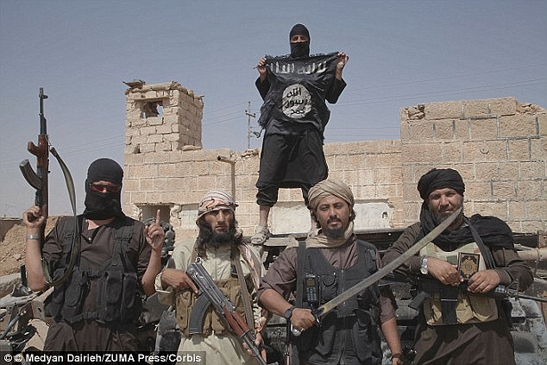
Questions?

