Slide 1
Overview of Mental Health Disorders
Savannah Martin MSW, LCSW
Elizabeth Gibbar, BS

Slide 2
Help me get to know you!

Slide 4
The Power of Storytelling
Stories allow us to connect with each other
Stories may facilitate personal memories
Stories may provide emotions to relate with

Slide 6
Course Objectives
Describe the definition of mental health disorders and mental health crisis
List the major types of mental illness
Explain the symptoms and characteristics of mental health disorders

Slide 7
Mental Health Hotline
https://www.youtube.com/watch?v=d0O0Z-F0k2o

Slide 8
Mental Health Disorder
Mental Health Crisis
-Affects a person's thinking, feelings or mood
-May affect someone's ability to relate to others and function each day.
-Each person will have different experiences, even people with the same diagnosis.
A mental health crisis is when you feel your mental health is at breaking point. For example, you might be experiencing: suicidal feelings or self-harming behavior, extreme anxiety or panic attacks, psychotic episodes

Slide 10
Group Activity
Provide a brief definition of disorder
List at 3-5 common symptoms
List possible treatment options
List age of onset (some disorder this may not apply)
List possible causes of disorder (Environmental? Genetic?)
If possible do you have a real life scenario to share of a time you responded to a call for someone with this diagnosis?

Slide 11
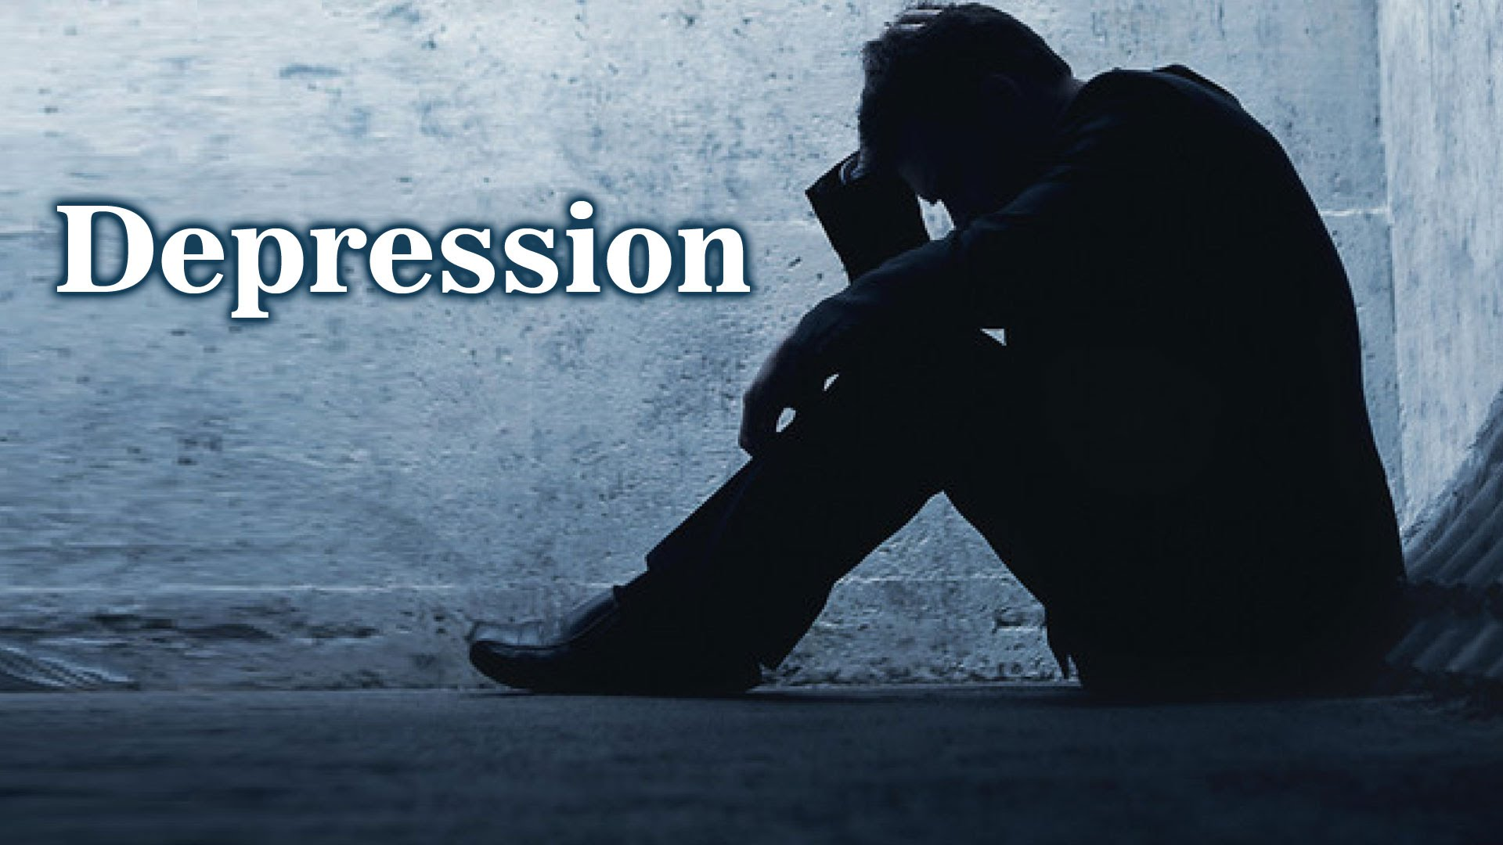

Slide 12
Common Symptoms of Depression
Persistent sad, anxious, or “empty” mood
Feelings of hopelessness or pessimism
Feelings of guilt, worthlessness, or helplessness
Loss of interest or pleasure in hobbies or activities
Decreased energy, fatigue, or being “slowed down”
Difficulty concentrating, remembering, or making decisions
Difficulty sleeping, early-morning awakening, or oversleeping
Appetite and/or weight changes
Thoughts of death or suicide or suicide attempts
Restlessness or irritability
Aches or pains, headaches, cramps, or digestive problems without a clear physical cause and/or that do not ease even with treatment

Slide 13
Depression Continued
To be diagnosed with depression, symptoms must be present most of the day, nearly every day for at least 2 weeks.
An episode can occur once in someone's life or they may experience recurrent episodes.
Causes of Depression: may be a combination of genetic and environmental factors
Depression can look different in different people
Depression is treatable, many different treatment options!

Slide 14
Sadness Vs. Depression
Sadness
Depression
Normal and appropriate emotional response.
In response to minor losses or disappointments.
Transient - emotion does not last.
Typically emotion does not interfere with functioning.
Persistent depressed mood (at least 2 weeks).
Can last for years if untreated.
Inability to experience happiness/ pleasure.
Interferes with daily functioning.
Can be triggered by an event or develop gradually.

Slide 15
Depression is like a dark tunnel

Slide 16
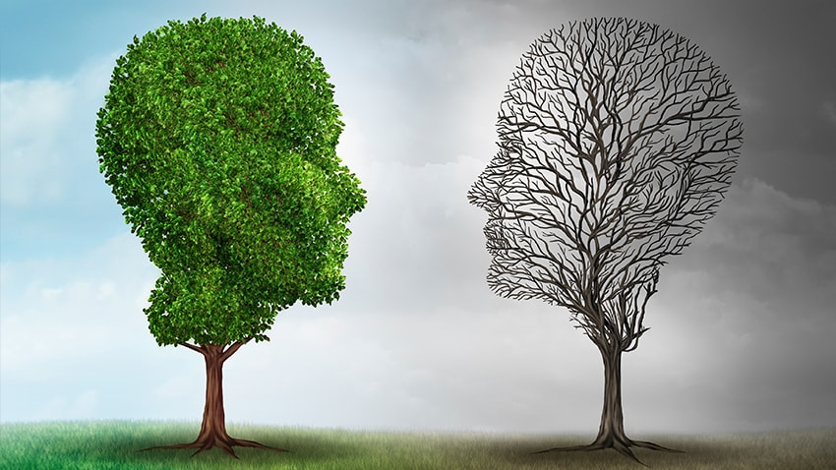
Bipolar Disorder

Slide 17
Symptoms of Manic Episodes
Mania: Period of abnormally and persistently elevated or irritable mood, lasting at least 1 week (or any duration if hospitalization is necessary).
Symptoms of mania include:
Abnormally upbeat, jumpy or wired.
Increased activity, energy or increases irritability
Exaggerated sense of well-being and self-confidence (euphoria)
Decreased need for sleep.
Unrealistic, grandiose beliefs about one’s abilities or powers
Talking so rapidly that others can’t keep up
Racing thoughts; jumping from one idea to the next
Unable to concentrate
Impaired judgment and impulsiveness
Acting recklessly without thinking about the consequences
Increased focus on religion or religious activity
Delusions and hallucinations (in severe cases)

Slide 18
Bipolar Disorder Continued
The length of episodes vary, on average a manic episode many last 3-6 months (if untreated) and a depressive episode may last 6-12 months (if untreated)
There is a higher risk of suicide during a manic episode
Some people cycles with season changes
Genetic predisposition, however not all will develop the disorder
May be triggered by stress, medications, substance use, loss of sleep
On average first episode may occur in teenage or early adulthood
Different variations, rapid cycling, mixed episode, hypomania

Slide 19
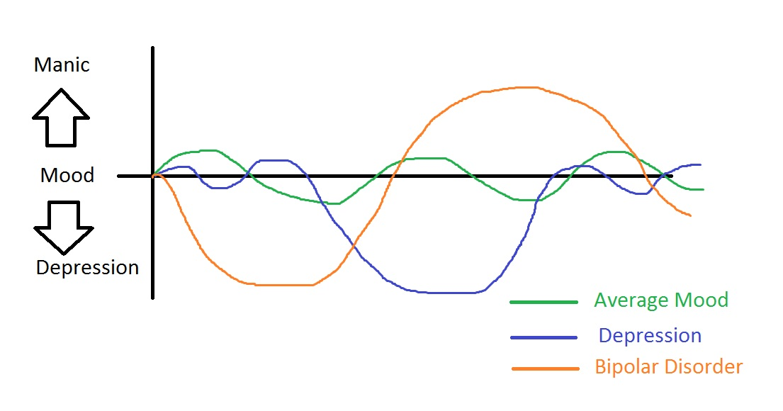

Slide 20
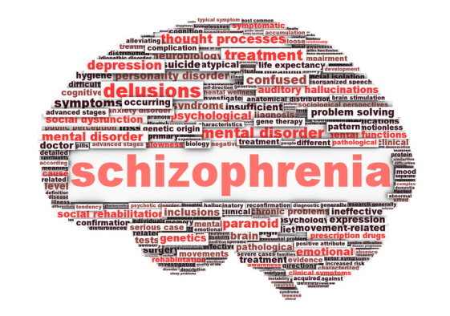

Slide 21
Symptoms of Schizophrenia
Schizophrenia affects how a person thinks, feels, and behaves. People with schizophrenia may seem like they have lost touch with reality
Symptoms of Schizophrenia
Hallucinations – auditory or visual
Delusions
Negative Symptoms- flat affect
Cognitive Issues/Disorganized Thinking- lack of insight

Slide 22
Symptoms of Schizophrenia Continued
Hallucinations:
These may include a person hearing voices, seeing things, or smelling things others can’t perceive.
These hallucinations are very real to the person experiencing it.
Auditory hallucination can be commanding or threatening.
Voices may involve people that are known or unknown to the person hearing them.
Generally it is best not to challenge the hallucinations unless there is a risk of harm to self or others.

Slide 23
Delusions
These are false beliefs that don’t change even when the person who holds them is presented with new ideas or facts.
People who have delusions often also have problems concentrating, confused thinking, or the sense that their thoughts are blocked.
Common Themes may include paranoia, grandiose, religious or control
Common Types of delusions
Bizarre delusions: These types of delusions are considered extremely odd, and highly unlikely or impossible. Example: belief that an alien performed surgery and replaced all of their blood with Kool-Aid without leaving a scar.
Non-bizarre delusions: These types of delusions are possible however unlikely. An example of a non-bizarre delusion would be that an individual believes they are being secretly video-taped and phone-tapped by the F.B.I. as part of an investigation.

Slide 24
Schizophrenia –Continued
Onset can occur at any age, the average age tends to be in the late teens to the early 20s for men, and the late 20s to early 30s for women.
Schizophrenia is a chronic and serious mental illness, however relatively rare, affecting approximately 1% of Americans.
Causes may include genetics, environment, brain chemistry, and substance use
Diagnosing can be challenging as some drugs, such as methamphetamines or LSD, can cause a person to have schizophrenia-like symptoms.

Slide 25
Meet Mary
Manic Episode
https://www.youtube.com/watch?v=DrzvsRqlgdc
Depressive Episode
https://www.youtube.com/watch?v=7PuJKw4SHl0

Slide 26
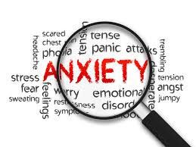

Slide 27
Anxiety Symptoms
All Anxiety Disorders share some common symptoms:
Panic, fear, and uneasiness
Sleep problems
Not being able to stay calm and still
Cold, sweaty, numb or tingling hands or feet
Shortness of breath
Heart palpitations
Dry mouth
Nausea
Tense muscles
Dizziness

Slide 28
Anxiety Disorders
Occasional anxiety is a normal part of life.
Anxiety disorders are more than temporary worry or fear, these symptoms can be disabling, making normal daily activities, extremely, overwhelming or impossible.
Anxiety disorders may develop from a combination of risk factors, including genetics, brain chemistry, personality, and life events.
Types of Common Anxiety Disorders:
Generalized anxiety disorder- You feel excessive, unrealistic worry and tension with little or no reason.
Social anxiety disorder- Feeling overwhelming worry and fear about everyday social situations such as feeling others are judging you or feeling embarrassed or ridiculed.
Phobias- You feel intense fear of a specific object or situation, such as heights or flying. The fear goes beyond what’s appropriate and may cause you to avoid ordinary situations.
Panic disorder. You feel terror that strikes randomly. During a panic attack, you may also sweat, have chest pain, and feel palpitations (unusually strong or irregular heartbeats). Sometimes you may feel like you’re choking or having a heart attack.

Slide 29
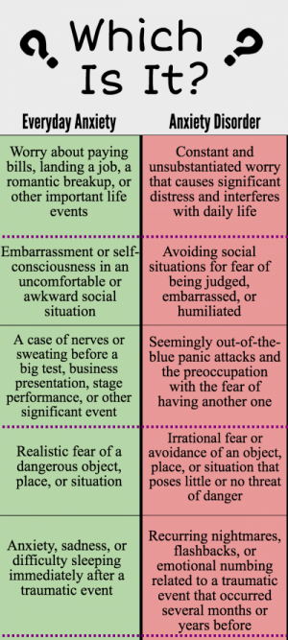

Slide 30
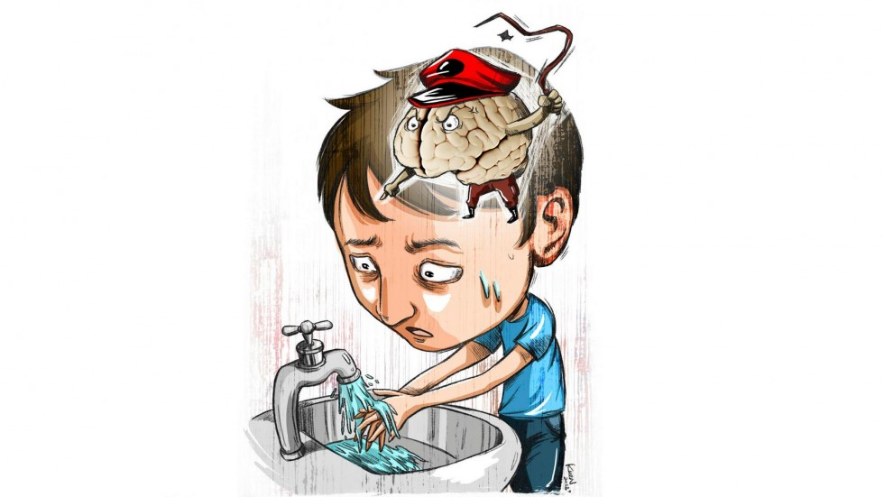

Slide 31
Obsessive Compulsive Disorder (OCD)
OCD is a type of anxiety disorder where a person focuses on unreasonable thoughts (obsessions)
These obsessions lead to irrational and repetitive behaviors (compulsions)
The compulsion or repetitive behavior may help the fear temporarily however they are will come back which triggers the cycle to re-occur
People with OCD may attempt to resist the urge to react to the obsession however this can cause increased anxiety
The person may realize their fear is unreasonable however their brain tells them their fear is urgent
Obsessions commonly have themes. Examples?
Notes:
Fear of contamination, fear of disease (frequent hand washing), fear of physical safety (locking doors), having things orderly and symmetrical

Slide 32
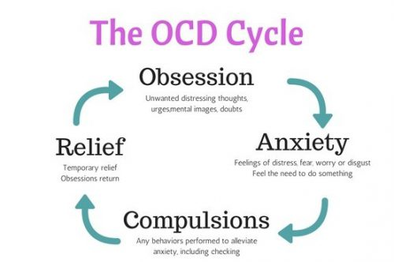

Slide 33
OCD continued
Cause of OCD is hard to determine however may be learned behavior from environmental factors, genetic/ bran chemistry
Treatment may include, therapy (systematic desensitization or cognitive therapy), medication or self help

Slide 34
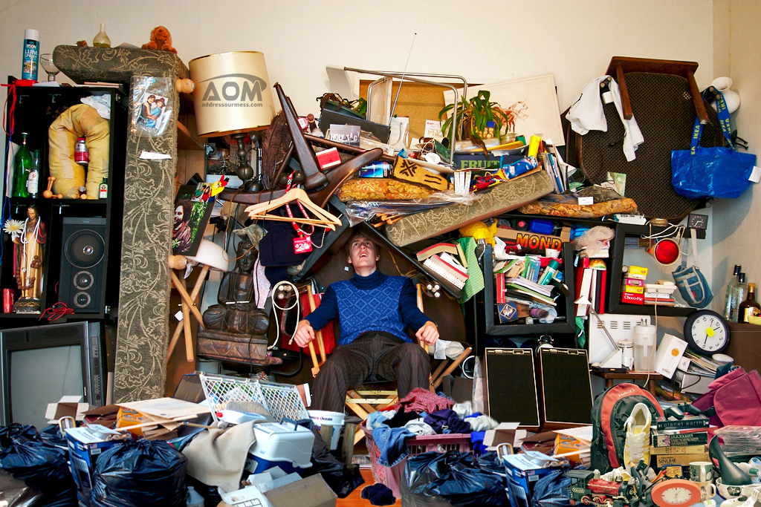

Slide 35
Hoarding Disorder
Individuals with hoarding disorder have difficulty discarding items because of strong perceived need to save items and/or distress associated with discarding. The symptoms result in the accumulation of a large number of possessions that congest and clutter living areas of the home or workplace and make them unusable.
Symptoms may include:
Problems with throwing out or giving away possessions, regardless of their actual value.
The problems are due to a perceived need to save the items and to distress linked to parting with them.
Items fill, block and clutter active living spaces so they cannot be used, or use is hampered by the large amount of items (if living spaces are clear it is due to help from others).

Slide 36
Hoarding Disorder Continued
Types of Hoarding: Animal, Information, Trash/Garbage, Food, Collectors, Recyclers, Shopping
Treatment may include therapy (CBT) and/or medications

Slide 37
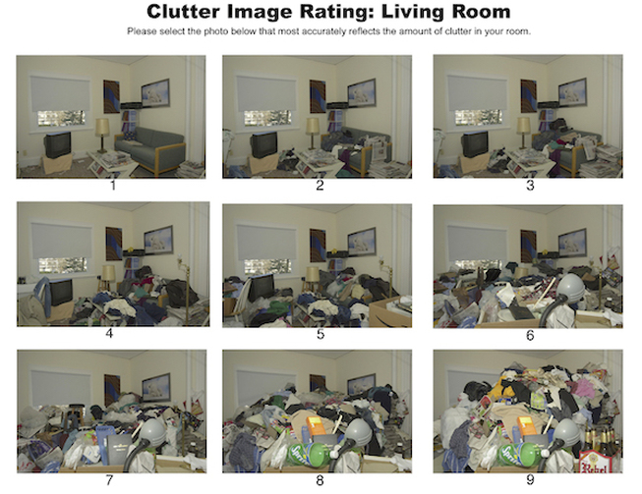
Notes:
Images 5-9 may want to consider a call to DHSS

Slide 38
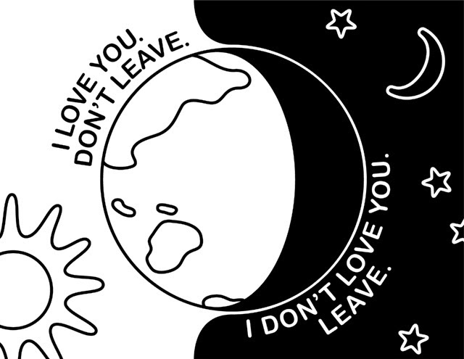

Slide 39
Borderline Personality Disorder
Borderline personality disorder may display an ongoing pattern of varying moods, self-image, and behavior. These symptoms often result in impulsive actions and problems in relationships. Persons may experience intense episodes of anger, depression, and anxiety that can last from a few hours to days.

Slide 40
Borderline Personality Disorder Symptoms
Intense and highly changeable moods, with each episode lasting from a few hours to a few days
Tend to view things in extremes, such as all good or all bad.
Opinions of other people can also change quickly such as a friend one day and an enemy or traitor the next. These shifting feelings can lead to intense and unstable relationships.
Inappropriate, intense anger or problems controlling anger
Chronic feelings of emptiness
Difficulty trusting, which is sometimes accompanied by irrational fear of other people’s intentions
Impulsive and often dangerous behaviors, such as spending sprees, unsafe sex, substance use, reckless driving, and binge eating
Self-harming behavior, such as cutting
Recurring thoughts of suicidal behaviors or threat

Slide 41
Borderline Personality Disorder Continued
Causes is still unclear however may be related to:
Family History
Brain Chemistry- the area of the brain that controls impulses and emotional regulation
Environmental, Cultural, and Social Factors. Many people with this disorder report experiencing traumatic life events, such as abuse, abandonment, or adversity during childhood. Others may have been exposed to unstable, invalidating and hostile relationships or conflicts
Treatment may involve an evidenced based treatment such as DBT or CBT and/or medications
Often diagnosed in early adulthood, however symptoms may be present earlier in life.

Slide 42
Resources
https://www.nimh.nih.gov
https://dmh.mo.gov/
https://www.nami.org/
https://www.samhsa.gov/

Slide 43
Psychosis Simulation
https://www.youtube.com/watch?v=SN1GCoVzxGg

