Slide 1
Community Resources
Presented by:
NAME/CREDIENTALS
AGENCY

Slide 2
Introduction
ACI & AGENCY have already discussed resources for urgent mental health situations that don’t automatically require immediate hospitalization.
Although it’s helpful to have resources less urgent situations.
ADD AGENCY LOGO
ADD ACI LOGO

Slide 3
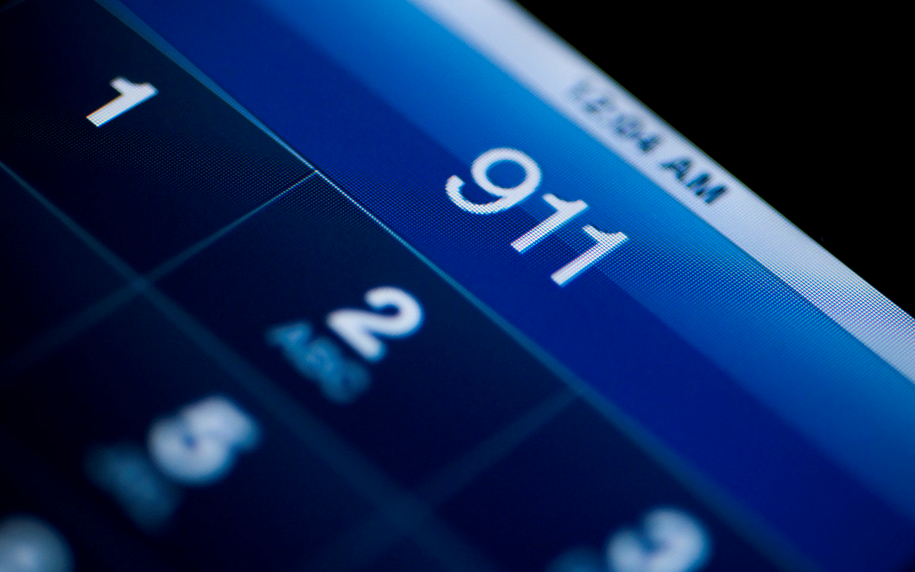
Many mental health calls may not involve criminal activity but do include:
Person(s) in crisis or distress which may (or may not) be due to a psychiatric disorder.
The person may still need behavioral health attention and intervention.
They may have called because they were upset, frightened or didn’t know who else to call.

Slide 4
What to do?
As first responders, you are often expected to “do something” or “fix it”, even when no crime was committed.
“Doing something” may include letting the individual with mental health needs know who they can call to get their needs met.
This will help out in the long term and potentially prevent or decrease repeated calls.

Slide 5
Most community organizations are open only during business hours, therefore ACI is a great 24 hour resource for you or the person(s) you’re assisting on the call.
ACI Cards
Refer to CMHL

Slide 6
Resources
Cheat Sheet/Resource Book
Specific to our area resources for non-urgent situations.
Laminated resource cards

Slide 7
Now What . . .
You can suggest the person or family member call an agency that may serve the needs of that person.
You may want to call the agency directly to provide/gather information.
Make a referral to CMHL
During the call, you may ask if the person is already involved with an agency.
If so, you can determine what services they’re already receiving (or at least eligible for), narrow down who you may want to follow-up with. If not, it could help you to decide if additional follow-up or referrals need to be made.

