Slide 1
Understanding Trauma, it’s Impact, and Trauma Informed Care

Slide 2
WELCOME

Slide 3
Presentation OBJECTIVES
Define trauma and list the signs and symptoms of trauma.
Identify unhealthy and healthy coping skills for dealing with stressful situations.
Identify the difference between trauma and Post Traumatic Stress Disorder (PTSD).
List adverse effects of PTSD.
What does trauma informed care mean?

Slide 4
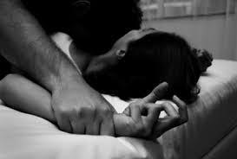
Trauma
A sudden, intense physically, emotionally, or psychologically distressful event.
Perceived and experienced as a threat to one’s safety or stability.
Single event or an accumulation of events.

Slide 5
Vicarious trauma
The emotional residue of exposure or witnessing the pain, fear, and terror that trauma survivors have endured.

Slide 6
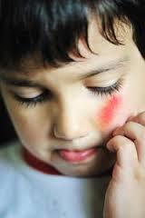
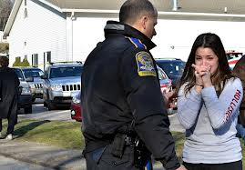
Traumatic Events
Any event that has sufficient impact to overwhelm the usually effective coping skills of either an individual or a group.
What is traumatic to one person, may or may not be traumatic to someone else. It’s personally defined.

Slide 7
Discussion
What are some examples of a traumatic event?

Slide 8
Types of Traumatic Events
Sexual Abuse or Assault
Physical Abuse or Assault
Emotional Abuse/Psychological Maltreatment
Neglect
Serious Accident or Illness/Medical Procedure
Natural or Man-made Disasters
Death of a loved one
War
Witnessing an act of violence/abuse

Slide 9
TRAUMA IN ADULTS: SIGNS & SYMPTOMS
Trauma survivors can begin to display symptoms soon after the traumatic experience has occurred (for PTSD dx--typically symptoms develop within first 3 months after the trauma).
These symptoms can manifest in several different ways:
Emotional
Physical
Cognitive
Behavioral
Relationship difficulties

Slide 10
Trauma in Adults: Signs & Symptoms
Emotional:
Denial
Anger
Sadness
Emotional outbursts
Self-blame, guilt and shame
Notes:
We have come to realize that unless we recognize the role that trauma and abuse has played in our consumers lives we will not be able to understand their symptoms and behaviors and what has caused these behaviors. Unfortunately we have for too long attributed certain symptoms and behaviors either to their mental illness or to their substance use, without considering how the trauma and abuse has affected them.

Slide 11
Trauma in Adults: Signs & Symptoms
Physical:
Insomnia or nightmares
Being startled easily
Racing heartbeat or having trouble breathing
Aches and pains
Fatigue
Edginess and agitation
Muscle tension

Slide 12
Trauma in Adults: Signs & Symptoms
Cognitive:
Lack of concentration
Difficulty remembering
Difficulty making healthy decisions
Easily distracted
Feeling paranoid or on edge
Notes:
http://psychiatryonline.org/doi/full/10.1176/jnp.23.1.jnp16

Slide 13
Trauma in Adults: Signs & Symptoms
Behavioral
Addictive and compulsive behaviors with
Alcohol
Drugs
Food
Sex
Gambling

Slide 14
Trauma in Adults: Signs & Symptoms
Relationship difficulties
Arguments
Conflict
Hostility
Isolation
Sexual problems
Attempting to control others

Slide 15
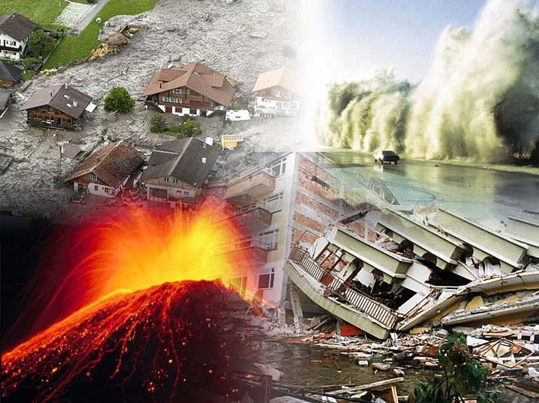
Trauma And Adults
A study conducted in an urban mental health center found that 94% of individuals had a history of trauma.
Between 34% and 53% of people with a severe mental illness report childhood physical/sexual abuse.
The National Co-Morbidity Study tells us that 55% to 90% of us in this room have experienced some type of traumatic event.
Notes:
Here are a few statistics that help us see how trauma has affected the majority of the population. Statistics tell us that about 95% to100% of individuals are trauma survivors. However, some of those that have dealt with trauma and are diagnosed with a mental disorder are somehow involved in the criminal system as well.
Trauma is often the central issue for people with mental health problems, substance use problems, or co-occurring disorders, and there are huge personal, social and economic costs to ignoring trauma.

Slide 16
Statistics on Trauma
People who have experienced trauma are:
15 times more likely to attempt suicide.
4 times more likely to suffer from alcoholism.
4 times more likely to contract a sexually transmitted disease.
4 times more likely to become a IV drug user.
3 times more likely to experience depression.
2.5 times more likely to smoke.
Notes:
http://www.newportacademy.com/teen-adolescent-trauma/ (Picture)

Slide 17
Trauma and children
26% of children in the United States will witness or experience a traumatic event before they turn four.
In one year, 39% of children ages 12-17 reported witnessing violence, 17% reported being a victim of physical assault and 8% reported being a victim of sexual assault.
As the number of traumatic events experienced increases, they also experience an increased risk of health problems in adulthood.

Slide 18
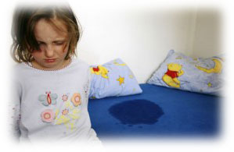
Signs and Symptoms For youth
Occurs from exposure to one or more trauma experiences.
Reactions include a variety of emotional, behavioral, physiological and cognitive responses.
These reactions interfere with the child’s daily life and ability to function and interact with others.
Notes:
http://temiville.files.wordpress.com/2011/01/child-crying.jpg (boy crying)
http://www.sterlingchiropractic.com/images/bedwetting.jpg (girl on bed)

Slide 19
Cognitive Difficulties
Demonstrate poor verbal skills.
Exhibit memory problems.
Difficulty focusing or learning in school.
Develop learning disabilities.
Show poor skill development.
Notes:
http://www.edconsult.org/special-education-schools/ (picture)

Slide 20
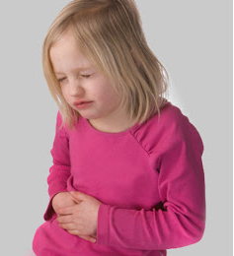
Physiological Difficulties
Have a poor appetite, low weight and/or digestive problems.
Experience stomachaches and headaches.
Have poor sleep habits.
Experience nightmares or sleep difficulties.
Wet the bed or self after being toilet trained or exhibit other regressive behaviors.
Notes:
http://health.howstuffworks.com/pregnancy-and-parenting/your-childs-headaches-may-be-migraines.htm (child headache picture)
http://hopespringsbc.com/stomachaches-in-children-is-anxiety-to-blame/ (stomach ache picture)
http://fit.webmd.com/kids/recharge/article/kids-sleep-problems (child with blanket on face)

Slide 21
Behavioral Difficulties
Display excessive temper.
Demand attention through both positive and negative behaviors.
Exhibit aggressive behaviors.
Act younger than their age.
Act out in social situations.
Imitate the traumatic event.
Verbally abusive.
Scream or cry excessively.
Startles easily.
Notes:
http://cdn2-b.examiner.com/sites/default/files/styles/image_content_width/hash/e2/d5/e2d591cbc69c246645aa8debbda57c3d.JPG?itok=Y4ETEGbz (picture)

Slide 22
Discussion
What are some healthy coping skills?

Slide 23
Healthy Emotional Responses to Trauma
Learn personal triggers
Improve coping skills
Use the experience to change your life in positive ways

Slide 24
Healthy coping Skills
Developing healthy coping skills for trauma allows the survivor to accept the traumatic incident and take action to improve things.
Healthy coping skills include:
Understanding that recovery is a process
Developing positive coping actions:
Education: learn about trauma and PTSD
Talk to others for support
Practice relaxation methods
Distract yourself with positive activities
Talk to a doctor or counselor about trauma and PTSD

Slide 25
Discussion
What are some unhealthy coping skills?

Slide 26
Distressing Emotional Responses to Trauma
Feelings of intense fear, helplessness, or horror
Re-experiencing the event
e.g., nightmares, intrusive thoughts of the event, feeling detached from others, dissociation, sleep disturbances, startle response, etc.
Post-Traumatic Stress Disorder

Slide 27
Unhealthy Coping Skills
Chaotic lifestyle
Compulsive behaviors
Smoking
Refusing to get support/help
Risky behaviors
Beating self up
Blaming others
Negativity
Social withdrawal
Lowered expectations
Hopelessness
Pessimism
Substance use
Avoidance
Self-injury
Passivity
Silence
Promiscuity

Slide 28
Post-Traumatic Stress Disorder (PTSD)

Slide 29
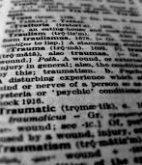
Trauma Versus PTSD
Most people experience a traumatic event in their lifetime.
May experience PTSD symptoms.
PTSD develops when symptoms:
Persist over time (over one month)
Affects functioning
Risk for developing PTSD increases with more extreme and prolonged trauma.
Early identification and treatment of symptoms decreases risk for developing PTSD.

Slide 30
What is Post Traumatic Stress Disorder?
Can develop after experiencing or witnessing a traumatic event.
Perceived as life-threatening.
Single event or accumulation of events over time.
May feel stressed or frightened even when they are no longer in danger.

Slide 31
U.S. Prevalence of PTSD
About 3% of the U.S. population have PTSD.
Nearly half do not receive treatment for their condition.
42% of those receiving treatment are provided “minimally adequate” therapy.
Probability of developing PTSD after a traumatic event:
Men 8–13%
Women 20–30%
Notes:
Women are more likely to develop PTSD than men.
PTSD affects about 7.7 million American adults—no specific age, can occur at anytime
An individual does not have to experience a dangerous event to have PTSD—can be impacted by trauma that affects family and friends.

Slide 32
Signs/symptoms of PTSD
Intrusive memories
Insomnia
Dreams/Nightmares
Flashbacks
Increased anxiety
Hyper-vigilance
Avoidance
Emotionally numb
Irritability
Angry outbursts
Difficulty remembering the traumatic event
Strained relationships
Notes:
Re-experiencing symptoms-may cause problems with a person’s daily routine. It stems from the person’s own thoughts and feelings. Words, objects, or situations that are reminders of the traumatic event can also trigger re-experiencing symptoms.
Avoidance symptoms-feeling emotionally numb, feeling strong depression, guilt or worry, losing interest in activities that were previously enjoyable, having trouble remembering the traumatic event. Can cause a person to change his or her routine.
Hyperarousal is “a state of increased psychological and physiological tension marked by such effects as reduced pain tolerance, anxiety, exaggeration of startle responses, insomnia, fatigue and accentuation of personality traits.”

Slide 33
Adverse Effects of PTSD
Personality change
Issues with employment or school
Relationship problems including inter-personal violence (domestic violence)
Physical symptoms and chronic illness
Substance use
Social impacts: homelessness, gang violence, increased criminal activity and incarceration

Slide 34
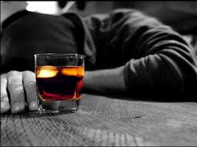
PTSD and substance use
Alcohol use occurs in 60-80% of Vietnam Veterans seeking PTSD treatment.
35% of men and 27% of women who had a history of PTSD reported dependence on or use of drugs at some time in their lives.
Compared to 15% for men and 8% of women in the general population.

Slide 35
Adverse Childhood Experiences (ACEs) Study
Original ACE Study conducted between 1995-1997 by Kaiser Permanente and the CDC in Southern California
Questionnaires on family health history and health appraisals were administered to collect info on child abuse, neglect, household challenges, etc.
“While you were growing up, during the first 18 years of life did you experience…?”
About 17,000 participants were recruited and followed long term
Almost 2/3 of study participants reported at least one ACE, and more than 1 in 5 reported 3 or more.

Slide 36
ACE Study Findings
The ACE score, total sum of different categories of ACEs reported by participants, is used to assess cumulative childhood stress. The higher the score, the higher risk for the following:
Substance abuse and addiction
COPD
Depression
Financial stress
STD’s
Suicide attempts
Early initiation of sexual activity
Adolescent pregnancy
Risk for DV and SV
Poor school performance
Health-related quality of life
Heart disease
Early death

Slide 39
PTSD treatment
Recovery is possible!
Various therapeutic treatments.
Cognitive Behavioral Therapy.
Exposure Therapy.
EMDR.
Medication.

Slide 40
Trauma Informed Care: what do we do with this information?
Treat everyone like they have a trauma background!
According to SAMHSA’s concept of a trauma-informed approach, “A program, organization, or system that is trauma-informed:
1.Realizes the widespread impact of trauma and understands potential paths for recovery;
2.Recognizes the signs and symptoms of trauma in clients, families, staff, and others involved with the system;
3.Responds by fully integrating knowledge about trauma into policies, procedures, and practices; and
4.Seeks to actively resist re-traumatization."

Slide 41
Trauma Informed Care : why it’s important
This information is vital for staff at every level of any organization to promote best practices and wellness
Core Principles:
Safety
Trust
Choice
Collaboration
Empowerment

Slide 42
Tips for interacting with individuals who have trauma histories
Do:
Maintain good eye contact.
Speak slowly, & in a low-pitched, non-threatening voice.
Take your time and eliminate noise and distractions.
Respect personal space.
Give choices whenever possible
Keep individuals informed
Be mindful of closed doors and small spaces and how you are standing in relation to others
Practice good self care
Educate yourself further on trauma and it’s impacts

Slide 43
Tips
Don’t:
Touch or restrain individuals whenever possible
Yell, scream, raise voice
Argue
Tell individuals what to do
Use insulting language (using words like “crazy” or “psycho”)
Minimize other’s experiences
Assume you know what someone is going through

Slide 44
Presentation OBJECTIVES
Defined trauma and listed the signs and symptoms of trauma.
Identified unhealthy and healthy coping skills for dealing with stressful situations.
Identified the difference between trauma and Post Traumatic Stress Disorder (PTSD).
Listed adverse effects of PTSD.
Trauma Informed Care

Slide 45
QUESTIONS

Slide 46
Thank you!

Slide 47
PRESENTERS CONTACT INFO
Kristen Fishback, MSW, LCSW
Arthur Center Community Health
340 Kelley Parkway, Mexico, MO 65265
Crisis line: 1-800-833-2064
573-581-7887 ext. 2030
kfishback@arthurcenter.com

Slide 48
Resources
ACI (Access Crisis Intervention) 888-279-8188 Crisis Line
National Suicide Prevention Lifeline
http://veteranscrisisline.net/
1-800-273-TALK (8255)
Veterans should press “1” to speak to a specially trained counselor
Veteran’s Administration
http://www.ptsd.va.gov/

Slide 49
Resources
National Center for Post Traumatic Stress Disorder http://www.ncptsd.va.gov or 802-296-6300
National Resource Center for Child Traumatic Stress Network http://www.nctsn.org/
Center for Mental Health Services Emergency Services and Disaster Relief Branch http://www.nebhands.nebraska.edu/files/SPMI%20&%20Disaster%20Health.pdf
National Empowerment Center http://www.power2u.org/

Slide 50
resources
Post-Traumatic Stress-Moodjuice Self-Help Guide http://www.moodjuice.scot.nhs.uk/posttrauma.asp Badge of Life http://www.badgeoflife.com
Concerns of Police Survivors COPS http://www.nationalcops.org
Copline 1-800-267-5463 or http://copline.org Code 9 Officer Needs Assistance http://vimeo.com/26689571

Slide 51
References
American Psychological Association (2014). Trauma. Retrieved from http://www.apa.org/topics/trauma/index.aspx\
American Counseling Association, (n.d.). Fact sheet #9. Retrieved from http://www.counseling.org/docs/trauma-disaster/fact-sheet-9---vicarious-trauma.pdf?sfvrsn=2
Department of Veterans Affairs (2014). Effects of PTSD on the family. Retrieved from http://www.ptsd.va.gov/public/family/effects-ptsd-family.asp
Federal Occupational Health. (2001). Effects of traumatic experiences. Retrieved from: www.foh.hhs.gov/Disaster/EAP/Effects%20of%20Traumatic%20Experiences.pdf
Georgetown University Center for Child and Human Development (2014). Recognizing and addressing trauma in infants, young children, and their families. Retrieved from http://www.ecmhc.org/tutorials/trauma/mod1_3.html
Koyama, Emi (2012). Reclaiming “victim” and embracing unhealthy coping. Retrieved from http://harmreduction.org/wp-content/uploads/2013/01/Negative_Survivorship_HRC_Public.pdf

Slide 52
References
Kulbarsh, Pamela, (2008). What is posttraumatic stress disorder? Retrieved from http://www.officer.com/article/10248615/what-is-posttraumatic-stress-disorder
Missouri Institute of Mental Health (2004). Trauma among people with mental illness, substance use disorders and/or developmental disabilities. Retrieved from http://dmh.mo.gov/docs/mentalillness/TraumaFactSheet2004.pdf
National Alliance on Mental Illness (n.d.). Post-traumatic stress disorder. Retrieved from http://www.nami.org/Template.cfm?Section=By_Illness&Template=/TaggedPage/TaggedPageDisplay.cfm&TPLID=54&ContentID=68642
National Child Traumatic Stress Network. (n.d.). Trauma types. Retrieved from http://www.nctsn.org/trauma-types
National Center for PTSD (2014). Coping with Traumatic Stress Reactions. Retrieved from http://www.ptsd.va.gov/public/treatment/cope/coping-traumatic-stress.asp

Slide 53
References
National Institute of Mental Health. (n.d.). Post-traumatic stress disorder. Retrieved from http://www.nimh.nih.gov/health/publications/post-traumatic-stress-disorder-ptsd/index.shtml
Psychguides.com (2014). Signs and symptoms of trauma-causes and effects. Retrieved from http://www.psychguides.com/guides/trauma-symptoms-causes-and-effects/
Saisan, J., de Benedictis, T., Barston, S., & Segal, R. (2008). Understanding sleep: Deep sleep, REM sleep, cycles, stages, and needs. Retrieved from http://www.helpguide.org/life/sleeping.htm
Stolbach, B. (2012). Trauma informed care. Retrieved from http://www.mentalhealthconnection.org/trauma.php

Slide 54
References
http://psychiatryonline.org/doi/full/10.1176/jnp.23.1.jnp16
https://www.psychologytoday.com/blog/the-anatomy-addiction/201207/trauma-survivors-and-addiction
http://www.dualdiagnosis.org/post-traumatic-stress-disorder-and-addiction/
http://www.ptsd.va.gov/professional/newsletters/research-quarterly/V16N4.pdf
https://www.cdc.gov/violenceprevention/acestudy/index.html
http://www.samhsa.gov/nctic/trauma-interventions

