Slide 1
Substance Abuse and Co-occurring Disorders
Julie Hook

Slide 2
SUBSTANCE ABUSE
Suggests the misuse of mood-altering chemicals - can be legal or illegal
Can lead to addiction

Slide 3
Progression of Understanding…
AMA – Designated alcoholism as a treatable
condition in 1956
APA – Declared alcoholism to be a disease
in 1965
AMA – Followed suit in 1966.
NIDA – Re-defined addiction to be a brain
disease in 2004.

Slide 4
THE ESSENCE OF ADDICTION
The entire concept of addiction has suffered greatly from imprecision and misconception.
Confusion arises, in part, because of what is now considered an archaic distinction between whether specific drugs are ‘physically’ or ‘psychologically’ addicting…essentially is a non-issue other than anticipating how much physical withdrawal might be anticipated.

Slide 5
Addiction and the brain
Brain imaging technology has shown how certain parts of the brain get ‘turned on’ with the use of most mood-altering chemicals.
Due to the chemical (drug) releasing dopamine into receptor-sites. Actually alters brain to become adapted to and need of, more chemicals. Tolerance develops which can lead to compulsive use (addiction).

Slide 6
Addiction – not simply will power
Having this brain disease does not absolve the addict of responsibility for his or her behavior, but it does explain why an addict cannot simply stop using drugs by sheer force of will alone.

Slide 7
Addiction – An Equal Opportunity
Important to avoid ‘stererotyping’
Addiction plays no favorites
Cuts across all socio-economic, race, age and professions…includes law enforcement

Slide 8
Addiction- An illness that tells you… you don’t have an illness.
Denial
Withdrawal
Self-delusion
Tolerance – loss of control is progressive
Personality change – gradual denigration
Chronic…Incurable…Progressive (three stages)

Slide 9
Problems - The Barometer of Addiction
The prolonged and continual use of chemicals despite the presence of problems associated with use…
Health
Law
Career
Relationships
Any one of these problems associated with the use of substance(s) can be an indicator of pathology.

Slide 10
What makes one individual more vulnerable than another?
Immature brain – age of onset of use
Heredity/genetics – genetic ‘characteristics’ may predispose…especially if combined with
Immaturity or wounded psyche
Dysfunctional family/upbringing that has created a toxic environment due to:
Physical abuse
Sexual abuse
Emotional/psychological abuse
Thereby creating a pre-existing condition that has set the stage for self-medicating.

Slide 11
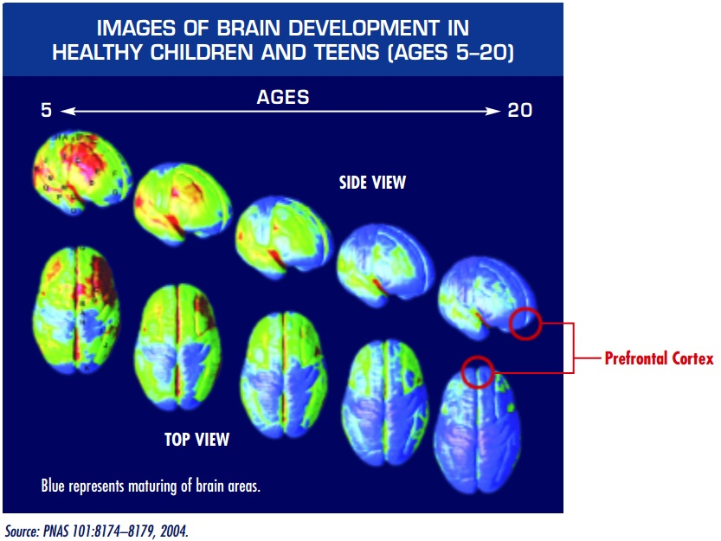
Notes:
The brain doesn’t finish developing until the mid-20’s

Slide 12
Definition of Substance Use Disorder:
DSM-V Definition: Patterns of symptoms resulting from use of a substance which the individual continues to take, despite experiencing problems as a result.

Slide 13
DSM V Substance Abuse Disorder
Severity of the DSM-5 substance use disorders is based on the number of criteria endorsed:
2–3 criteria indicate a mild disorder
4–5 criteria, a moderate disorder
6 or more, a severe disorder

Slide 14
Criteria
Taking the substance in larger amounts or for longer than the you meant to
Wanting to cut down or stop using the substance but not managing to
Spending a lot of time getting, using, or recovering from use of the substance
Cravings and urges to use the substance
Not managing to do what you should at work, home or school, because of substance use
Continuing to use, even when it causes problems in relationships

Slide 15
Criteria
Giving up important social, occupational or recreational activities because of substance use
Using substances again and again, even when it puts the you in danger
Continuing to use, even when the you know you have a physical or psychological problem that could have been caused or made worse by the substance
Needing more of the substance to get the effect you want (tolerance)
Development of withdrawal symptoms, which can be relieved by taking more of the substance

Slide 16
DSM V Classes of Substances
Alcohol
Caffeine
Cannabis
Hallucinogens
Inhalants
Opioids
Sedatives
Hypnotics
Anxiolytics
Stimulants
Tobacco
Other or unknown substances

Slide 17
ALCOHOL
#1 problem
Social acceptance
Is a depressant drug
1 in 10 drinkers will develop a problem
Variety of drinking ‘patterns’
Has synergistic affect w/ many other drugs

Slide 18
MARIJUANA
Effects: euphoria, relaxed inhibitions, increased appetite, disorientation
Overdose effects: fatigue, paranoia, possible psychosis…can be addictive
“Not your father’s marijuana” - ONDCP began tracking THC levels in 1970’s -1983 THC level average was 4%...current average level of THC in seized samples is 8.5%

Slide 19
MARIJUANA (cont.)
Strong correlation with mental health disorders
Many unknowns regarding impact, legalization, etc.

Slide 20
COCAINE/METHAMPHETAMINE
Highly addictive
Effects: Increased alertness, excitation, euphoria, increased pulse rate and blood pressure, insomnia, loss of appetite
Overdose: Agitation, increased body temperature, hallucinations, convulsions, arrhythmia, psychosis, impulsivity, crash after use, possible death

Slide 21
HALLUCINOGENS
Effects: Illusions, hallucinations, poor perception of time & distance
Overdose: longer, more intense ‘trip’ episodes, psychosis, possible death

Slide 22
OPIOIDS
Natural/Illegal: opium, morphine, HEROIN!
Effects: Euphoria, drowsiness, respiratory depression, constricted pupils, nausea
Overdose: slow and shallow breathing, clammy skin, convulsions, coma, possible death

Slide 23
RX DRUGS
Can be just as addicting as illicit drugs
Ritalin, dextromethorphan, diet pills…
Pain meds – Synthetic/legal: OLD: demerol,
dilaudid, perocet, percodan, darvocet,
darvon NEW: Oxycontin, oxycodone,
vicodin – highly addictive….
Combining with alcohol can be fatal

Slide 24
INHALANTS
Any kind of fume, vapor, spray or gas that can be breathed to produce a “high”
Four classes: Solvents
Aerosols
Refrigerants
Medical anesthetics
Cheap, available

Slide 25
AS IF ADDICTION WEREN’T DIFFCULT ENOUGH All BY ITSELF…
Addiction combined with one or more mental
health diagnoses…formerly referred to as
dual diagnosis –
now known as:
Co-occurring Disorders

Slide 26
Co-occurring Disorders
An individual who has both a substance abuse diagnosis and at least one mental illness diagnosis
Either can come first

Slide 27
Psychiatric Co-occuring Disorders
64% of drug users in treatment met the criteria for a coexisting mental disorder
Approximately 8.9 million adults have co-occurring disorders
Only 7.4 percent of individuals receive treatment for both conditions with 55.8 percent receiving no treatment at all.
Approximately half of those who suffer from an addiction also have a mental disorder

Slide 28
Most common disorders…
Among those reporting a history of substance abuse the most prevalent psychiatric disorders are:
Depression
Anxiety
Bipolar
Schizophrenia

Slide 29
Vicious cycle of co-occurring
Stress
More Self-medicating
Self-Medicating
Increased
Stress

Slide 30
DSM V Substance-Induced Disorders
substance induced mental disorders
substance induced psychosis
substance induced bipolar and related disorders
substance induced depressive disorders
substance induced anxiety disorders
substance induced obsessive-compulsive and related disorders
substance induced sleep disorders
substance induced sexual dysfunctions
substance induced delirium
substance induced neurocognitive disorders

Slide 31
IN A CRISIS THERE WILL OFTEN BE UNPREDICTIBILITY
Don’t diagnose!
Don’t assume!
You could have an individual who is totally delusional absent of any chemical intake…
or,
You might be dealing with a drug-induced psychosis, or - something else entirely…the various disorder combinations are profound!

Slide 32
LET SOMEONE ELSE DIAGNOSIS
Techniques that work:
Compassion
Empathy
Non-judgmental
Avoid black & white thinking
Patience/tolerance
Objective:
Stabilization – (get chemicals out of system first)
Treatment

Slide 33
Consequences of undiagnosed or untreated
Homelessness
Incarceration
Medical illnesses
Suicide
Early Mortality

Slide 34
Integrated treatment
Treatment that addresses mental and substance use conditions at the same time is associated with lower costs and better outcomes such as:
Reduced substance use
Improved psychiatric symptoms and functioning
Decreased hospitalization
Increased housing stability
Fewer arrests
Improved quality of life

Slide 35
Current Treatment Challenges
Access – increasingly difficult
Expertise…accurate, timely diagnosis
Appropriate Response to need
Treatment duration
System limitations

Slide 36
CO/SA Treatment Goals
Stabilize
Education
Therapy
Medication management
Attitude shifts
Housing
Employment
Ongoing therapy/support/medical care

Slide 37
Treatment Issues for the CO/SA
Dealing with client fears (lifestyle, change, symptom return)
Resistance to change
Lifestyle
Living life without a crutch/escape

Slide 38
Solutions
Find a family member or friend to assist whenever possible
Know your resources:
Call BHR - Behavioral Health Response
Facilities in your immediate area
NCADA – 314-962-3456
(636-239-7652 in Franklin County)

