Slide 1
Suicide Intervention
Rick Strait, LPC, CRDAC

Slide 2
Objectives
Describe the frequency of suicide amongst those with mental illness.
List Common myths related to suicide
Describe predictors and risk factors
Describe an effective basic risk assessment

Slide 3
Objectives
We will also cover:
Suicide by Cop
Protective factors
Responding to a suicide
Non-Suicidal Self Injury

Slide 4
Challenge 1
Let us try to look at suicide through the eyes of someone who is having suicidal thoughts or has attempted.
Craig Miller author - This is How It Feels

Slide 5
Challenge 2
Try to look at the need of suicide prevention and education beyond your current and future job.
As a law enforcement officer it is important, but this information can also impact your personal life. (Family, friends, neighbors, co-workers, etc.)

Slide 6
Myths Surrounding Suicide
Lets take just a few minutes to review some of the myths that surround suicide.

Slide 7
Suicide Myths and Facts
Myth No one can stop a suicide, it is inevitable.
Fact If people in a crisis get the help they need, they will probably never be suicidal again.
Myth Confronting a person about suicide will only make them angry and increase the risk of suicide.
Fact Asking someone directly about suicidal intent lowers anxiety, opens up communication and lowers the risk of an impulsive act.
Myth Only experts can prevent suicide.
Fact Suicide prevention is everybody’s business, and anyone can help prevent the tragedy of suicide

Slide 8
Suicide Myths and Facts
Myth Suicidal people keep their plans to themselves.
Fact Most suicidal people communicate their intent sometime during the week preceding their attempt.
Myth Those who talk about suicide don’t do it.
Fact People who talk about suicide may try, or even complete, an act of self-destruction..
Myth Once a person decides to complete suicide, there is nothing anyone can do to stop them.
Fact Suicide is the most preventable kind of death, and almost any positive action may save a life.
Question – what season has the highest risk for suicides

Slide 9
CIT Suicide Awareness Overview
Why train law enforcement in suicide prevention?

Slide 10
CIT Suicide Awareness Overview
In your job you are very likely to come across individuals who are suicidal
Statically individuals working in in law enforcement and other emergency services have an increased risk of suicide.

Slide 11
Why QPR for Emergency Services Professionals?
Exposure to trauma increases risk
Trauma exposure includes personal assault, murder, suicide and death investigations
Familiarity with death reduces our fear of it
More police officers die by suicide than are killed by felons or line of duty accidents

Slide 12
Police Suicide By the Numbers Data from 2012
126 Number of officer suicide in 2012
49 Officers killed by gunfire in 2012
42 Average age of police suicide
16 years Average time on the job of a police suicide victim

Slide 13
15%-18% (150,000) Officers suffering from PTSD
91% of suicides were by male officers
63% of police suicide victims were single
11% of police suicide victims were military veterans

Slide 14
Times are changing
Suicide is now preventable
Everyone is responsible to take action to prevent a death, including by suicide
Suicidal thinking and planning often precede not only violence to self but others. Thus, preventing suicide prevents other forms of violence.

Slide 15
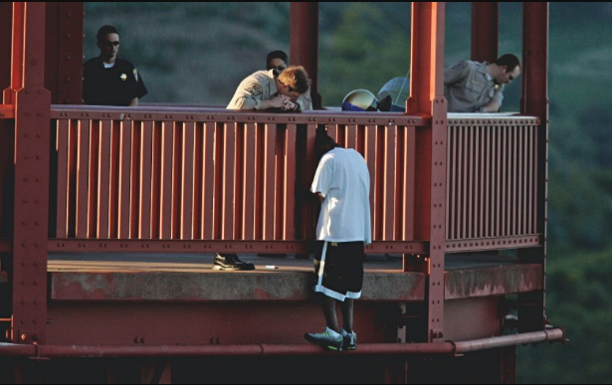
Sgt. Brigg’s Story

Slide 16
Sgt. Brigg’s Story
Questions
What can I do to help?
What are your plans for tomorrow?
Then just listening – not trying to solve problems

Slide 17
Ask A Question, Save A Life

Slide 18
QPR
Question, Persuade, Refer

Slide 19
QPR Goals
Access
Active Intervention
Accompanied Referral
Alleviation of Immediate Risk Factors
We can make a difference!

Slide 20
45,000 deaths annually
2016 44,965
2015 44,193
2014 42,773
2013 41,149
2012 30,600
2011 39,518
2010 38,364
2009 36,909
2008 36,065
attributed to suicide

Slide 21
Timing of USA suicides
1 suicide every 12 minutes
or
123 suicides every day

Slide 22
5723 young people
(age 15-24)
die by suicide each year (2016)
at a rate of
one suicide every two hours

Slide 23
Suicide is a leading cause of death (2016)
Rank & Cause Number of deaths
1. Diseases of the heart 635,260
2. Malignant neoplasms (cancer) 598,038
3. Accidents (unintentional injury) 161,374
4. Chronic obstructive pulmonary diseases 154,596
5. Cerebrovascular diseases (stroke) 142,142
6. Alzheimer’s Disease 116,103
7. Diabetes mellitus 80,058
8. Pneumonia and influenza 51,537
9. Nephritis, nephrosis 50,046
10. Suicide (Intentional Self-Harm) 44,965
Homicide ranks 16th 19,362

Slide 24
National ranking and rate of suicide, 2016
01 Alaska 26.0 18 New Hampshire 18.3 36 North Carolina 13.5
02 Montana 25.6 19 Kansas 17.7 36 Minnesota 13.5
03 Wyoming 24.6 20 Kentucky 17.0 38 Nebraska 12.9
04 New Mexico 22.6 20 Maine 17.0 38 Mississippi 12.8
05 Nevada 22.1 22 Tennessee 16.7 40 Texas 12.5
05 Colorado 22.1 23 South Carolina 16.4 40 Delaware 12.5
07 Oklahoma 21.0 24 Alabama 16.2 42 Hawaii 12.2
08 Idaho 20.9 25 Washington 15.7 43 Rhode Island 11.9
09 Utah 20.3 26 Indiana 15.6 44 Illinois 11.1
10 West Virginia 19.8 27 Pennsylvania 15.4 44 Connecticut 11.1
11 Oregon 18.9 28 Florida 15.2 46 California 10.9
Vermont 18.9 29 Wisconsin 15.0 47 Maryland 9.7
13 South Dakota 18.8 30 Ohio 14.7 48 Massachusetts 9.3
14 Missouri 18.6 31 Louisiana 14.5 48 New York 8.5
14 Arkansas 18.6 32 Iowa 14.4 50 New Jersey 7.7
16 North Dakota 18.5 33 Virginia 13.9 51 Washington, DC 5.9
17 Arizona 18.3 34 Georgia 13.7 34 Michigan 13.7
USA Total Rate 13.9

Slide 25
Missouri Statistics
In 2016: 1168 Missourians killed themselves (up from 1133 in 2015)
Higher than the National average
18.6 vs. 13.9 per 100,000 (up from 16.98)
In 2016 Suicides outnumbered:
1043 vs. 539 suicides to homicides
1043 vs. 947 suicides to vehicle accident deaths

Slide 26
Scope of the problem in the US, and over the past 12 months…
15.8% seriously considered suicide
12.8% made a plan for suicide
7.8% attempted suicide one or more times
2.4% made a suicide attempt that lead to treatment by a doctor or nurse
For 15-24 year olds, suicide was the 2nd leading cause of death in 2011
Source: 2011 Youth Risk and Behavior Survey

Slide 27
Numbers to remember
Boys die 4.34 X as often as girls
Girls attempt 3 X as often as boys
Boys use firearms more and are more likely to die from an attempt
Lethality of method contributes to outcomes
90% of youth who die by suicide are suffering from an Axis I mental disorder (mood disorder, substance abuse and often both).

Slide 28
Missouri Student Survey 2016
One out of eight (12.3%) of middle school students have seriously considered suicide in the past year
One in six (15.6%) high school students have seriously considered suicide in the last year
Suffocation (hanging and asphyxiation) is the primary means of suicide among youth under 18 (48%) followed by firearms (43%)
- Missouri Student Survey (MSS) 2016

Slide 29
While it is our most preventable death….
“More teenagers died from suicide than from cancer, heart disease, AIDS, birth defects, stroke, pneumonia and influenza, and chronic lung disease combined.”
Source: U.S. Public Health Service (1999)

Slide 30
National ranking and rate of suicide, 2016
USA Total Rate 13.9 per 100,000
Missouri Ranked 14th highest 18.6
Bollinger County – 13.31 Cape County – 12.72 Madison County – 16.1 Perry County – 14.29 Ste. Genevieve County – 13.85

Slide 31
Estimates of attempted suicide
25 attempts for each documented death
(Note: 40,000 suicides translates into 1,000,000 attempts annually)

Slide 32
Impact of Suicide
Inclusive of blood relatives, Julie Cerel at U of KY has reported the following additional impacts from a single death by suicide:
115 are exposed
53 have short term disruption in life
25 have a major life disruption
11 have devastating effects on their life
Impacts especially severe in small, tight-knit communities.

Slide 33
The Many Paths to Suicide
Fundamental Risk
Factors
Proximal Risk Factors
“Triggers or Final Straws”
Cause of Death
Biological
Crisis in Relation
Poison
Genetic Load
Sex
Loss of Freedom
Gun
Race
Age
Personal/Psychological
Increasing Hopelessness Contemplation
of Suicide
as Solution
Fired/ Expelled
Hanging
Child Abuse
Loss of Parent
Culture Shock/
Shift
Values
Religion
Beliefs
Drugs or
Alcohol
WALL OF RESISTANCE
Illness
Autocide
Model for Suicide
Environmental
Urban
vs.
Rural
Geo-graphy
Major Loss
Jumping
Season of year
?
?
All “Causes” are real.
Hopelessness is the common pathway.
Break the chain anywhere = prevention.

Slide 34
Suicidal Crisis Episode
Risk is Imminent
7
6
5
3
2
1
Risk
Level
4
Initial Hazard
is Encountered
Crisis
Begins
Crisis
Peaks
Crisis
Diminishes
Stable
Stable
Years
Days
Hours
Days
Years
Approximately 3 weeks

Slide 35
QPR
QPR is not intended to be a form of counseling or treatment.
QPR is intended to offer hope through positive action.

Slide 36
Suicide Clues And Warning Signs
The more clues and signs observed,
the greater the risk.
Take all signs seriously.

Slide 37
Direct Verbal Clues:
“I’ve decided to kill myself.”
“I wish I were dead.”
“I’m going to commit suicide.”
“I’m going to end it all.”
“If (such and such) doesn’t happen, I’ll kill myself.”

Slide 38
Indirect Verbal Clues
“I’m tired of life, I just can’t go on.”
“My family would be better off without me.”
“Who cares if I’m dead anyway.”
“I just want out.”
“I won’t be around much longer.”
“Pretty soon you won’t have to worry about me.”

Slide 39
Behavioral Clues:
Any previous suicide attempt
Acquiring a gun or stockpiling pills
Co-occurring depression, moodiness, hopelessness
Putting personal affairs in order
Giving away prized possessions
Sudden interest or disinterest in religion
Drug or alcohol abuse, or relapse after a period of recovery
Unexplained anger, aggression and irritability

Slide 40
Situational Clues:
Being fired or being expelled from school
A recent unwanted move
Loss of any major relationship
Death of a spouse, child, or best friend, especially if by suicide
Diagnosis of a serious or terminal illness
Sudden unexpected loss of freedom/fear of punishment
Anticipated loss of financial security
Loss of a cherished therapist, counselor or teacher
Fear of becoming a burden to others

Slide 41
Tips for Asking the Suicide Question
If in doubt, don’t wait, ask the question
If the person is reluctant, be persistent
Talk to the person alone in a private setting
Allow the person to talk freely
Give yourself plenty of time
Have your resources handy; QPR Card, phone numbers, counselor’s name and any other information that might help
Remember: How you ask the question is less important than that you ask it

Slide 42
Q Question
Less Direct Approach:
“Have you been unhappy lately? Have you been very unhappy lately? Have you been so very unhappy lately that you’ve been thinking about ending your life?”
“Do you ever wish you could go to sleep and never wake up?”

Slide 43
Q Question
Direct Approach:
“You know, when people are as upset as you seem to be, they sometimes wish they were dead. I’m wondering if you’re feeling that way, too?”
“You look pretty miserable, I wonder if you’re thinking about suicide?”
“Are you thinking about killing yourself?”
NOTE: If you cannot ask the question, find someone who can.

Slide 44
Q Question
How NOT to ask the suicide question:
“You’re not thinking of killing yourself, are you?”
“You wouldn’t do anything stupid would you?”
“Suicide is a dumb idea. Surely you’re not thinking about suicide?”

Slide 45
P Persuade
How to Persuade someone to stay alive
Listen to the problem and give them your full attention
Remember, suicide is not the problem, only the solution to a perceived insoluble problem
Do not rush to judgment
Offer hope in any form

Slide 46
P Persuade
Then Ask:
“Will you go with me to get help?”
“Will you let me help you get help?”
“Will you promise me not to kill yourself until we’ve found some help?”
YOUR WILLINGNESS TO LISTEN AND TO HELP
CAN REKINDLE HOPE, AND MAKE ALL THE DIFFERENCE.

Slide 47
R Refer
Suicidal people often believe they cannot be helped, so you may have to do more.
The best referral involves taking the person directly to someone who can help.
The next best referral is getting a commitment from them to accept help, then making the arrangements to get that help.
The third best referral is to give referral information and try to get a good faith commitment not to complete or attempt suicide. Any willingness to accept help at some time, even if in the future, is a good outcome.

Slide 48
Remember
Since almost all efforts to persuade someone to live
instead of attempt suicide will be met with
agreement and relief, don’t hesitate to get involved
or take the lead.

Slide 49
For Effective QPR
Say: “I want you to live,” or “I’m on your side...we’ll get through this.”
Get Others Involved. Ask the person who else might help. Family? Friends? Brothers? Sisters? Pastors? Priest? Rabbi? Bishop? Physician?

Slide 50
For Effective QPR
Join a Team. Offer to work with clergy, therapists, psychiatrists or whomever is going to provide the counseling or treatment.
Follow up with a visit, a phone call or a card, and in whatever way feels comfortable to you, let the person know you care about what happens to them. Caring may save a life.

Slide 51
REMEMBER
WHEN YOU APPLY QPR, YOU PLANT THE SEEDS OF HOPE. HOPE HELPS PREVENT SUICIDE.

Slide 52
Contagion Effect
When one person in the community dies by suicide, it may increase the risk for other troubled individuals due to ‘contagion effect’
“If they can’t make it, how can I?”
Still being researched

Slide 53
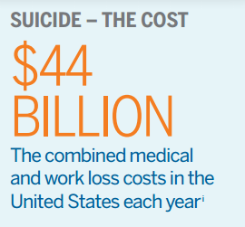
Survivors of Suicide
For every 1 suicide
115 are exposed (4.7 million annually)
25 experience major life disruptions
1 in every 15 Americans are survivors of suicide.

Slide 54
Suicide and Mental Illness
90% of all suicides have a diagnosable mental illness
Depression is the most common
Co-occurring psychiatric disorders
Mood Disorders
Addictions
Personality Disorders
Borderline Personality Disorder

Slide 55
Depression, Anxiety, and Bipolar
Depression almost always present
Changes in sleep, appetite, weight
Isolation
Helplessness/Hopelessness
Talks or jokes about suicide
These impair the person’s social or work functioning

Slide 56
Substance Abuse
If someone is currently intoxicated on drugs or alcohol, risk level is elevated
Due to impulsivity
Frequency of alcohol or drug abuse can elevate the risk level as well

Slide 57
Personality & Misc. Disorders
Borderline Personality Disorder
Pattern of instability in interpersonal relationships, self-image, and affects
Emotion dysregulation
Fear abandonment
Schizophrenia (Spectrum)
Delusions, hallucinations, disorganized thinking, or abnormal motor behavior

Slide 58
Motivations for Suicide
Stop the pain
Overwhelming grief
Painful terminal illness
Responding to “voices” or hallucinations
To avoid public disgrace
Although YOU may not understand, it makes sense to the person at risk.

Slide 59
Warning Signs
Use this acronym to recognize risk: Is Path Warm?
I Ideation
S Substance abuse
P Purposelessness
A Anxiety
T Trapped
H Hopelessness
W Withdrawal
A Anger
R Recklessness
M Mood Change

Slide 60
What to do next: QPR
Question: Are you having thoughts about suicide? (not harm or “doing something stupid”)
Never “planting” the idea
Give the person permission to say yes
Don’t over or under react to the answer
Ask about plan
When?
Where?
How? (access to the means?)
Is there a chance for someone to intervene during their plan?
The more detailed the plan, the higher the risk!

Slide 61
What to do next? (QPR cont)
Persuade: Persuade the person to get help
If high risk, don’t leave them alone
Refer: Refer them to the appropriate assistance
Adult for minor
Therapist or psychiatrist
Emergency Room if the risk is high or steps have already been taken to end their life
Question, Persuade, Refer

Slide 62
Therapists Calling Police
Why do therapists call the police to their office when they have a suicidal client?
“Isn’t that THEIR job to deal with that?”
Therapists will call the police only when they don’t believe their client can stay safe after talking with them for some time
The therapist clinically believes the client will attempt suicide if they do not go to the hospital
They often cannot transport due to liability and safety concerns both for themselves and the client
While the client cooperates now, what about during transport?

Slide 63
Factors with Influence on Risk
Previous attempts: how many, how recent, have the methods escalated?
Loss: significant relationship (divorce/death), real or perceived, more recent
Psychiatric care: diagnosed with disorder, previous or recent hospitalization

Slide 64
Determining Risk Level
After having asked the prior questions, what, where, when, possibility of intervention, and listening for the other risk factors, you can determine risk level.

Slide 65
Screening Assessment Tool

Slide 66
Screening Assessment Tool

Slide 67
Screening Assessment Tool

Slide 68
Screening Assessment Tool

Slide 69
Levels of Risk
Low: ideas but no real plan, no time frame, no access to means, generally no prior attempts within last 10 years
Medium: some details to plan, means determined, time frame more than 24 hours

Slide 70
Levels of Risk
High: well thought out plan, time frame less than 24 hours, ready access to means, several other factors *if they are talking to the hotline, the CW may contact PD for “check the welfare”
Immediate High and/or Suicide in Progress: well defined plan, means at hand, attempt imminent, already put plan into action (took pills) *hotline will call PD for “Suicide in Progress”

Slide 71
Intervention Strategies
Take all threats seriously
Not healthy to “joke” about suicide
If “just for attention” then they need attention
Acknowledge the person’s problems and feelings
It’s about how they feel
No judgments

Slide 72
Intervention Strategies
Separate from the means
Determined the next steps
Call Community Counseling Center Crisis line at 800-356-5395 (24 hours a day)
Call National Suicide Lifeline 1-800-273-TALK
Get a commitment from them to get help so they can create a “Safety Plan” with a professional
Transport as situation dictates

Slide 73
Intervention Don’t(s)
Don’t argue about their right to suicide
Don’t minimize the person, their feelings, or the situation
Don’t tell them they have everything to live for
Don’t judge them when you are not in their shoes

Slide 74
Protective Factors
Regular school/work attendance Having a good social support system
Economic security
Community bonding
For youth feeling close to at least one adult
Healthy practices
High self-esteem
Good problem solving skills
Feeling in control in their own life
Spirituality

Slide 75
Wall of Resistance to Suicide
Counselor or therapist
Duty to others
Others?
Good health
Medication Compliance
Fear
Job Security or
Job Skills
Responsibility
for children
Support of significant
other(s)
Difficult Access
to means
A sense of
HOPE
Positive
Self-esteem
Religious
Prohibition
Calm
Environment
AA or NA
Sponsor
Pet(s)
Best
Friend(s)
Safety
Agreement
Treatment
Availability
-- Sobriety --
Protective Factors

Slide 76
What if you respond to suicide
Follow your departments protocol
Be sensitive – remember this families life has just changed forever
If you had to hear this news how would you like to hear
Offer to call someone family, friend, religious leader
No two people will handle the news the same
Remember there is nothing you can say to make situation better, just say things “I’m sorry for your loss, what can I do to help”

Slide 77
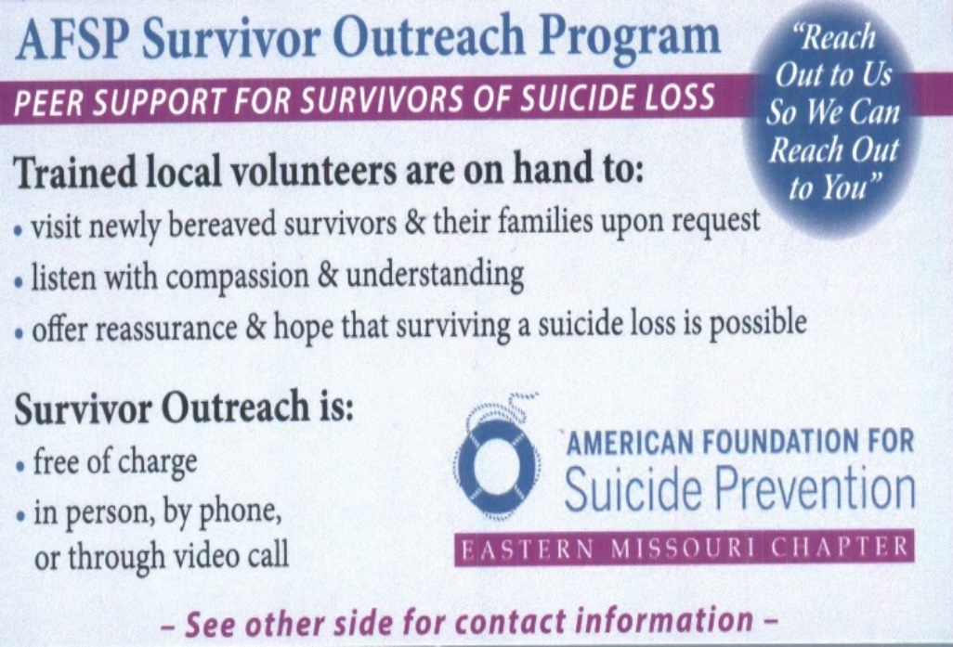
Give families resources

Slide 78
Give families resources
There is a local support group for survivors of suicide Survivors of Loved Ones to Suicide (SOLOS)
They meet at Cape Library on 2nd Wednesday of each month from 6:30 to 7:30
They have online support group through Facebook as well

Slide 79
Additional trainings
Mental Health First Aid (MHFA)-POST certified
Youth Mental Health First Aid
Mental Health First Aid Public Safety Model
Question Persuade Refer (QPR)
safeTALK
Applied Suicide Intervention Skills Training (ASIST)
Talk Saves Lives

Slide 80
Additional trainings continued
Attend Community Counseling Center’s annual suicide prevention and awareness conference
Participate in Out of the Darkness Walks (Cape and Ste. Genevieve counties)
Ask for additional specialized training

Slide 81
Suicide by Cop
Information taken Policeone.com from information from Dr. Bary Perrou, Psy.D – Founder of Public Safety Research Institute and a contributor to “Suicide By Cop: Inducing Officers to Shoot”
Disclaimer – this part of the training is purely research driven

Slide 82
Suicide by Cop
Although a peaceful resolution is certainly the desired outcome, it MUST NOT come at the expense of your safety.
Your safety must remain number one priority

Slide 83
Suicide by Cop
The 15 indicators are:
The subject is barricaded and refuses to negotiate.
The subject has just killed someone, particularly a close relative, his mother, wife or child.
The subject says that he has a life-threatening illness.
The subject's demands of police do not include negotiations for escape or freedom.

Slide 84
Suicide by Cop
The subject has undergone one or more traumatic life changes (death of a loved one, divorce, financial devastation, etc.)
Prior to the encounter, the subject has given away all of his money or possessions.
The subject has a record of assaults.
Subject says he will only surrender to the person in charge

Slide 85
Subject indicates that he has thought about planning his death.
Has expressed an interest in wanting to die in a "macho" way.
Has expressed interest in "going out in a big way."
Subject expresses feelings of hopelessness or helplessness.

Slide 86
Subject dictates his will to negotiators.
Subject demands to be killed

Slide 87
In "Suicide By Cop" Dr. Perrou also shares some potential indicators that a peaceful resolution to an SBC may be at hand. Some things that he has observed in subjects prior to peaceful resolutions:

Slide 88
Less interactive tension
Lowered voice
Less anger
Less profanity
Diminished aggressive body language
Increased non-aggressive body language
Diminished threats of violence

Slide 89
Less hopelessness and helplessness
Greater willingness to listen to the officer's suggestions
Solicitation of situation outcome promises and safeguards, such as "No handcuffs, no press and I will surrender if you will…“
Note: It is important to keep in mind that these indicators should not entice you to compromise your safety by weakening your tactical awareness.

Slide 90
Profile of Suicide by Cop Subjects
95% were male
5% female
Average age male - 35
Average age female - 40
36% were under the influence of alcohol
87% of individuals made a suicidal communication prior and/or during the incident
(handout with additional information)

Slide 91
Remember that although a peaceful resolution is certainly the desired outcome, it MUST NOT come at the expense of your safety.

Slide 92
Non-Suicidal Self Injury
Reasons for Self-Injury
To escape unbearable anguish
To change the behavior of others
To escape a situation
To show desperation to others
To “get back at” other people
To gain relief from tension
To seek help

Slide 93
How to Help with a Person Who Self-Injures
Recognize that self-injury is usually a symptom
of serious psychological distress
Avoid any negative reactions to the self-injury
Discuss the situation calmly
Focus on ways to stop the distress
Do Not
Focus on stopping self-injury
Trivialize the feelings or situations that have led to self-injury
Punish the person

Slide 94
Resources
www.afsp.org
www.suicidology.org
www.nowmattersnow.org
www.NAMI.org
www.thisishowitfeels.com
www.livethroughthis.org

Slide 95
Thank
You
Questions?

