Slide 1
Addressing Hoarding Issues in Housing
St. Louis County Department of Public Works
Problem Properties Unit

Slide 2
How do we get our referrals?
Police
Emergency Medical Services
Fire Department
Division of Aging
Department of Family Services
Case workers
Family members, friends, neighbors

Slide 3
WHAT does the Resource Coordinator do?
Assists residents with abating violations
Assists hoarders with resources, decluttering & organization

Slide 4
Hoarding
What is compulsive hoarding?
Hoarding Disorder (HD) is a mental health disorder where people have difficulty getting rid of possessions that are no longer useful, and efforts to get rid of the items and not new acquire items causes distress.
A person collects & keeps a lot of items, even things that appear useless or of little value to most people
These items clutter the living spaces and keep the person from using their rooms as they were intended, and
These items cause distress or problems in day-to-day activities
-OCD Foundation

Slide 5
Hoarding Signs
Outdoor clutter
Overgrowth
Windows
Resident usually comes outside from the back of the house
Excessive amount of items in their vehicle
Derelict vehicles on the property
Poor hygiene
Depressed
Anxious
Unable to control items

Slide 6
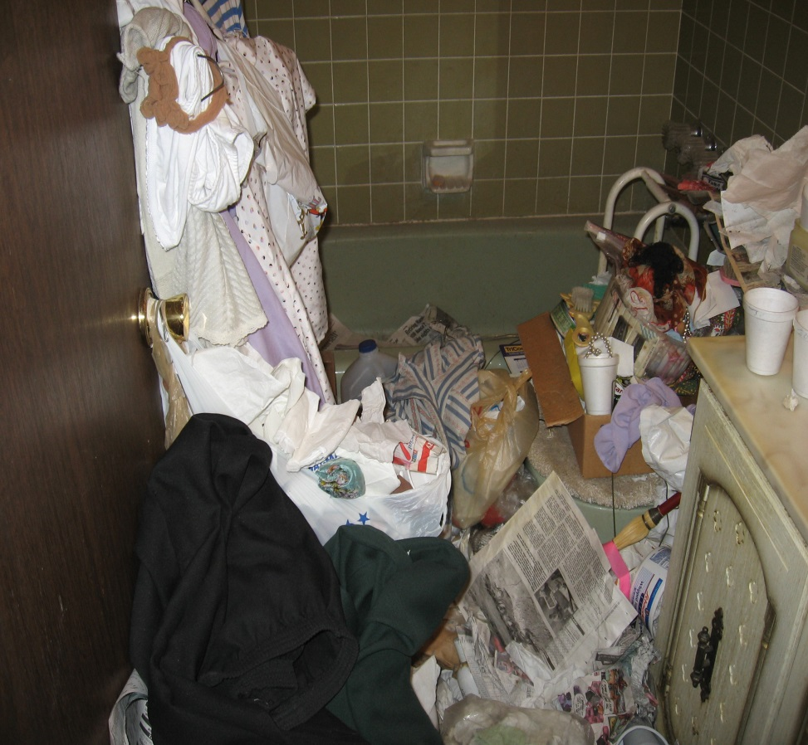
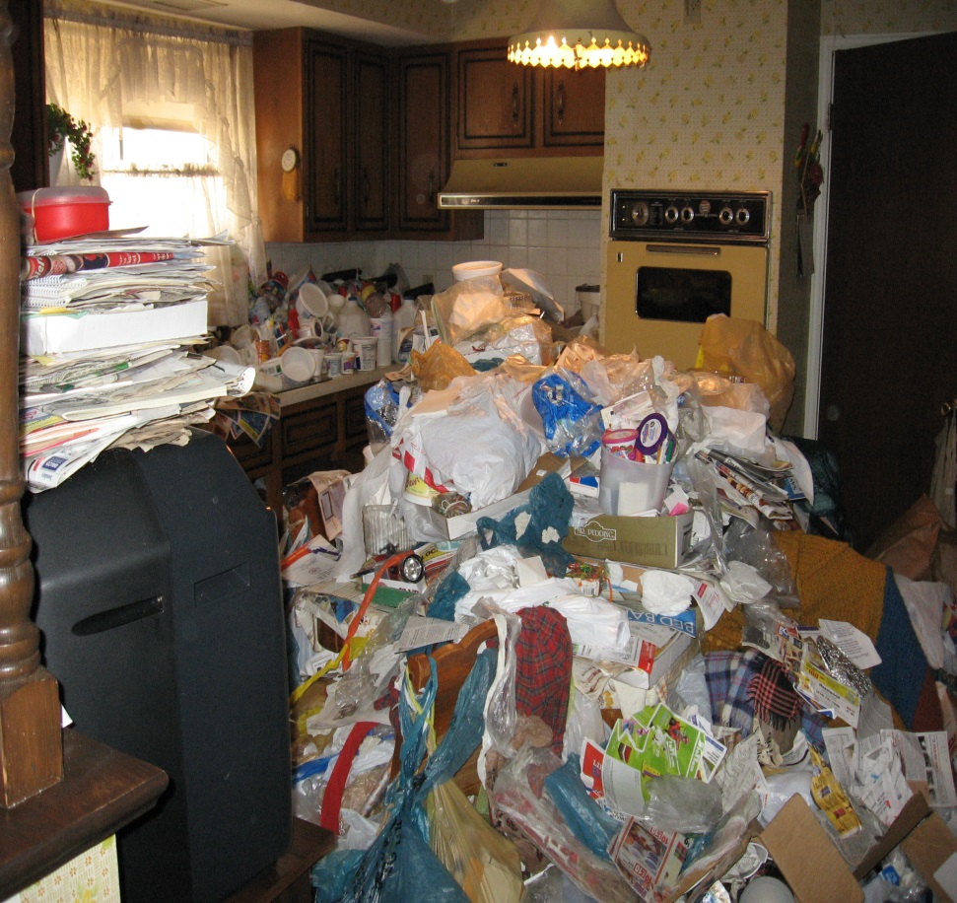
Interior of an 88 year olds home
Bathroom
Kitchen

Slide 7
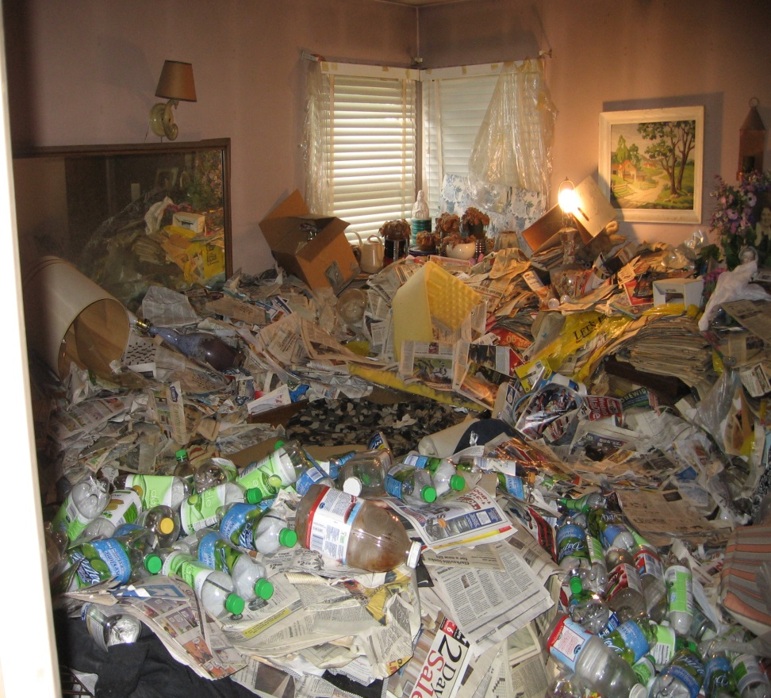
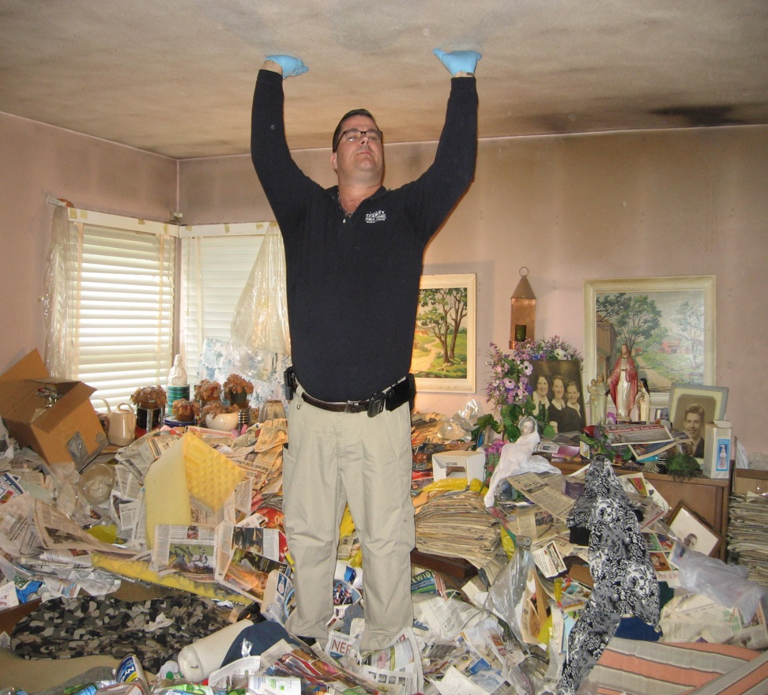
Bedroom of a 90 year old

Slide 8
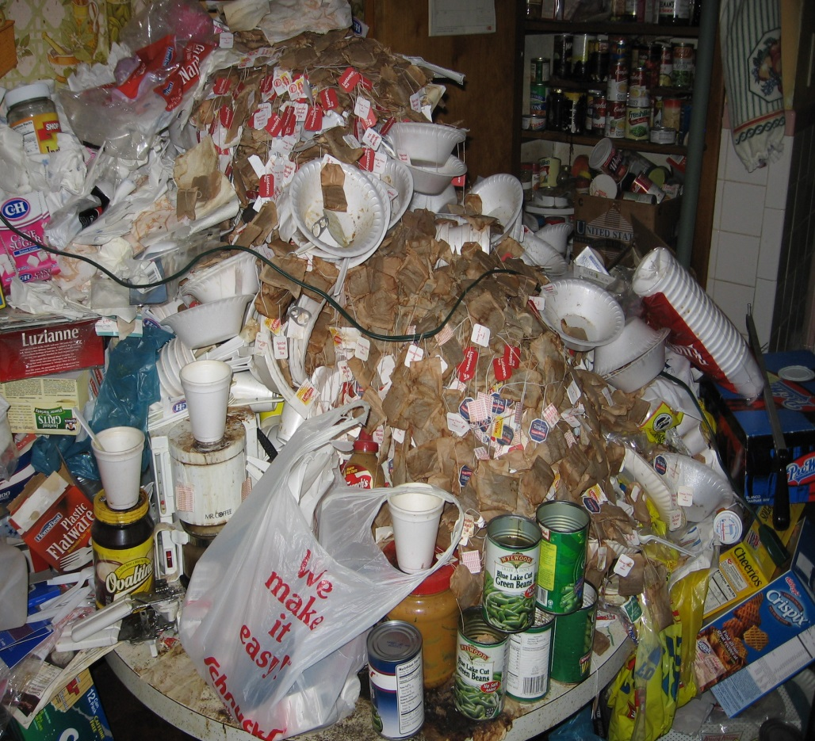
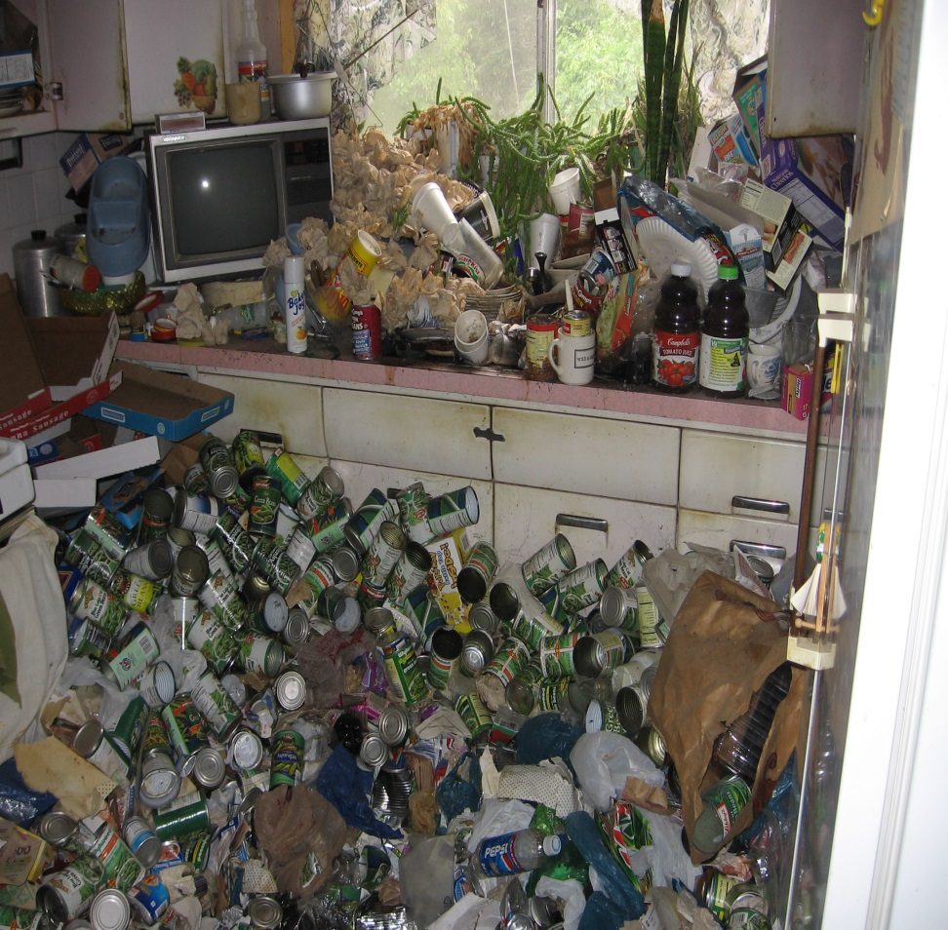
Kitchen of a 51 year old man
Kitchen table
Kitchen floor & sink

Slide 9
Hoarding Statistics
Up to 5% of the world population displays clinical hoarding
75% of hoarders engage in excessive buying
50% excessively acquire free items
15% acknowledge their behavior is irrational

Slide 10
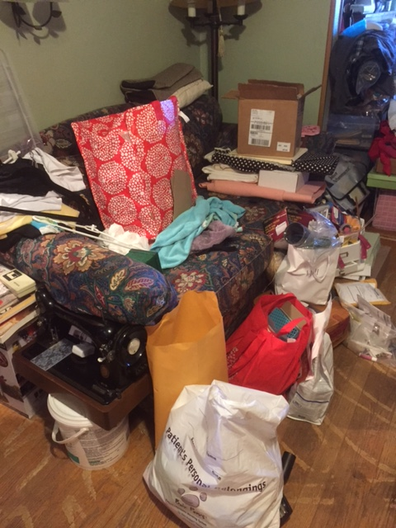
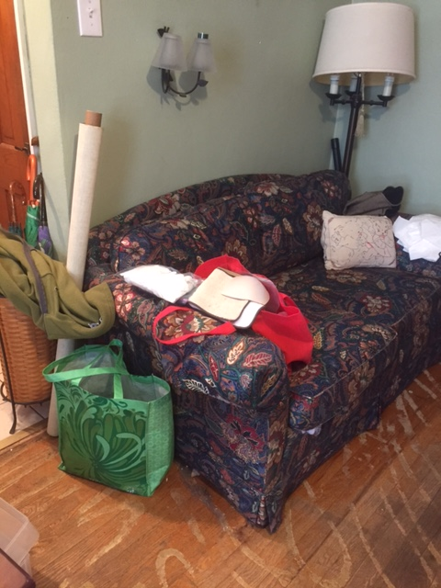
Living room of a hoarder
Before & After

Slide 11
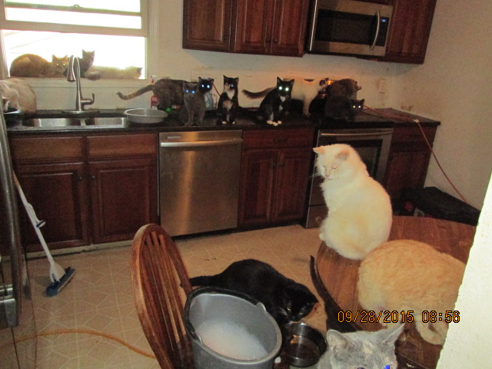
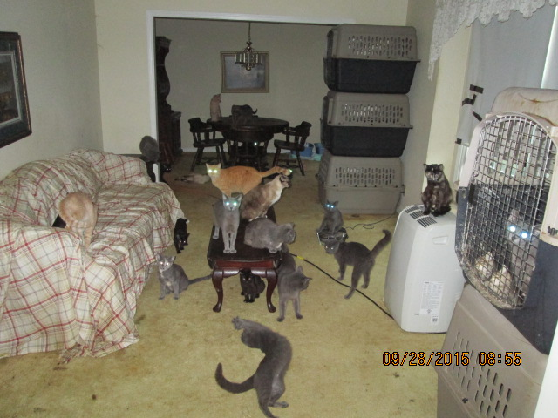
Animal Hoarding

Slide 12
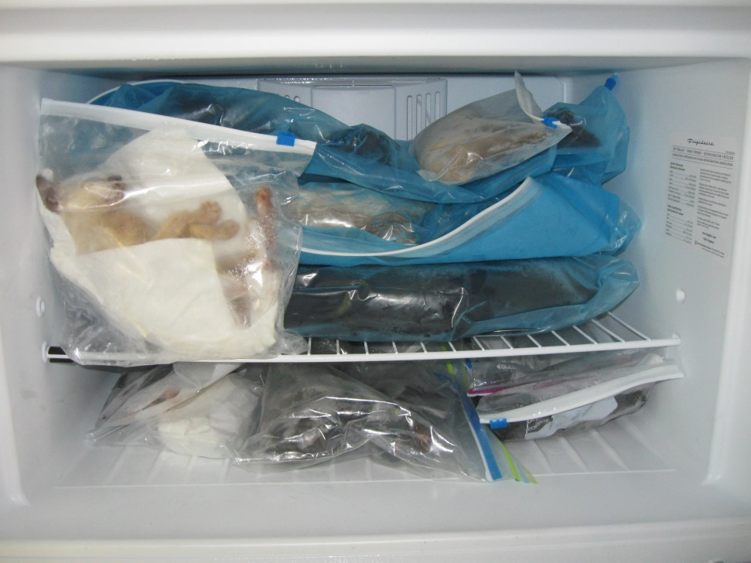
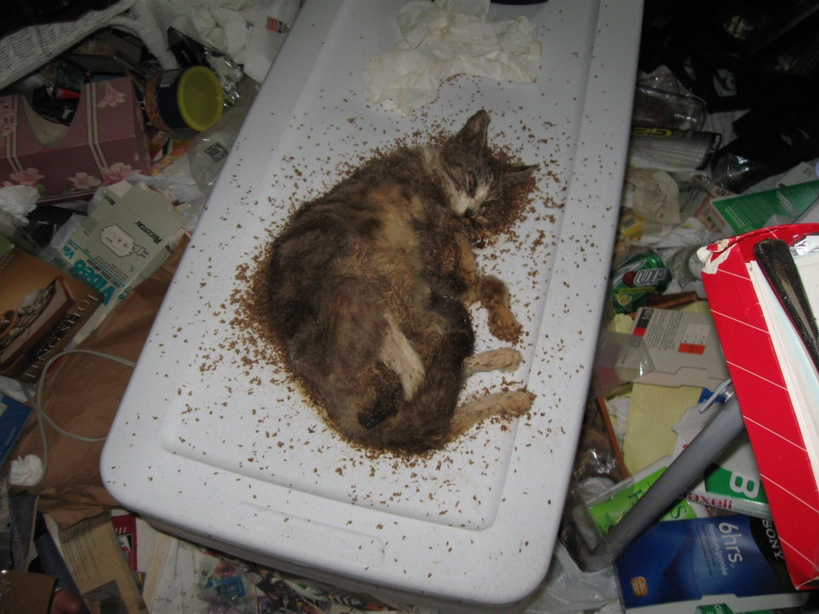
Animal Hoarding

Slide 13
HOW are hoarding issues approached?
Gentle approach
Gain resident’s TRUST!
Demonstrate respect
Explain thoroughly what has to be done
Focus on positive outcome
Resident is in charge. It is their house, their things
People with HD usually have problems with organizing, problem solving, and making decisions

Slide 14
What NOT to do
Expect a reasonable response
Touch their possessions without their permission (except animals)
Refer to the resident as a hoarder
Remove their items when they are not present
Refer to their items as trash, junk or crap

Slide 15
Effects of Hoarding
Unable to clean their property
Socially isolated
Fire and fall danger
Danger to fire fighters
Fire danger to neighboring houses
Vermin infestation
Neighborhood property values

Slide 16
WHERE do the resources come from?
St. Louis County - dumpsters
St. Louis County Older Residence Program - minor home repairs
Non-profit organizations provide resources through grant funding, i.e. utility assistance, home & plumbing repairs, weatherization
Volunteers from churches
Volunteers from high schools
Family & friends

Slide 17
If resident does not cooperate:
Could be vacated from the property if there are any of the following violations:
* unsanitary conditions
* illegal sleeping areas
* accumulation of rubbish
* defective sanitary drains
* no utilities
* dangerous wiring
* obstructed egress
* food preparation area inadequate
Alternative living facility may be needed

Slide 18
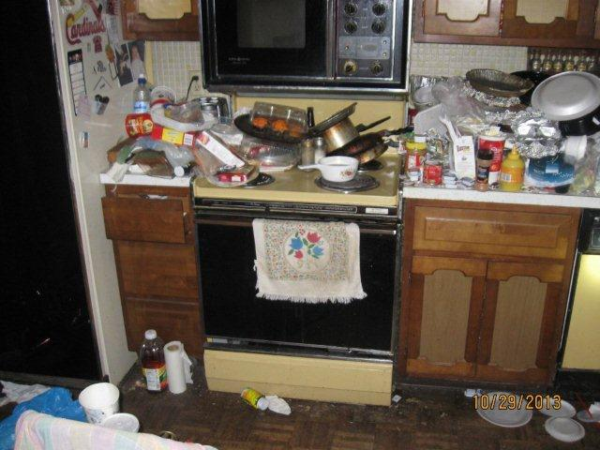
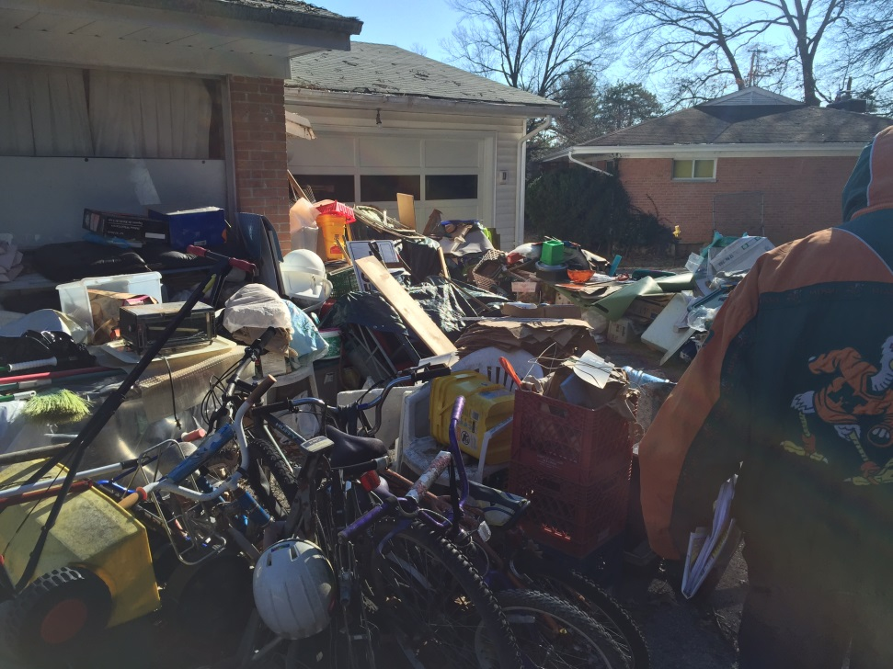
Violations
Food preparation area is inadequate
Accumulation of rubbish

Slide 19
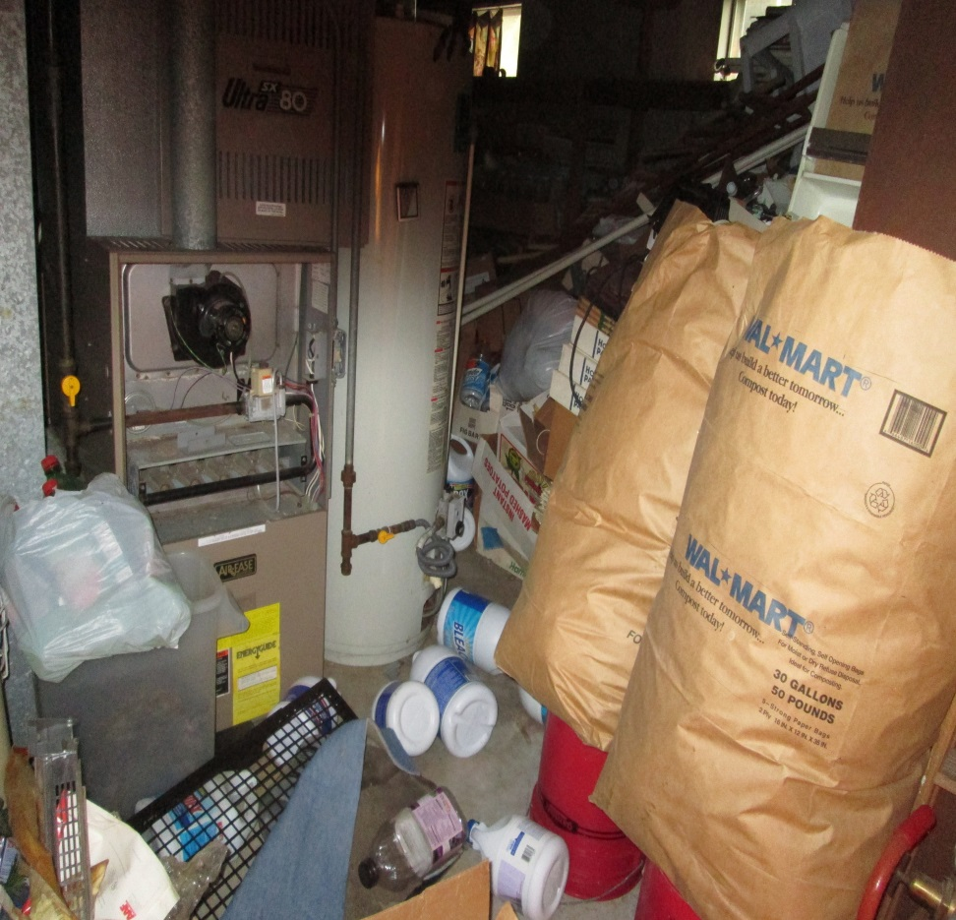
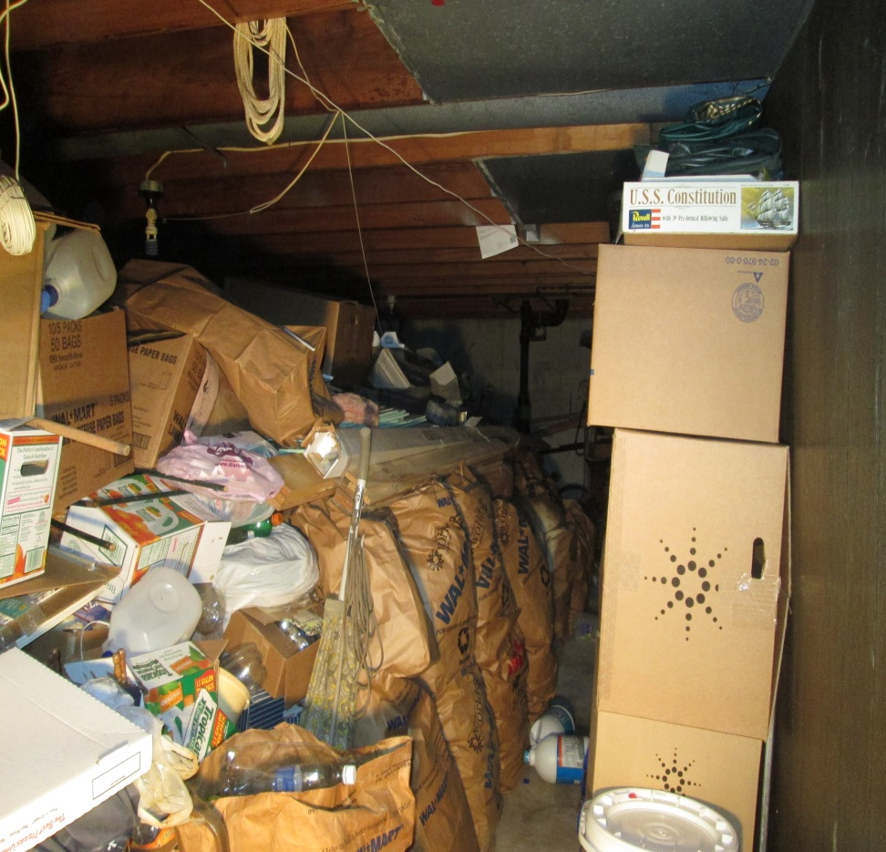
Fire Hazard in the Basement
Furnace area
Basement area

Slide 20
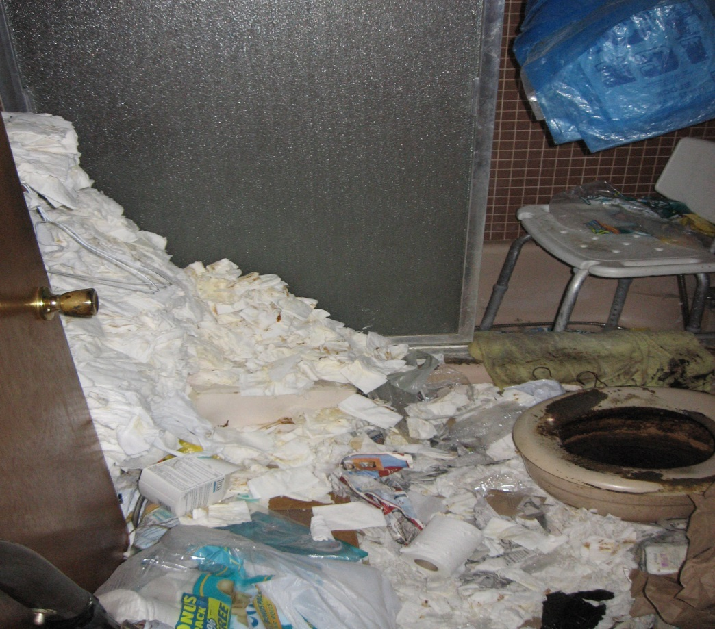
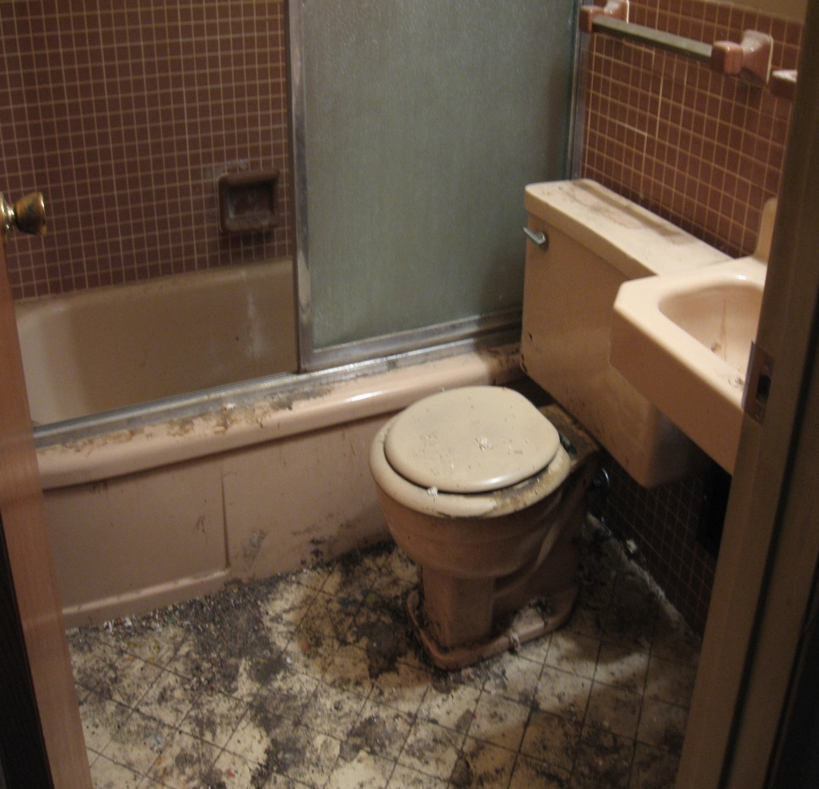
Bathroom
Before
After

Slide 21
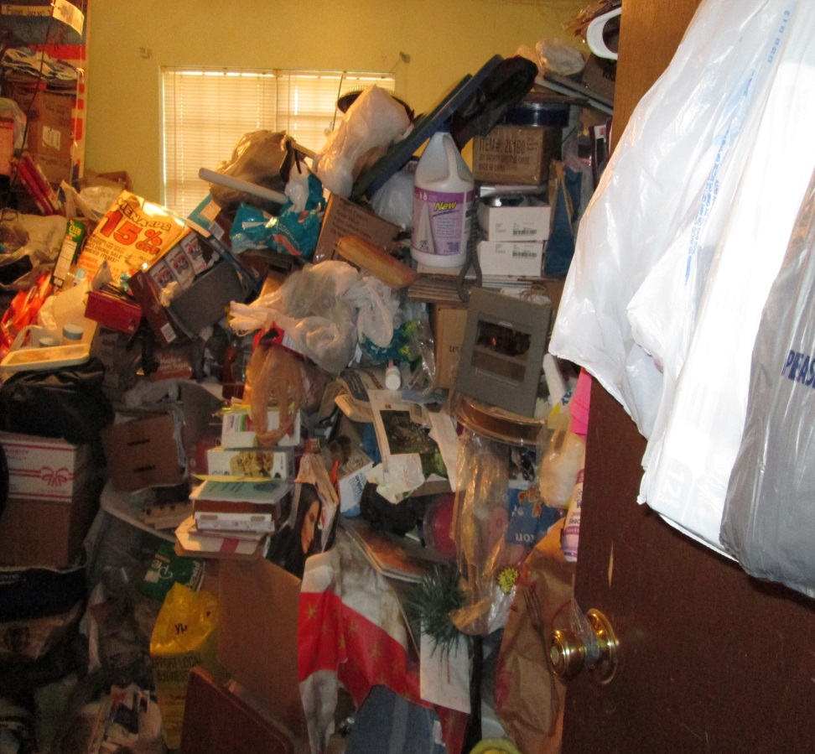
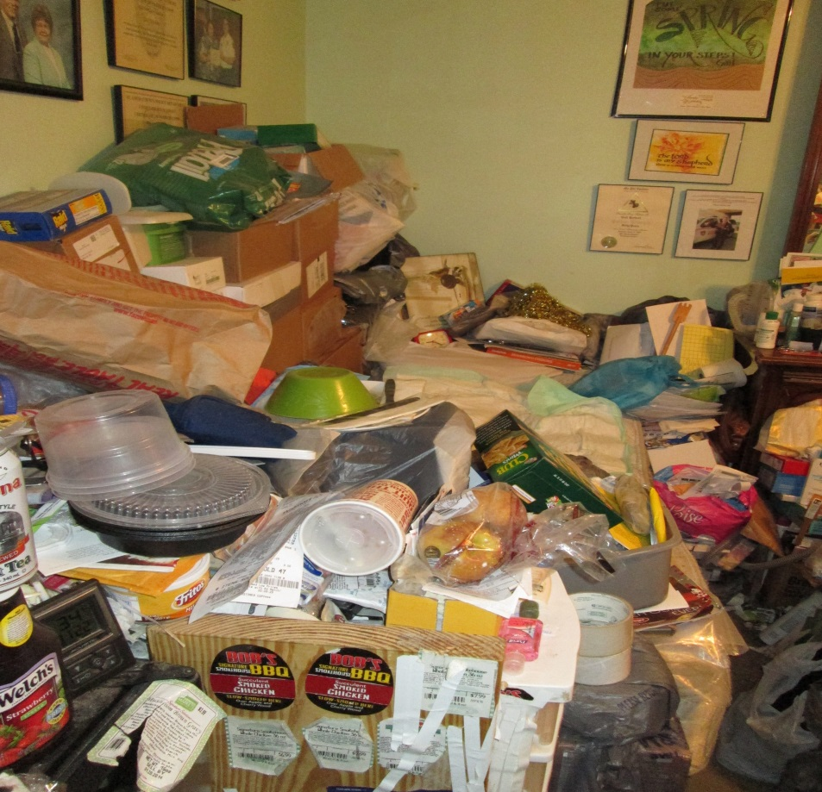
Unsafe Sleeping Area
Bedroom
Bedroom

Slide 22
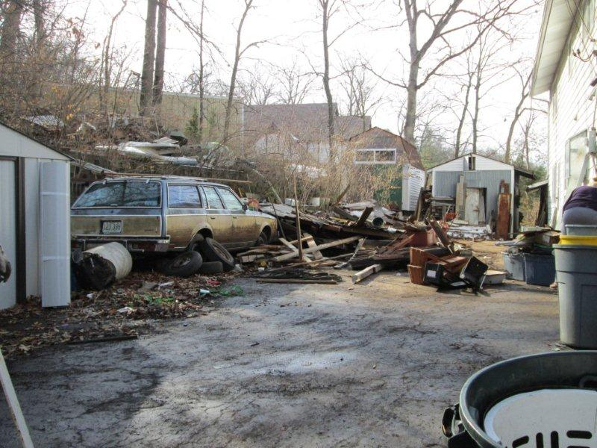
Illegal Outside Storage

Slide 23
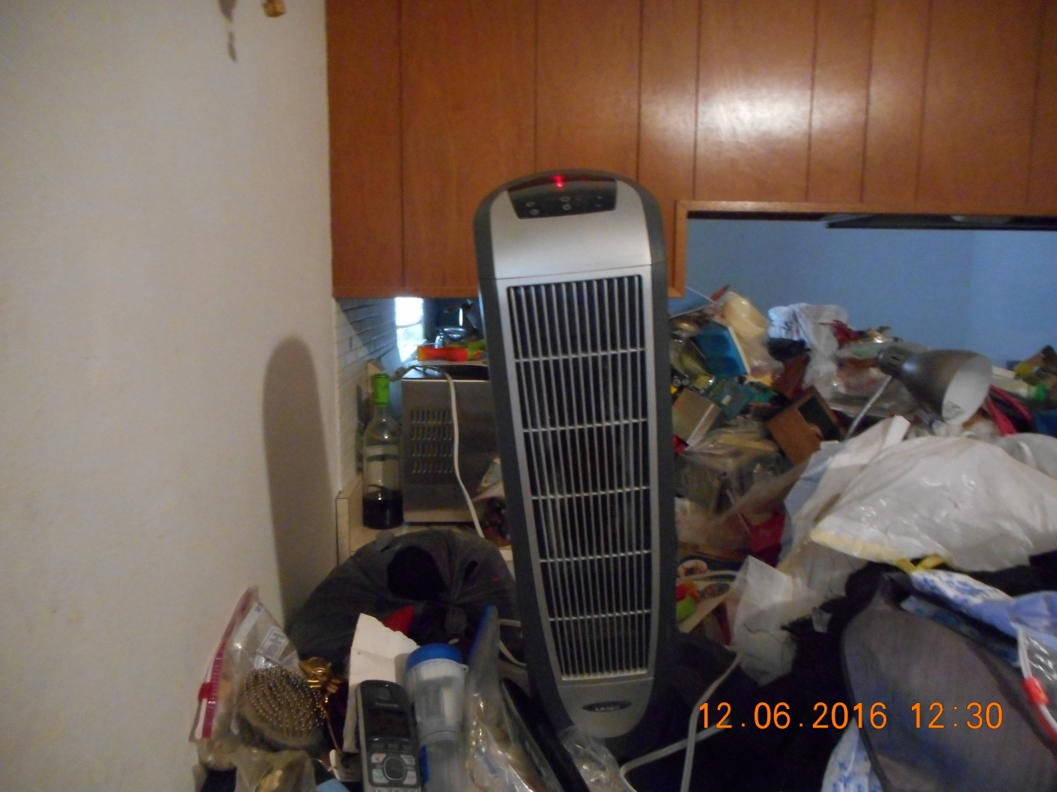
Gas service has been shut off.
Use of space heater on top of excessive amounts of clothes, plastic bags, paper.

Slide 24
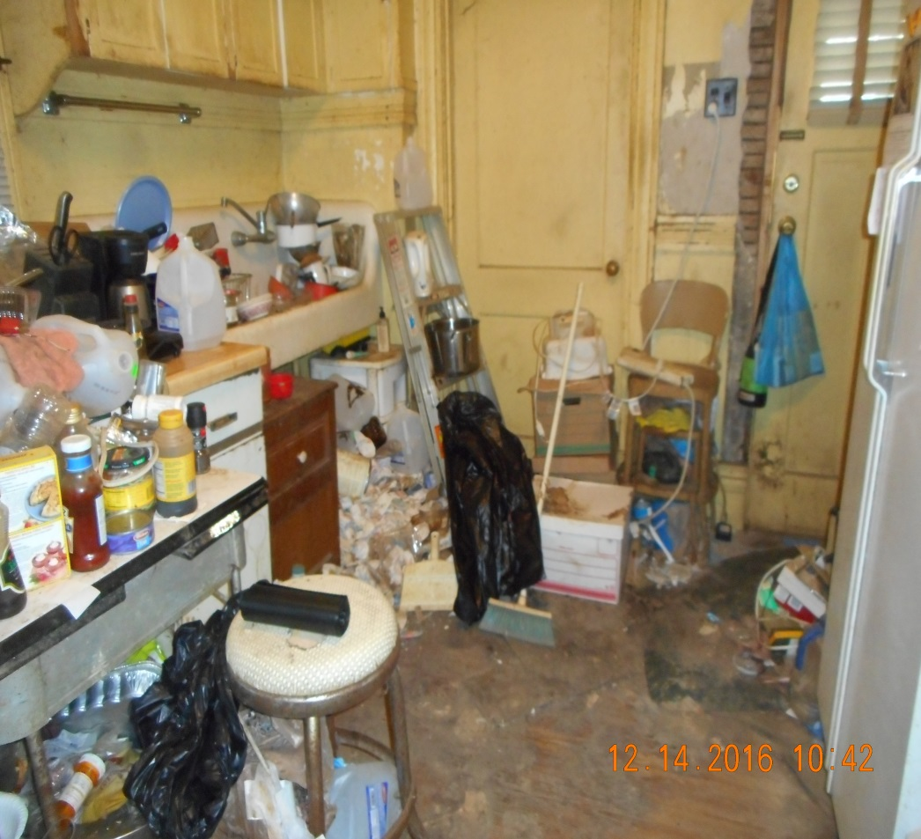
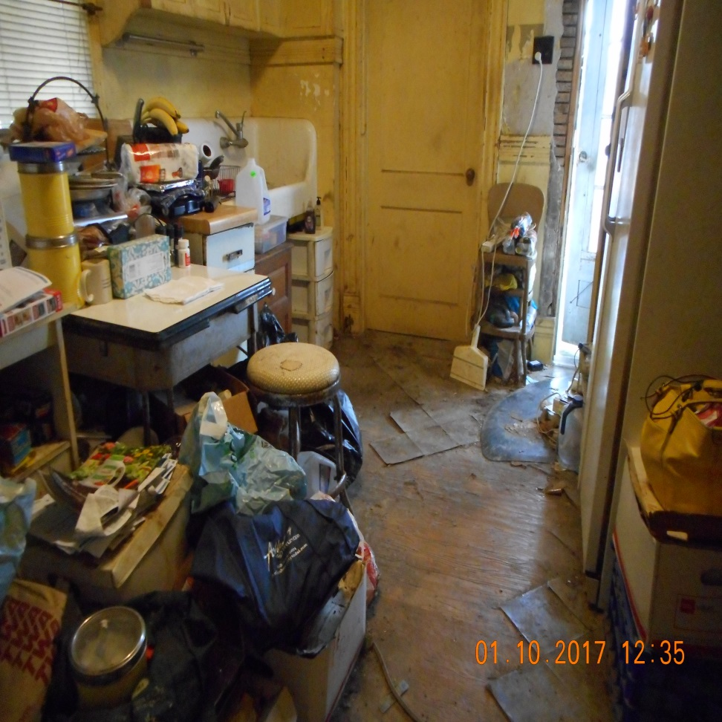
Unsanitary conditions
Food preparation area is inadequate
Before
After

Slide 25
Can Hoarding be treated?
Challenge the hoarder’s thoughts and beliefs about the need to keep items and about collecting new things
Go out without buying or picking up new items
Get rid of and recycle clutter. First, practice the removal of clutter with the help of a clinician or coach and then independently remove clutter
Find and join a support group or team up with a coach to sort and reduce clutter
UNDERSTAND THAT RELAPSE CAN OCCUR
Develop a plan to prevent future clutter

Slide 26
Questions to ask:
1) Do I need this?
2) Can I afford it?
3) Do I have room for it?
4) Do I have something at home that serves the
same purpose?
Asking these questions interrupts the impulse to buy.

Slide 27
What next?
Regular follow up in home visits
Funding is needed to assist these residents with in home psychological therapy, corporations, universities?
More individuals are needed to coach and assist in decluttering & organizing

Slide 28
Problem Properties Unit Teams
South of Highway 64
Officer Tim Rehagen – (314) 713-4395
Specialist – Jeff Young (314) 486-8912
West of Highway 367 to Highway 64
Officer Rob Rinck – (314) 486-8928
Specialist – Mike Cross (314) 486-8918
East of Highway 367 –Glasgow Village & Spanish Lake
Officer Jon Armbrister – (314) 405-0487
Specialist – Phil Jones (314) 810-4919

Slide 29
Debbie Kricensky, Resource Coordinator
Problem Properties Unit
St. Louis County Public Works
1050 N. Lindbergh Blvd.
St. Louis, MO 63132
314.486.8906 (cell)
dkricensky@stlouisco.com

