Slide 1
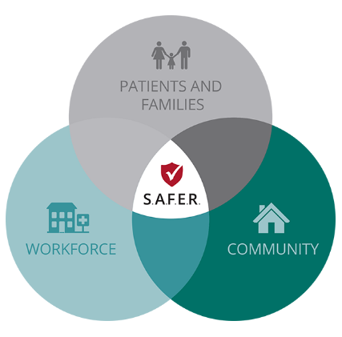
Law Enforcement & the Emergency Department: A Community Resource Partnership
Jane C. Drummond
General Counsel and Vice President of Legal Affairs

Slide 2
Background
According to OSHA, health care providers are four times more likely to be assaulted in the workplace.
In 2013, 13 percent of missed work days by health care or social services workers were due to workplace violence.
In 2017, 54 percent of Missouri hospitals reported violence or aggression in their top three internal threats.
15 percent reported it as their primary risk
MHA Annual Preparedness and Safety Survey, December 2017, n – 123 hospitals

Slide 3
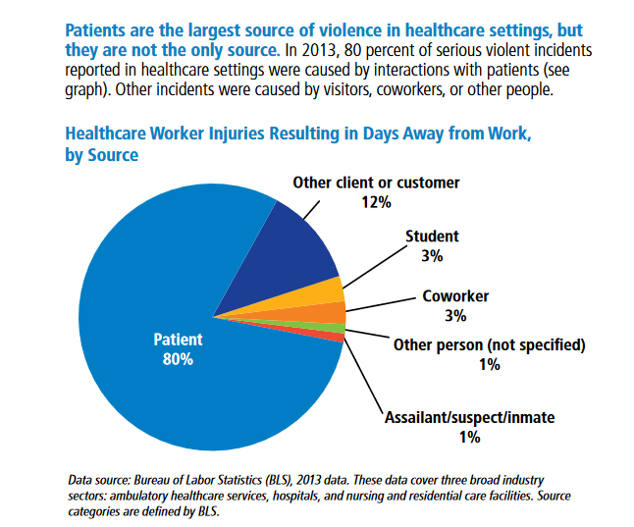
Workplace Violence in Healthcare: Understanding the Challenge
Retrieved from: https://www.osha.gov/Publications/OSHA3826.pdf

Slide 4
External Stressors Faced By Hospital Staff
Criminal activity resulting in law enforcement and legal implications
Recognized shortage in behavioral health resources in our state’s health care system
Opioid abuse — resource demands and drug seekers
Prevalence for violence and/or assault by patients and visitors
Regulatory environment

Slide 5
Identified Threats in Ranked Order
Behavioral health patient boarding in nonpsychiatric facilities (more prevalent in rural settings)
Violent patient encounters – ambient societal violence
Lack of resources to address law enforcement drop offs
Search and confiscation of narcotics
Search and confiscation of weapons
Law enforcement presence to execute warrants or question patients/visitors on site
Notes:
During the fall, staff listened to members recount frequent, alarming examples of workplace violence.
To develop long-term actions, staff conducted a listening tour of members to deepen understanding of workplace violence. Eight specific MHA member groups representing 225 physicians, executive leadership, clinical, human resources, security and front-line staff participated in the listening tour. Based on the quantitative and qualitative responses, the following have been identified as the greatest identified threats in ranked order.
behavioral health patient boarding in non-psychiatric facilities (more prevalent in rural settings)
violent patient encounters (more prevalent in urban and metropolitan areas)
law enforcement drop-offs that create holding and/or elopement concerns
Boarding of behavioral health/substance abuse patients in non psychiatric facilities
• • • • Law enforcement drop-offs that create holding and or elopement concerns
• Violent patient encounters (not resulting from one of the above triggers)

Slide 6
Environmental Scan
65 percent (84 hospitals) employ security workforce as hospital personnel.
28 percent (36 hospitals) provided dedicated security in the ED 24/7.
36 percent (47 hospitals) have armed security officers.
40 percent (24) firearm
48 percent (29) TASER
31 percent (19) pepper spray
42 percent (26) baton

Slide 7
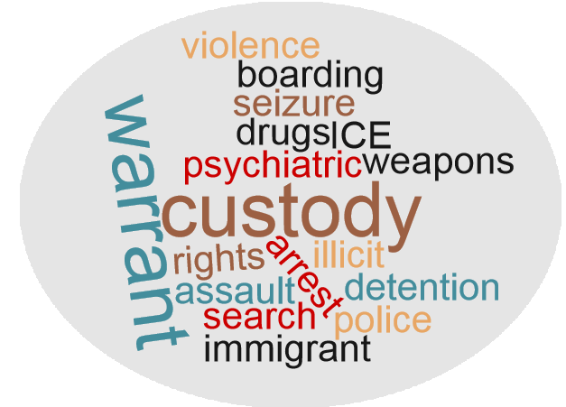
Common Issues
Patients under detention or in custody
Law enforcement involved patients
Controlled substances
Weapons
Psychiatric boarding

Slide 8
Central Theme
Intersection of rights and responsibilities between the hospital, staff, patients and law enforcement officials in regulated environment
GOAL: Synthesize concerns surrounding violence, criminal behavior, behavioral health and interactions with law enforcement to provide hospital policymakers, front-line staff and their local law enforcement partners, with education, training and technical tools to manage complex and stressful situations in a safe, legally compliant manner

Slide 9
The Emergency Department and EMTALA
What is EMTALA?
EMTALA stands for the Emergency Medical Treatment and Labor Act.
EMTALA is a federal law requiring a hospital to perform a medical screening exam for anyone who comes to the emergency department. If a patient is experiencing an emergency medical condition, the hospital must provide stabilizing care unless the hospital lacks the capacity or capability to do so, in which case the patient must be transferred to a facility that can care for the patient.

Slide 10
The Emergency Department and EMTALA
What is EMTALA?
A hospital cannot release a patient until an identified emergency medical condition has been stabilized for discharge or transfer.
EMTALA is enforced by the Centers for Medicare & Medicaid Services (CMS). If CMS determines a hospital violated EMTALA, it can cite the facility for placing patients in “immediate jeopardy,” in which case the hospital can be terminated from participation from the Medicare program within 23 days.

Slide 11
Case Study #1
The Wentzville Police Department has an individual in custody who has stated on several occasions he would like to die. One day, he informs a deputy that he ingested cleaning fluid in an attempt to kill himself, although the deputy is skeptical that the inmate had access to chemicals that could cause him harm. Still, he arranges for transport to SSM St. Joseph. The prisoner is examined and found to be in no apparent distress, so the emergency room physician places him under observation. After two hours, with no change in the inmate’s condition, the officer tires of waiting and wants to take the inmate back to jail. Is he free to do so?

Slide 12
EMTALA Considerations
Request for treatment need not come from the patient. A hospital is required to provide a medical screening exam for anyone who comes to the emergency department. EMTALA is triggered:
When the patient seeks treatment
When someone else requests treatment on the patient’s behalf
When it is apparent that the patient may be suffering from an emergency condition

Slide 13
Facilitating Emergency Room Interactions
Hospitals and their law enforcement partners should work to establish best practices before a difficult situation arises. Some things to consider:
Prisoner triage system
Triage is not the same as a medical screening exam
Save the ER for emergencies
Once a patient is brought to the emergency department, hospital cannot release until medically stable
Cooperative de-escalation techniques
Understand each other’s roles, responsibilities and resource limitations
Understand regulatory framework of EMTALA

Slide 14
Case Study #2
A Springfield police officer comes upon a vehicle partially in the ditch on a dark road. He approaches the driver who appears partially stunned. He asks the driver if she is alright. She slurs her words when responding, and the deputy smells alcohol on her breath. He administers a field sobriety test and ultimately takes her into custody and to CoxHealth for a blood draw to ascertain her blood alcohol level. Must the hospital follow EMTALA requirements?

Slide 15
EMTALA and Blood Draws
Generally, a request for a blood draw does not trigger EMTALA. However, some situations may give rise to a medical screening exam. An exam is required when the health care provider has reasonable belief that the individual may have an emergency medical condition.
Accident
Patient request for emergency treatment
Observation of the patient by medical personnel

Slide 16
Case Study #3
Two Clinton police officers arrive at the scene of a domestic disturbance. They are told by a female at the home that her husband is a Gulf War veteran and suffers from PTSD. She further informs the officers that he has been drinking heavily all day, which tends to exacerbate his PTSD. Over the course of the evening, he has verbally abused her, shoved her into a wall, choked her briefly and pulled her hair. She ultimately called law enforcement when he threatened her with a shotgun. She would like them to take him into custody until he sobers up. The officers arrest him and take him to the emergency room at Golden Valley, but they are unable to stay with him due to another call. Can they leave him at the emergency department?

Slide 17
Facilitating Emergency Room Interactions
If the patient is not in custody or detained, HIPAA restricts information that the hospital can share with law enforcement once they leave the patient at the facility. Additionally, individuals brought to the emergency department who may engage in violent behaviors create additional stress and resource issues for hospital staff.
Lack of dedicated security
Limited ability to restrain
Danger to other patients and staff
Boarding issues
Elopements

Slide 18
Facilitating Emergency Room Interactions
These situations can result in EMTALA violations.
Example: Domestic violence offender brought to the ED by ambulance at the direction of law enforcement. He was examined and refused to be treated. While he signed out against medical advice, he would not leave the premises and engaged security staff. Upon leaving, he went directly to a convenience store, called 911 and was brought back to the facility. The hospital received an EMTALA violation for failing to hold the patient.
Example: About ten minutes after coming to the emergency department, a patient fled. He was observed by staff, who immediately contacted law enforcement. The hospital was issued an EMTALA violation for failing to stop the patient from leaving.

Slide 19
Facilitating Emergency Room Interactions
Hospitals and their law enforcement partners should work to establish best practices for emergency department interactions before a difficult situation arises. Some things to consider:
Understand each other’s roles, responsibilities and resource limitations
Custody/detention of the patient
Dedicated security staff at hospital?
Understand regulatory framework of EMTALA
Develop cooperative/community plans
Hospital as part of the regular beat

Slide 20
Case Study #3 (cont.)
Approximately three hours after the officers leave the individual at the hospital, the director of the emergency department calls the police department and informs them the patient assaulted a nurse, breaking her nose. He is now threatening to leave the hospital against medical advice. The director asks the officers to return to the hospital and detain the patient in the emergency department until he is stable for discharge. Do the officers have authority to do so?

Slide 21
Facilitating Emergency Room Interactions
Law enforcement officers have certain rights to detain individuals who present a likelihood of serious harm to self or others.
Ability to take into custody for suspected criminal activity
Request of mental health coordinator for transport to a mental health facility
Officer’s belief that there is a likelihood of imminent, serious harm
Application for detention upon arrival

Slide 22
Case Study #4
The Gentry County Sheriff’s Department receives a call from the social worker at Northwest Medical Center. The facility has a patient who is the subject of an involuntary commitment, or 96-hour hold order signed by the probate judge. The closest available psychiatric bed for this patient is in Kansas City at Two Rivers Behavioral Health System, which is over 100 miles away. The social worker informs the sheriff that the judge has ordered that the patient be transferred to that facility by a deputy. The sheriff does not have the manpower to take a deputy out of commission for the several hours it will take to transport the patient and return to Gentry county. Must the sheriff’s department transport the patient?

Slide 23
Facilitating Emergency Room Interactions
Hospitals and their law enforcement partners should work to establish best practices for emergency department interactions before a difficult situation arises. Some things to consider:
Understand each other’s roles, responsibilities and resource limitations
Understand regulatory framework of EMTALA
Develop cooperative/community transportation plans
Statutory reimbursement for sheriff’s department

Slide 24
The Law Enforcement Perspective
What issues have you faced interacting with hospital emergency departments?
What types of situations present the most difficult patient transitions?
What practices have you developed to ensure smooth patient transitions?
Do you have any formal agreements or plans in place to address these situations?

Slide 25
CONTACT INFORMATION
Jane Drummond
General Counsel and Vice President of Legal Affairs
Missouri Hospital Association
jdrummond@mhanet.com
(573) 893-3700, ext. 1328
https://web.mhanet.com/

