Slide 1
Veterans Justice Outreach
Gary Helle, MSW, LCSW
Veterans Justice Outreach Specialist
John J. Pershing VA Medical Center
Cape Girardeau CBOC
573-778-4075 (w)
573-718-6190 ©
Gary.Helle@va.gov

Slide 2
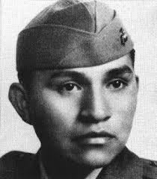
Who is this marine?
He was arrested 52 times for public drunkenness.[20] Referring to his alcoholism, he once said: "I was sick. I guess I was about to crack up thinking about all my good buddies. They were better men than me and they're not coming back.”

Slide 3
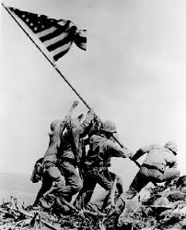
Who is this marine?
Ira Hayes died at the age of 32 due to exposure and alcohol poisoning.

Slide 4
VA is making a system-wide effort to ensure access to services for the justice involved veteran population at risk for homelessness, substance abuse, mental illness, and physical health problems http://www.va.gov/homeless/vjo.asp

Slide 5
May 27, 2009. VA national directive requiring VA medical centers to provide outreach to justice involved veterans in the communities they serve.
Each VA medical center must designate a VJO specialist who will be responsible for direct outreach for justice involved veterans who are involved with local jails, courts, and justice system partners

Slide 6
Veteran Justice Outreach Initiative
The purpose of the Veteran Justice Outreach Initiative (VJO) initiative is to avoid the unnecessary criminalization of mental illness and extended incarceration among Veterans by ensuring that eligible justice-involved Veterans have timely access to VHA mental health and substance abuse services when clinically indicated, and other VA services and benefits as appropriate. VA is requiring justice-focused activity at the medical center level. VA Medical Centers have been strongly encouraged to develop working relationships with the court system and local law enforcement and must now provide outreach to justice-involved Veterans in the communities they serve. Each VA medical center has been asked to designate a facility-based Veterans’ Justice Outreach Specialist, responsible for direct outreach, assessment, and case management for justice-involved Veterans in local courts and jails, and liaison with local justice system partners.

Slide 7
A Justice-involved veteran is: a. A Veteran in contact with local law enforcement who can be appropriately diverted from arrest into mental health or substance abuse treatment; b. A veteran in local jail, either pretrial or serving a sentence ; or c. A Veteran involved in adjudication or monitoring by a court d. A veteran being supervised by a state or federal probation parole agency.

Slide 8
The Facts:
23,440,000 veterans in the United States (source: U.S. Department of Veterans Affairs) 1.7 million veterans of Iraq and Afghanistan (source: Iraq and Afghanistan Veterans of America) 1 in 5 reports symptoms of mental disorder (source: RAND Ctr. For Military and Policy Research)
1 in 4 Veterans ages 18-25 met criteria for substance abuse disorder in 2006 (source: Substance Abuse and Mental Health Services Administration) 1.8 million vets met the criteria for having a substance abuse disorder in 2006 (source: Substance Abuse and Mental Health Services Administration)

Slide 9
Emerging Bio/Psycho/Social Issues
Medical Issues
Suicide
Relationship issues/Divorce
Anger related issues
Driving offenses
Reintegration difficulties
Violence/Abusive Behavior
Addiction
Employment Issues
Criminal Justice Involvement

Slide 10
Today’s War
Battlemind
PTSD
TBI

Slide 11
Battlemind is the Soldier’s inner strength to face fear and adversity in combat with courage.
Normalize
Life there vs. life here
Readjust

Slide 12
“Battlemind skills helped you survive in combat… but may cause problems when you get home…”
Buddies (cohesion) vs. Withdrawal
Accountability vs. Controlling
Targeted Aggression vs. Inappropriate Aggression
Tactical Awareness vs. Hypervigilance
Lethally Armed vs. “Locked and Loaded” at Home
Emotional Control vs. Anger/Detachment
Mission Operational Security vs. Secretiveness
Individual Responsibility vs. Guilt
Non-Defensive (combat) Driving vs. Aggressive Driving
Discipline and Ordering vs. Conflict

Slide 13
Risky behaviors to get the adrenaline rush
Speeding/erratic driving/road rage (drive down middle of road/avoidance of objects on side of road, swerving under bridges, driving over curbs.)
In traffic jam, may panic, feel “ambushed” if stuck in traffic.
Alcohol abuse/DV/child abuse
Addiction (various – work, alcohol, drugs, sex, food, adrenaline)

Slide 14
Soldiers returning from Iraq:
95% observed dead bodies or human remains
93% were shot at, or received small arms fire
89% were attacked or ambushed
65% observed injured or dead Americans
48% were responsible for the death of an enemy combatant

Slide 15
Post Traumatic Stress Disorder
Falls under the DSM-5 Trauma and Stressor-Related Disorders.
Criterion must include the following:
Exposure to actual or threatened death, serious injury, or sexual violence.
Presence of any of the following intrusive symptoms:
nightmares related to the trauma incident, distressing memories of the trauma
flashbacks
intense prolonged psychological distress at exposure to internal or external cues that symbolize aspects of the trauma event.
Physiological reactions to internal or external clues that symbolize aspects of the trauma event

Slide 16
PTSD cont.
3 Persistent avoidance of stimuli associated with the trauma event(s) as evidenced by one of the following:
Avoidance of, or efforts to avoid distressing memories, thoughts, feelings about or closely associated with the trauma event(s).
Avoidance of, or efforts to avoid external reminders (people, places, conversations, activities, objects, situations) that arouse distressing memories, thoughts, or feelings.

Slide 17
PCL-5
Instructions: Below is a list of problems that people sometimes have in response to a very stressful experience. Please read each problem carefully and then circle one of the numbers to the right to indicate how much you have been bothered by that problem in the past month. In the past month, how much were you bothered by: Not at all A little bit Moderately Quite a bit Extremely
1. Repeated, disturbing, and unwanted memories of the stressful experience? 0 1 2 3 4
2. Repeated, disturbing dreams of the stressful experience? 0 1 2 3 4
3. Suddenly feeling or acting as if the stressful experience were actually happening again (as if you were actually back there reliving it)? 0 1 2 3 4
4. Feeling very upset when something reminded you of the stressful experience? 0 1 2 3 4
5. Having strong physical reactions when something reminded you of the stressful experience (for example, heart pounding, trouble breathing, sweating)? 0 1 2 3 4
6. Avoiding memories, thoughts, or feelings related to the stressful experience? 0 1 2 3 4
7. Avoiding external reminders of the stressful experience (for example, people, places, conversations, activities, objects, or situations)? 0 1 2 3 4
8. Trouble remembering important parts of the stressful experience? 0 1 2 3 4
9. Having strong negative beliefs about yourself, other people, or the world (for example, having thoughts such as: I am bad, there is something seriously wrong with me, no one can be trusted, the world is completely dangerous)? 0 1 2 3 4

Slide 18
PCL-5
10. Blaming yourself or someone else for the stressful experience or what happened after it? 0 1 2 3 4
11. Having strong negative feelings such as fear, horror, anger, guilt, or shame? 0 1 2 3 4
12. Loss of interest in activities that you used to enjoy? 0 1 2 3 4
13. Feeling distant or cut off from other people? 0 1 2 3 4
14. Trouble experiencing positive feelings (for example, being unable to feel happiness or have loving feelings for people close to you)? 0 1 2 3 4
15. Irritable behavior, angry outbursts, or acting aggressively? 0 1 2 3 4
16. Taking too many risks or doing things that could cause you harm? 0 1 2 3 4
17. Being “superalert” or watchful or on guard? 0 1 2 3 4
18. Feeling jumpy or easily startled? 0 1 2 3 4
19. Having difficulty concentrating? 0 1 2 3 4
20. Trouble falling or staying asleep? 0 1 2 3 4

Slide 19
Signs and Symptoms of PTSD
Hyperarousal
Vigilance
Agitation
Anger issues
Violence
Anxiety
Isolation
Insomnia
Nightmares
Flashbacks
Avoidance
Numbing
Suicide

Slide 20
Traumatic Brain Injury (TBI)
A traumatic brain injury is a blow or jolt to the head or a penetrating head injury that disrupts the function of the brain.
The severity of such an injury may range from mild to severe.
A TBI can result in short- or long-term problems with independent function.

Slide 21
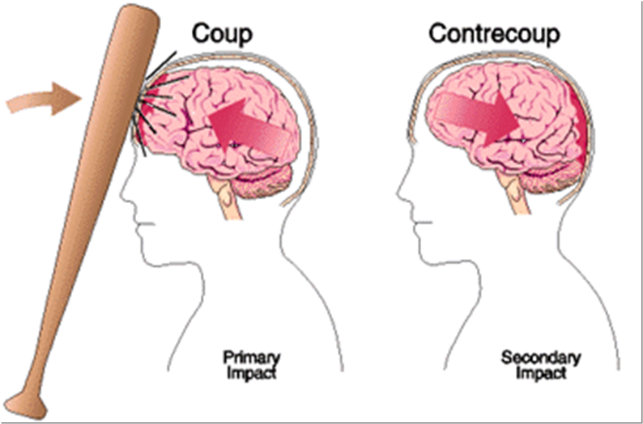

Slide 22
“Start by envisioning a bowl of jello. Tap it on one side and watch how it wiggles all the way over to the other. This mundane image illustrates the force of a blast wave — from a bomb, an improvised explosive device (IED), a mine, grenade or mortar shell — traveling through brain matter, disrupting pathways and unleashing a chemical soup on its victim, according to Jonathan Fellus, MD, Director of Brain Injury Services at Kessler Institute of Rehabilitation

Slide 23
Traumatic Brain Injury
Mood
Apathy/Depression
Anxiety
Irritability
Emotional lability
Insensitivity
Egocentricity
Behavior
Lack of initiation
Disinhibition
Impulsivity
Restlessness
Aggression
Agitation
Cognition
Motor/sensory disturbances
Impairments in:
Language, communication
Attention, concentration, memory
Learning new information
Speed of information processing
Judgment, decision-making, problem-solving, insight

Slide 24
TBI- PTSD symptom overlap
PTSD
Flashbacks
Attention
Problems
TBI
Nightmares
Depression
Headache
Isolates
Self
Irritability
Poor Anger
Control
Nausea &
Vomiting
Sleep
Problems
Hearing
Loss
Easily
Startled
Ringing
in Ears
Anxiety
Dizziness

Slide 25
Implications for Law Enforcement

Slide 26
Predictors of Violence in Veterans
Severe Violence
Mild Violence
Younger age
Combat exposure*
Alcohol misuse
Criminal arrests
PTSD*
Homelessness
History of Arrests
Combat Exposure*
Alcohol Misuse
PTSD*
This does not mean all or even most veterans with these factors will commit crimes. But the more of these factors a veteran has, the more likely it is.
* The correlation between violence and PTSD or combat exposure is not clear. Some studies say it correlates, some say it doesn’t.
Notes:
Elbogen EB, Johnson SC, et al. Protective Factors and Risk Modification of Violence in Iraq and Afghanistan War Veterans. Journal of Clinical Psychiatry. 2012 June ; 73(6): e767–e773.
Sreenivasan S, Garrick T, McGuire J, et al. Critical concerns in Iraq/Afghanistan war veteran-forensic interface: Combat-related postdeployment criminal violence. Journal of the American Academent of Psychiatry and the Law. 41:263-73, 2013.

Slide 27
Protective Factors
Severe Violence
Mild Violence
Older age
Increased perception of self-determination
Older age
Satisfactory social support
Higher psychological resilience
Ability to meet basic needs.
The more protective factors a veteran has, the less like he/she is to commit violence.
Notes:
Elbogen EB, Johnson SC, et al. Protective Factors and Risk Modification of Violence in Iraq and Afghanistan War Veterans. Journal of Clinical Psychiatry. 2012 June ; 73(6): e767–e773.

Slide 28
Veterans and Violence Overall
Veterans are less likely to commit violence than the general population.
Correlation does not mean causation!
It is almost impossible to isolate a single cause of criminal behavior.
Example: Most crimes involving PTSD also involve alcohol or other substance abuse.
Like alcohol, TBI can disrupt emotional regulation and disinhibit negative behaviors.
Notes:
Sreenivasan S, Garrick T, McGuire J, et al. Critical concerns in Iraq/Afghanistan war veteran-forensic interface: Combat-related postdeployment criminal violence. Journal of the American Academent of Psychiatry and the Law. 41:263-73, 2013.

Slide 29
Compared to the general population, veterans are more likely to…
Be armed and trained in combat.
Have “battlemind” or other readjustment challenges.
Have a traumatic brain injury – as many as 18% may have at least a mild TBI.
continued

Slide 30
Law Enforcement Implications - tactical
Inquire earlier about weapons
Try not to startle
Loud noises, sudden movements can escalate anxiety and desire to escape, and therefore escalate the situation.
Be aware of the tendency to feel easily threatened
Can you avoid approaching them from the rear? Can you avoid standing behind them or in their periphery? This will increase agitation and in some individuals, the fight response.

Slide 31
Assessment and Verbal Interaction
Assessments for risk, as usual.
Make references to safety, that you are there to keep them/everyone safe (feeling chronically unsafe and threatened is a major after-effect of a traumatic event).
Explain who you are and why you’re there.
If a consumer appears disoriented, try to bring him/her back to the present “Do you know where we are?” “Do you know why I’m here?” (i.e., grounding).
Keep low and calm tones.
Avoid the power struggle!
Keeping a collaborative/helping posture is going to lower a veteran’s defensiveness – asserting your control is likely to bring on the fight because they’ve learned that this is the only way to keep themselves safe.

Slide 32
Assessment and Interaction cont’d
Assess for predictors of violent behavior:
Age, combat exposure, alcohol use, criminal arrest record, housing stability, PTSD symptoms.
Assess for protective factors:
Perception of self-determination, social support, psychological resilience, ability to cover basic needs, employment situation, self care.

Slide 33
Assessment and Interaction cont’d
Make a connection for them between trauma and their current functioning (you may be the first and only person to do this).
Have you been injured or assaulted before?
Are you a veteran? If yes: How have you been doing since you got back?
If you’re developing good rapport, it’s okay to challenge a bit: You just got done telling me that you’re getting divorced, lost your job, and are about to be homeless. Do you think it might be time to do something about this? I.E, “How’s that been working for you?”
It seems like you’ve really been struggling since ___ happened. It’s a pretty significant thing to happen, I can imagine needing help myself if I went through that . . .

Slide 34
Consequences for Criminal Actions
Is giving the guy a break helpful or enabling?
Sometimes contact with law enforcement (and possible consequences) is the first and only way someone will be motivated to enter treatment.
They may be more likely to trust you than to trust some mental health professional that says they need help.
Have heard several veterans comes into treatment saying “I just got arrested. This is not who I am. I need help.”
If you do give the vet a break: do so only for minor offenses, only once, and still hold them accountable for doing something about their difficulties at this time.

Slide 35
VETERANS IN JAILS
Most recent United States Justice Bureau of Justice Statistics (BJS) (2002) data, indicates 9.3% of people incarcerated are veterans.
70% non-violent
82%of those released from jails are eligible for VA
BJS (2006) 60% of all US jail inmates had mental health problem.
5 in 6 with MH Dx had received no previous
BJS (2002) found 65% had alcohol or drug dependency problem
Historically, reports of Vietnam and Post-Vietnam era veterans with histories of civilian and military trauma suggest an association between trauma and subsequent contact with the legal system.

Slide 36
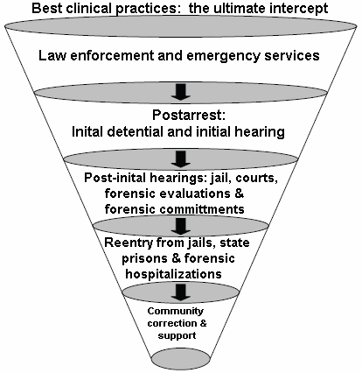
Sequential Intercept Model
Intercept Point 1
Intercept Point 2
Intercept Point 3
Intercept Point 4
Intercept Point 5
Munetz and Griffin 2006

Slide 37
Veterans Courts
Utilize Drug Court/Mental Health court models
VA is the primary treatment provider
Over 150 nation wide per Justice for Vets (NADCP)

Slide 38
Why a Veterans Only Docket?
Better Understanding
Camaraderie Among Those who Served
One Stop Shop (VA)
Veteran Mentors
http://www.justiceforvets.org/
Missouri Revised Statutes
Chapter 478 Circuit Courts Section 478.008

Slide 39
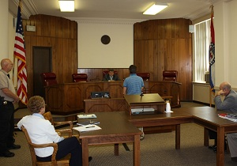
Veterans court activities In Southeast Missouri:
SEMO VETERANS COURT
This first in the nation multi-jurisdictional Southeast Missouri (SEMO) Veterans Treatment Court held its first session on September 7, 2011, with Drug Court Commissioner, Phillip Brit presiding. The court will divert eligible veteran defendants with substance abuse dependence and/or behavioral health needs that are charged with a felony criminal offence to a specialized criminal court docket. A treatment problem-solving model will be substituted for traditional court processing.

Slide 40
US Veterans Court, Cape Girardeau.
1 of 4? in the nation.
18 counties in Southeast Missouri as well as St. Louis City and County.
A voluntary program for individuals on supervised release who are United States military veterans and are in need of services from the Veterans Administration (VA) to comply with the conditions of supervision.
The program includes three phase levels. It is anticipated that most veterans will complete the program within 12 months, giving each participant the opportunity to establish a lifestyle that will promote successful reintegration into the community.

Slide 41
VA Mental Health Treatment
Mental Health Homeless Programs
HUD VASH – Housing and Urban Development/ VA Supportive Housing
Section 8 Vouchers at Medical Center
Chronically & Literally homeless
Grant Per Diem (GPD)
Beds at community site (Catholic Charities, Salvation Army, etc.)
Transitional – focus on work & sobriety
Contract Residential Beds
Community Based Outpatient Clinics
Psychotherapy, Psychiatry, Nursing
Recovery Groups

Slide 42
VA Substance Abuse Treatment (outpatient)
Intensive Outpatient Treatment
Relapse Prevention
Aftercare
AA/NA Meetings on Site
Addictive Disorders Clinic
Individual CBT, DBT, Relational & Supportive Therapy
Psychiatry
Research Studies
Antabuse, Suboxone & Methadone Clinics
AA/NA, Coping Skills, SMART Recovery, WRAP, Mindfulness, MI/SUD, YOGA
Community Based Outpatient Clinics

Slide 43
VA Mental Health and Substance Abuse Treatment (inpatient)
Residential PTSD Treatment
30-45 Residential Rehabilitation Treatment Program (RRTP) Dual Disorder Program
Independent Living Skills Program. Week to week placement.

Slide 44
VA Mental Health Treatment
Acute Psychiatry Unit
Locked Unit
Partial Psychiatry Hospitalization (PPH)
Primary Axis I or II Diagnosis (other than Substance Use)
Has PTSD & Substance Use Disorder tracks
Primary care/Mental Health
MHICM (Mental Health Intensive Case Management) Suicide Prevention (1-800-273-8255)

Slide 45
Evidenced Based Therapeutic Interventions
Cognitive Processing Therapy (CPT)
Prolonged Exposure Therapy (PE)
Seeking Safety
Cognitive Behavioral Therapies
Dialectical Behavioral Therapy
Moral Reconation Therapy (MRT)
Other therapies (relational, psychodynamic, ACT)

Slide 46
VA Medicine & Specialty Care
Spinal Cord Injury Center
Polytrauma & TBI
Orthopedics
Cardiac Surgery Program
Pharmacy
24/7 Emergency Care
Dental & Eye
Neurology
Inpatient Medicine Beds

Slide 47
VA Supportive Services
Vocational Rehabilitation
Supported Employment

Slide 48
VBA Services
Home Loans
Compensation
Disability
Education
Life Insurance
Home Loans

Slide 49
Local Services
DAV – Transportation
County Van’s
Public Transit
Medication Management
Domestic Violence/Change Step
VET Centers
Take OTH discharges

Slide 50
Who we can not serve:
Other Than Honorable discharges (OTI’s)
Bad Conduct Discharge
Dishonorable Discharge
Appeal processes are available: DD FORM 293

Slide 51
VA Specialists/Healthcare service programs: beginning “Cans/Cant's” for realists
Can…
Reach out to law enforcement, jails, and courts;
Provide comprehensive healthcare services;
With Veteran consent, communicate essentials (attendance, progress, tx testing, d/c plan);
Serve all veteran eras;
Function as court team member;
Assess veteran’s healthcare needs, identify appropriate VA and non-VA services;
Refer and link veteran to services;
Provide EBT for court-monitored veterans.
Can’t…
Write lengthy court reports, complete Diversion paperwork;
Serve only OEF/OIF veterans;
Decide criminal justice criteria for veteran court participation or decide who gains admission to specialty treatment court;
Perform forensic psychiatric or psychological evaluation for the court;
Do Diversion Programming, accept custody;
Guarantee program acceptance;
Advocate for legislation;
Serve VHA ineligible Veterans.
Notes:
51

Slide 52
Questions?

