Slide 1
Mental Health Interventions for Youth in Crisis
Shawna R LeGrand, MA, LPC
Director of Children’s Services
Community Counseling Center’s Cottonwood Residential Treatment Center

Slide 2
Overview of Presentation
Common Diagnosis seen in children today - ADHD, Bipolar Disorder, Oppositional Defiant Disorder, and Conduct Disorder
Review normal behavior versus possible behaviors during a mental health crisis
Discuss the impact of family dynamics on intervention
Review community resources

Slide 3
Law Enforcement & People with Severe Mental Illness
Secondary to the reduction of mental health funding and programs, our law enforcement officers are increasingly being forced to become front line mental health workers.
Without adequate training and education on mental health crisis intervention, the rate of officers hurt by those suffering from mental illness has skyrocketed.
Individuals with mental illnesses are killed by police in justifiable homicide at a rate of nearly 4x greater than the general public.

Slide 4
Snapshot of the Crisis of Children with Mental Illness
20% (or 1 in 5) children ages 13-18 currently have and/or previously had a debilitating mental disorder. As a comparison, 8.3% of children <18 yrs old have asthma & .2% have diabetes

Slide 5
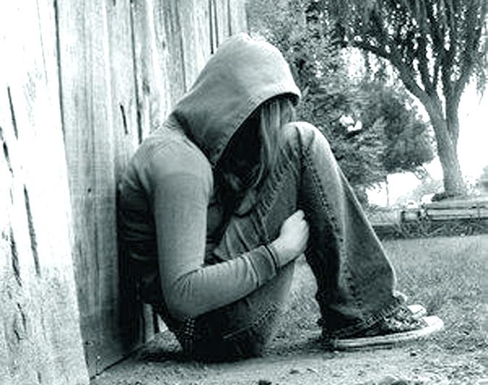
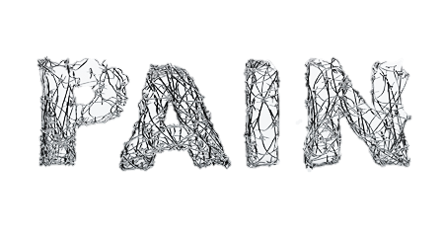
Snapshot of the Crisis for Children with Mental Illness (cont.)
PAIN pain PAIN Pain Pain PAIN pain PAIN Pain Pain
Suicide is the second highest cause of death in youth ages 15-34.
90% of those who died by suicide had an underlying mental illness.
50% of all lifetime cases of mental illness begin by age 14 and 75% by 24.
The average delay between onset of symptoms and intervention is 8-10 years.

Slide 6
Children At Risk
50% of students age 14 and older with a mental illness drop of out high school
70% of youth in state and local juvenile justice systems have a mental illness

Slide 7
Risk Factors for Youth
Family history of mental illness
Stress within family, school, community via poverty, learning disabilities, unsafe home and neighborhoods
Abuse and Neglect
Substance Use/Dependence of youth or family
Loss/family death/ trauma
Every increasing culture of violence ( via video games, TV, social media)
Lack of connection/relationship with families , church, community
Social isolation
Entitlement
Lack of personal responsibility and consequence

Slide 8
Top 10 Myths about Mental Illness
Mental Health problems are uncommon
People with Severe Mental Illness are dangerous and violent
Mental Illnesses are not real medical problems or diseases
People who talk about suicide do not commit suicide
Addiction is a lifestyle choice and shows a lack of willpower. People with substance use problems are morally weak or “bad”
Mental Health Disorders are often lifelong and difficult to treat
Persons with mental illness never recover
Mental health problems are best treated by my primary care physician
Depression is a normal part of the aging process
I can handle my own mental health problems, if I cannot, I am weak

Slide 9
Where Mental Health and the Law Intersect
Anywhere from 7 to 15% of all calls to which the police are called to respond involve someone with a mental illness
The criminal justice and mental health systems know very little about each others profession
CIT ( Crisis Intervention Training) is an effort to bridge that gap

Slide 10
What is Important to Know About Working with Youth in Crisis
Children At Risk
Family history of mental illness
Stress within family, school, community via poverty, learning disabilities, unsafe home and neighborhoods
Abuse and Neglect
Ability to communicate
Individuals with mental illness in crisis need a calm, caring, voice of someone who understands mental illness
A commanding presence will often scare and exacerbate the crisis
The police officer uniform can be very frightening to persons in mental health crisis- gun, handcuffs, etc…
Myths about the police and their role can increase fear & frustration making mental health crisis escalate.
Acts of fear on the part of the client can be mistaken for aggression and escape or disrespect on the part of the officer

Slide 11
Characteristics for CIT officers (cont)
An interest and Compassion for this segment of the population.
specialized and more individualized training
Interest in community partnerships/relationships
A trauma informed care perspective or viewing an individuals behavior
Compassion for the struggles that mental illness brings with it (anxiety, depression , fear, paranoia, delusions)

Slide 12
Differences between Youth & Adults in Crisis
Consider developmental differences-physical, cognitive, emotional
Increased possibility of psychotic behavior with adults
Past experiences/trauma will affect behavior and may youth may be “triggered” by events unfolding
Fear factor- people who are fearful will often behave in ways that they might not otherwise
Children, by nature, are impulsive
It is always helpful to have choice even over the smallest of things

Slide 13
Normal Behavior vs Mental Illness Crisis
Can he link consequences to negative behavior?
Can you follow his line of thinking?
Is he able to stop behaviors long enough to listen?
Does he remember his actions afterwards?

Slide 14
Mental Health Crisis Interventions
Listen- to both what the youth may be saying verbally and non-verbally
Validation and Reflection- validate or reflect what you hear or see them saying without judgement. Validation is an acknowledgement that you are listening and observing. Examples may be as simple as “ “you are really angry right now” “ you seem very sad/scared/angry/frustrated”…. Simply making such reflection statements lets them knows they are being heard and you are paying attention. If you make a statement of validation and they comment ( or scream) that “NO I AM NOT ANGRY” do not argue the point just wait patiently and they will typically continue to yell or express themselves giving you more information such as “Mrs. XXX is a XXXX. “ You can then make a statement such as “ you are really angry with Mrs. XXX”.

Slide 15
The important points to remember about this process is that :
In reflection and validation we are not making judgements, this is not the time for judgement as this will likely escalate the situation.
If the goal is assist the individual in a mental health crisis to gain increased control and maintain their dignity then the listen , reflect, validate method coupled with a comfortableness for silence and support will be most effective.

Slide 16
Mental Health Interventions (cont)
Assess the need- what is it this individual is in need of or trying to communicate to me about their needs? Examples of common needs include: food, water, shelter, sleep, physical comfort, physical touch, attention, self esteem, autonomy/self direction.
Is there a way that you can meet or partially meet the need of the individual?
Be cognizant of the cultural differences that may lead to misinterpretation of a behavior- (ex)lack of eye contact in some cultures is sign of respect , not disrespect.
Be sure to communicate that you are there to help and that you want to help- (ex) I want to help you feel safe.
Many individuals with special needs are triggered simply by environmental factors, it is important to remember that as you encounter a youth in crisis

Slide 17
Examples of environmental triggers
Physical conditions (light, heat/cold crowding, noise)
Chaotic circumstances (screaming, yelling, fighting in environment)
Audience
Particular individuals with whom the youth is upset
Specific spaces – being confined or backed into a room with exit blocked

Slide 18
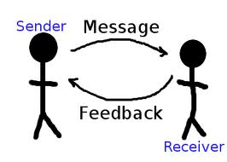
Principles of Crisis Communication
Self control enables critical thinking
Assessment of situation and individual is continuous and comes before any action
You want to always remember to take away energy from a charged situation not contribute energy to it
Communication keeps the door open
Communication should be assertive and clear- simple, short, clear expectations
Patience pays off
Be prepared for the unexpected

Slide 19
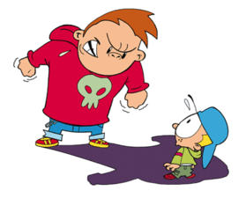
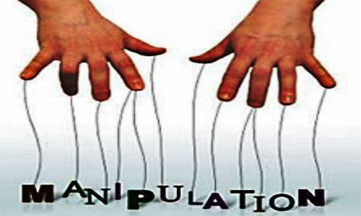
There are 4 basic reasons why people threaten and injure themselves or others
Fear
Frustration
Manipulation
Intimidation

Slide 20
Matching your communication to the motive of youth in crisis
FEAR- an emotional response to a perceived threat (may not be rational) for safety
-your muscles relaxed, open hands in full view
-voice soft and low tones
-brief phrases such as “I want to help” “I want you to feel safe”
-explain any action or steps before you act on them
-do not force eye contact
-remain out of striking range and avoid physical contact

Slide 21
FRUSTRATION- an emotional response to a perception of being out of control
- the goal in working with a youth who is operating of out of frustration is that a demonstration and lending of control in a respectful manner will help restore the internal control of the frustrated youth.
-reflection of what youth is expressing
-validation of their feeling (again this is not saying you agree, it is acknowledging the emotion
-repetitive, clear, action oriented communication “Joe I hear your angry, lets talk about it”
-eye contact focused on youth to whom you are speaking/listening to

Slide 22
MANIPULATION- an indirect attempt to obtain or avoid something
- detach yourself from the manipulation
-clearly and calming state expectation, use “broken record method”
-verbal tones low, monotone
-indirect eye contact, consider looking at the hairline
-remember to avoid a power struggle as youth, be clear about expectations but do not argue or escalate as this will reinforce the belief that the youth may hold regarding this approach will be successful

Slide 23
INTIMIDATION- a calculated effort to get something of desire through use of threat and harm - body posture poised and ready to move quickly, standing -being in a position of greatest defensive advantage -speech is matter of fact, emotionless -communication is clear and direct, statements of consequence, repeated frequently -eye contact used sparingly, used when needed to emphasize statement - communicate consequence as it relates to the immediate threat

Slide 24
Questions
Discussion

