Slide 1
Hospital Procedures

Slide 2
Objectives
List the phone numbers and persons to contact before arrival at the hospital.
Explain where to enter the hospital and take the individual.
Explain the hospital's requirements for paperwork and affidavits.
Explain what information the hospital will release to the officer/deputy/trooper regarding the individual’s discharge and direction to additional community services.

Slide 3
Statute 632.305 section 3
…a peace officer may take a person into custody for detention for evaluation and treatment for a period not to exceed ninety-six hours only when peace officer has reasonable cause to believe that such person is suffering from a mental disorder and that the likelihood of serious harm by such person to himself or others is imminent unless such person is immediately taken into custody. Upon arrival at the mental health facility, the peace officer or mental health coordinator who conveyed such person or caused him to be conveyed shall…complete an application for initial detention for evaluation and treatment for a period not to exceed ninety-six hours which shall be based upon his own personal observation or investigations…

Slide 4
Prior to arrival, Officer will contact the Charge Nurse when a mental health patient is identified as needing Emergency Department care: SSM Lake Saint Louis: 636-625-5300 SSM Wentzville: 636-327-1103 SSM Saint Charles: 636-4423-5703 or 636-947-5111

Slide 5
Upon arrival, Officer is to enter through the EMS/ Ambulance entrance. The Charge Nurse will determine the placement of the patient within the Emergency Department.

Slide 6
Officer will give a verbal report to the Charge Nurse and care will be assumed by Emergency Department staff as quickly as possible.

Slide 7
Officer will complete an affidavit where clinical presentation indicates (ie. for patients expressing suicidal, homicidal ideations and/or intent, or in the case of psychotic symptoms posing a safety risk to the patient or others.)

Slide 8
Affidavit – DMH 142
Begin your affidavits by identifying your relationship to the respondent
An affidavit should address issues of mental disorder or alcohol/drug abuse and likelihood of serious harm
Generally, an affidavit should answer the questions: who, what , when, where, and how
Describe those behaviors and statements which suggest the person may be mentally disordered or an alcohol and/or drug abuser
Describe those behaviors and statements that suggest the person may be harmful to himself or others.
Statement should be concise and to the point

Slide 9
Affidavit – DMH 142
Witnessed behaviors should be included if possible
Peace Officer affidavits are based on the officer’s own personal observations or investigations
Write only on the front of the affidavit form
Affidavits must be notarized
The affidavit becomes part of the court file and medical record which are accessible to the individual if the individual requests to see it. There is no guarantee of confidentiality
Some probate courts may require more than one affidavit in certain situations or may have other or additional requirements

Slide 10
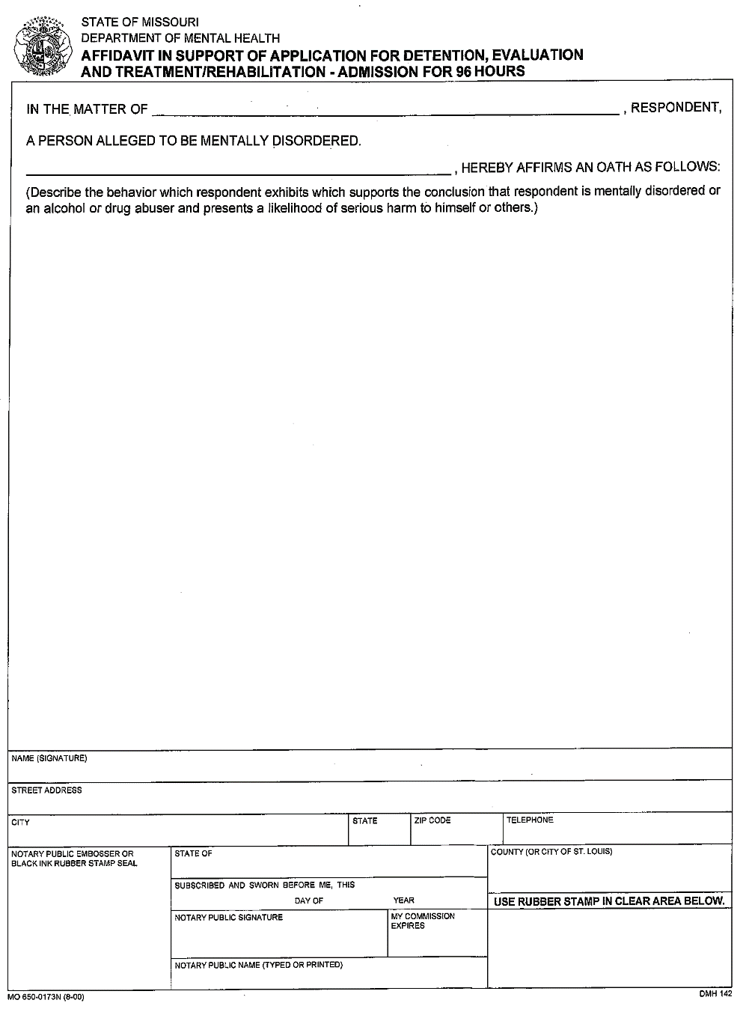
Form dmh 142
Affidavit should describe behaviors which suggest person may be mentally disordered or an alcohol/drug abuser
Affidavit should answer: who, what, when, where and how
Affidavit should describe behaviors that suggest the person may be harmful to self or others.
Must be notarized

Slide 11
Once affidavit is notarized and report is given to the nurse, the officer may return to service.

Slide 12
HIPPA
Health Insurance Portability and Accountability Act (HIPAA) Privacy Rule does not prevent your ability to disclose necessary information about a patient to law enforcement, family members of the patient, or other persons, when you believe the patient presents a serious danger to himself or other people. When a health care provider believes in good faith that such a warning is necessary to prevent or lessen a serious and imminent threat to the health or safety of the patient or others, the Privacy Rule allows the provider, consistent with applicable law and standards of ethical conduct, to alert those persons whom the provider believes are reasonably able to prevent or lessen the threat.

Slide 13
Web Resources
www.dmh.mo.gov
www.cridercenter.org
www.mhagstl.org
www.stl.unitedway.org
www.mentalhealth.org/cmhs
www.nimh.nih.gov
www.nami.org
www.getfit.samhsa.gov
www.befrienders.org/suicide

Slide 14
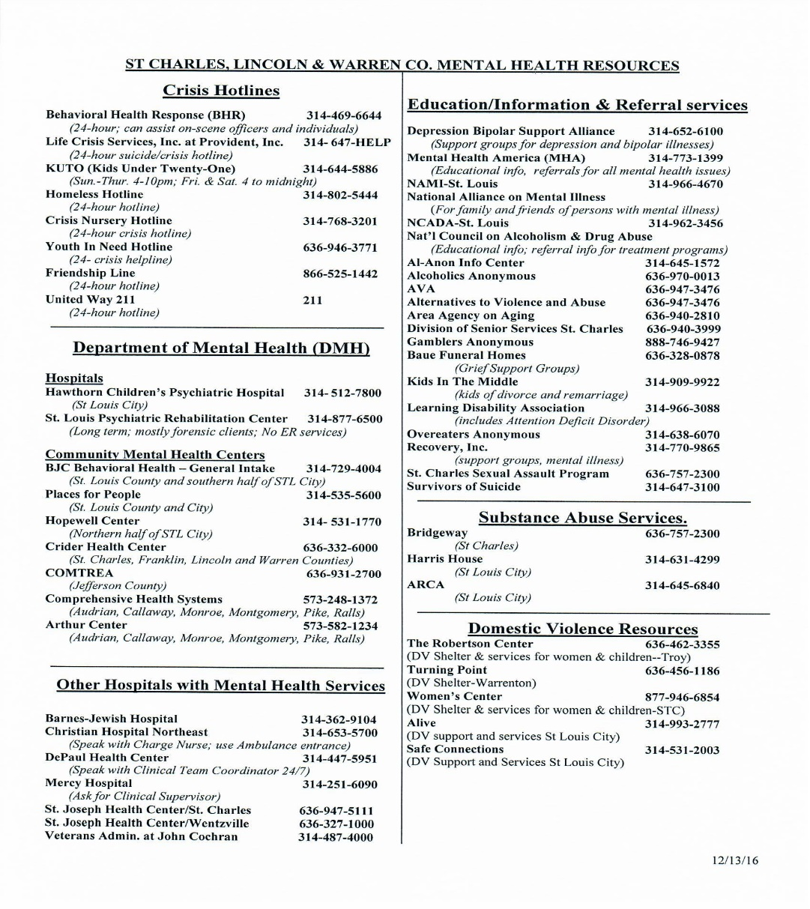
Additional Resources

