Slide 1
Crisis Intervention Team (CIT) Program Overview
Bobby Bollinger
Southeast Law Enforcement Academy
SEMO CIT Council / MO CIT Council

Slide 2
Objectives
Explain the history and objectives of CIT in Memphis and Missouri
Describe CIT as collaboration and an example of a successful community policing program
Describe the benefit of CIT for the officer/deputy/trooper and the community

Slide 3
Objectives
Describe why CIT training is necessary for law enforcement officers
Describe the content of CIT training
Describe the importance of collaboration with mental health agencies
List the benefits of the CIT program for law enforcement and the community
Describe the SEMO Council and it’s members
Pre-Test

Slide 4
Why Do We Need CIT? (We are not Mental Health Professionals. Why is this our problem?)
Deinstitutionalization
Millions of Americans suffer from a mental health or substance use disorder in any given year
We are a 24/7, 365 operation
The mentally ill need to get appropriate care, not warehoused in jails and prisons
Suicide
Notes:
1955 - 560,000 people in public psychiatric hospitals
1963 – Kennedy signs Community Mental Health Act (never adequately funded)
Start opening the doors and letting people out without a plan to provide adequate community based care.
Funding continues to drop until in 2010 43,000 psychiatric beds in U.S. Or 14 per 100,000 (Same ratio as in 1850)
We are back to institutionalizing mentally ill in jails instead of state hospitals.
No place for bad People
Suicide – 10th leading cause of death in U.S. (Homicide 17th) 2nd leading cause of death for 15 to 24 year olds.
What is unique and noble about our profession: We find a way to get the job done.
20 years ago we were behind and deficient. Now the MH system needs to get off their ass and catch up.

Slide 5
What CIT is not!!!!!
Notes:
Nothing about CIT is a replacement for good officer safety tactics
It does not solve everything contrary to what the media would lead us to believe.

Slide 6
What is CIT?
Specialized Training for Patrol Officers and Deputies on mental health and substance use disorders
Recognize mental health and substance use disorders
Work with family and providers to get individual connected with appropriate care
Re-direct consumers from the criminal justice system to mental health and social services
Recruit, Train and Support Law Enforcement Officers
Notes:
DOES NOT MAKE YOU A MENTAL HEALTH PROFESSIONAL
MHFA analogy

Slide 7
Goals of the CIT Program
Reduce injuries to consumers
Reduce Officer injuries and use of force
Reduce amount of Officer time spent on CIT calls
To have 24/7 CIT Officers available

Slide 8
CIT TRAINING 40 HOUR BASIC COURSE
Overview of Mental Illness
Impact of MI on Individuals and Families
Elderly and Mental Illness
Intervention with Children and Teenagers
Medications
Substance Abuse
Cultural Diversity
Developmental Disabilities
Suicide
Hospital Procedures
Community Resources
Communication
Mental Health Law
Mental Health Court
CIT from an officers POV
Panel Discussion
Tactical Planning
CIT Policies
Role Plays
Consumer Involvement

Slide 9
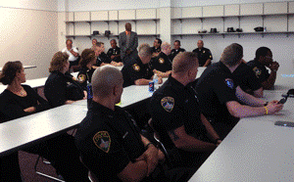
Additional CIT Training
Youth CIT Training
Veterans CIT Training
Dispatcher CIT Training
Advanced CIT Training
Mental Health First Aid

Slide 10
CIT a Collaboration
Advocacy
Families
Consumers
Providers
Law Enforcement
Notes:
Like legs of a table, you need all 4 parts in order to CIT to run smoothly, without them, it will fall. Groups such as MH professionals, MOCIT, partnering Law enforcement, families and the consumers themselves all need to be able to communicate and work together to ensure the continued success of the program. Councils have been developed in areas to aid in problem solving and build relationships.
How to apply this in your department.
To be successful a CIT Program must be more than just training!!!!!!!!!!
Providers - Hospitals, Substance Abuse, Housing, Employment, Community Based Mental Health.
CIT Council Approach

Slide 11
CIT Collaborative Approach
State CIT Council
Meets Bi-Monthly
SEMO CIT Council
Meets Monthly
Notes:
Law Enforcement Led Program
Training Committee – Law Enforcement and Mental Health Professionals
Recruit instructors for training
Evaluate training and make adjustments
Collect data
Coordinating Council - Law Enforcement and Mental Health Professionals Invite Everyone
Hospitals
Community mental health
Housing
Employment
Substance abuse
Advocacy
Law enforcement
Discuss issues
Promote training

Slide 12
Benefits of the CIT Program
Law Enforcement
Community
Increase officer safety
Reduce officer injuries
Extends an officers skills, expertise, and professionalism
Reduces the amount of time spend on CIT calls
Increases moral
Increases communities confidence in law enforcement
Reduces liability
Reduces potential of injury or death to those with mental health and substance use disorders
Reduces the possibility consumer will end up in the criminal justice system
Increases possibility that consumer will get connected to appropriate care

Slide 13
The CIT Officer Response
CIT Officer should respond to any call involving someone in mental health Crisis
Use CIT training to De-escalate the situation
Assess what resources are necessary
Arrange for transportation if necessary
Complete affidavit, CIT Report
Arrest of mentally ill
Follow-up if necessary, referral to CMHL
Notes:
Calls – Mental illness, developmental disability, Alzheimer's, in some cases substance use disorder
De-escalation - Do not every compromise safety
Resource assessment – hospital, community behavioral health, substance use, mobile outreach, housing etc.
Transportation – ambulance, patrol car etc.
Complete Paperwork
Arrest - Let jail know of mental illness, divert to specialty court if possible
Follow up – consistent follow up can lead to someone being successful with treatment

Slide 14
Responsibilities of CIT Officer
Use specialized skills to de-escalate situation and decide the appropriate solution
If hospitalization is necessary, arrange for transportation
If transporting to Justice Center, notify jail staff
Complete CIT report for follow-up
Notes:
Appropriate Solution - Release to family, refer to services, mobile outreach, hospitalization

Slide 15
History of CIT
CIT Memphis 1988
CIT Kansas City
CIT St. Louis
CIT Mid-Missouri
CIT Missouri
Notes:
How can CIT help you department-
Why it came to KC-
In 1998 area LE personnel went to Memphis and were trained in CIT. They returned with the concept of CIT and what training needed to be incorporated in such. The Mid-America CIT Council was formed, professionals in the MH sphere were obtained to assist with this program and the training was developed. Starting In 2000 CIT classes were offered and taught. As the word spread other officers from the Metro KC area began attending. MACIT knew the importance of this program and offered this program to police departments in Kansas and Missouri.
An incident involving a mentally ill individual, in a crisis, was shot and killed by officers from KCPD using the proper use of lethal force. The incident was reviewed and resulted in a decision the officers used lawful force. A civil lawsuit was brought forth by the parents. The parents were understood the need and very supportive of CIT and requested that 25% of KCPD officers be trained in CIT which placed the development of CIT on the “fast track”. Since this time MACIT has continues to offer four Basic CIT Courses a year and have developed CIT training specific to Juveniles, Veterans and Communications Operators and Detention Officers.
MACIT continues to work with other police agencies to share and assist with CIT training.
Why it came to STL-
Major Robert Trittler, St. Louis County PD, was assigned to gather information and begin the process of establishing a program for St. Louis County Officers. Major Trittler and NAMI St. Louis organized the St. Louis Area CIT Council with assistance from many mental health organizations like BHR. Five council members were able to attend a CIT Training in Lees Summit, MO based on the Memphis Model.
In the fall of 2002, committees were developed to organize different aspects of the CIT program. Sgt. Barry Armfield, St. Louis County PD, was assigned to Chair the Training Committee and was given a year or more to create the training program.
In the spring of 2003 an incident involving a mentally ill individual, in a crisis, was shot and killed by officers using the proper use of lethal force by a group of four St. Louis County Officers who responded to the call. The incident was reviewed and resulted in a decision the officers used lawful force. All civil lawsuits were decided in the officer’s favor. This incident put the development of CIT on the “fast track” and in September 2003 a class of 55 St. Louis County Police Officers attended the 40 hour training
In March 2004, Richard Stevenson was assigned as CIT Program Manager by NAMI St. Louis. After recognizing the success of the CIT Program, the training was open to all police officers including those from all departments in St. Louis County. Before being accepted for training, the Chief of Police, had to agree to participating and incorporating to all the concepts of the program in writing.
Effective July 1, 2005, NAMI St. Louis received a 3 year $1.5 Million grant from the Missouri Foundation of Health. This grant created a full time Law Enforcement position and several other programs to assist in CIT. Sgt. Barry Armfield was assigned as the full time CIT Program Coordinator, one of few, if not the only, law enforcement officer position in the nation. After many and maybe most of the 82 police departments in St. Louis County joined the CIT Council and with the measure of the success and with the training provided, filled the training classes to the maximum. St. Louis Metropolitan Police Department joined the CIT Council and in October 2005 provided its first training.
With Richard Stevenson and Sgt. Barry Armfield’s guidance and assistance, CIT Councils were developed; 2007 St. Charles – Warren – and Lincoln Counties, 2011 Jefferson County, 2011 Franklin County. As of January 2015, 88, 40-hour trainings have been provided to more than 3,600 officers. Many more trainings are scheduled. Mental health crisis calls average 300 calls a month for certified CIT Officers who bring help and understanding to those affected and their loved ones.
Why it came to Mid Mo
2000s in Lee’s Summit, and then spread – due to its thriving success in jail diversion, effective mental health referrals, and lower frequency of use-of-force encounters – to the St. Louis area, becoming a quick cornerstone in the bedrock of metropolitan law enforcement in the state. Boone County was next in line to adopt the ideology in 2006, welcomed into the area by a collaborative partnership between Columbia Police Department, Boone County Sheriff’s Department & Jail, University of Missouri Police Department, city and county government and judicial authorities, and (then) Mid-MO Psychiatric Center – now called “MUPC” since the university’s acquisition of the facility and its programs – establishing the governing Mid-Missouri CIT Council. The program has flourished over time into what we see today, and the Missouri CIT (MOCIT Model) program has successfully begun rapid expansion statewide, and regional councils are offering 40-hour basic CIT training progra

Slide 16
Missouri CIT Council (MO CIT)
Missouri Department of Mental Health provides funding for CIT
Notes:
goals
Training for LE and advocacy groups
Expansion of CIT throughout Missouri
Long term Support for the CIT program and growth

Slide 17
Missouri CIT Council –
purpose:
…to form a collaborative effort of law enforcement, mental health professionals, consumers and family members from across the state, committed to helping and serving individuals with mental illness and other brain disorders, by implementing a statewide CIT Program based on the Memphis model.
Notes:
Nationwide
Organized in 1978
Serve seven Missouri counties in St. Louis area.

Slide 18
Who is Part of MO CIT
LE agencies with established CIT Programs
LE agencies working to start CIT Programs
Missouri Department of Mental Health
Hospitals
Community Mental Health Agencies
Missouri Department of Corrections
Missouri Division of Health and Senior Services
National Alliance on Mental Illness (NAMI)
Notes:
Law Enforcement agencies from throughout Missouri with established CIT Programs
Law Enforcement agencies that are actively working to start CIT Programs
Missouri Department of Mental Health
Hospitals
Community Mental Health Agencies
Missouri Department of Corrections
Missouri Division of Health and Senior Services
National Alliance on Mental Illness

Slide 19
Goals of the MO CIT
Support ongoing CIT training from established CIT Programs
Support LE agencies to establish their own CIT Programs
Create a standardized core CIT curriculum that all Missouri will use.
Additional funding to continue to support CIT in Missouri as it expands
Notes:
Support ongoing CIT training from established CIT Programs
Support law enforcement agencies in Missouri to establish their own CIT Programs
Create a standardized core CIT curriculum that all law enforcement agencies in Missouri will use.
Identify and obtain additional funding in order to continue to support CIT in Missouri as it expands

Slide 20
Missouri CIT Council

Slide 21
CIT Expansion Process
Educate an area about the CIT Program
Assist with the establishment of CIT Council and Training Committee
Support new Council with their first 40 hour CIT Training
Assist with the evaluation of CIT training
Provide ongoing technical and financial support

Slide 22
Expansion - Use of Technology
Website/Facebook
Logo/Branding
Online registration
Online data reporting system
www.missouricit.org

Slide 23
Obstacles to Expansion in Rural Areas
Buy in from Law Enforcement and Mental Health Agencies
Traditional Law Enforcement mindset
Lack of resources
Lack of financial support
Development of 40 hour training in 5 day format
Conflict between Law Enforcement agencies
Notes:
Buy in from Law Enforcement and Mental Health Agencies
Traditional Law Enforcement Mindset
(We are not social workers)
Lack of resources
Lack of financial support
Development of 40 hour training
Conflict between Law Enforcement agencies

Slide 24
Present & Future in Missouri
State CIT Coordinator
State Strategic Plan
Standardized Curriculum
State CIT Conference
Missouri CIT Website/Facebook
Statewide CIT Reporting System

Slide 25
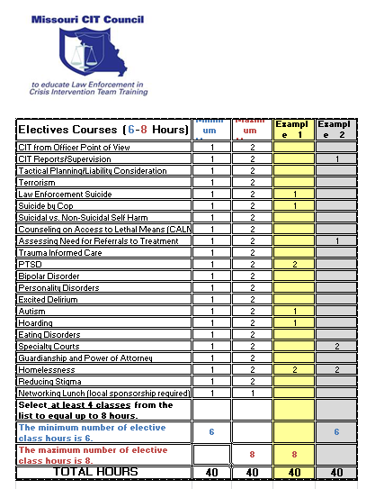
Missouri Curriculum

Slide 26
The Future of CIT in Missouri
Expansion
Funding
Conference
Mobile Training Teams
Notes:
All law enforcement agencies in Missouri have CIT
To do this we will need additional funding
Continue to improve our conference
Mobile Training Units (Illinois)

Slide 27
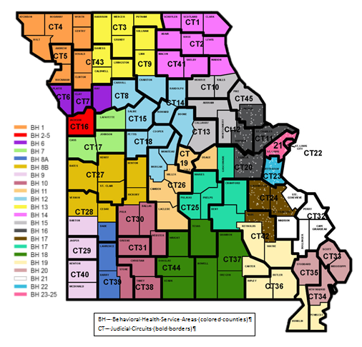
Community Mental Health Liaison (CMHL) Program
CMHLs are statewide
31 Mental Health Professionals
Employed by Community Mental Health Centers (CMHCs)
Post crisis

Slide 28
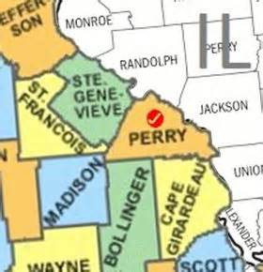
SEMO CIT Council
Organizational meeting in June 2013
Began monthly meetings in July 2014
Recognized as a CIT Council in July 2015
Currently have approximately 50 members attend regular Council meetings
SEMO CIT Council includes Ste. Genevieve, Perry, Madison, Bollinger and Cape Girardeau Counties

Slide 29
SEMO CIT Council Agencies Represented
Community Counseling Center Community Mental Health Liaison Missouri Department of Health and Senior Services Missouri Department of Mental Health Missouri Department of Probation and Parole Perry County Memorial Hospital Ste. Genevieve Memorial Hospital Perry County Ambulance Service Southeast Hospital Veteran's Administration Gibson Recovery Center Perry County Courts/32nd Judicial Circuit

Slide 30
SEMO CIT Council Law Enforcement Agencies
Perry County Sheriff's Office Perryville Police Department Cape Girardeau County Sheriff's Office Cape Girardeau Police Department Jackson Police Department Southeast Missouri University Department of Public Safety Ste. Genevieve County Sheriff's Office Ste. Genevieve Police Department Madison County Sheriff's Office Fredericktown Police Department Bollinger County Sheriff's Office Marble Hill Police Department Missouri State Highway Patrol

Slide 31
WHAT CAN THE COMMUNITY CAN DO TO HELP CIT OFFICERS
IS CIT PART OF YOUR POLICE DEPARTMENT?
ASK FOR A CIT OFFICER
PROVIDE LIST OF MEDICATION AND DOCTORS INFO TO OFFICER
MEET OFFICERS OUTSIDE OR PROVIDE INFO TO DISPATCHERS
KEEP GUNS OUT OF THE HOME OR ADVISE OFFICERS IF GUNS ARE PRESENT
DO NOT INTERFERE WITH THE CIT OFFICER
BE PREPARED TO GO TO THE HOSPITAL IF NECESSARY
INTRODUCE FAMILY MEMBERS TO POLICE WHEN THEY ARE NOT IN CRISIS
REASSURE YOUR FAMILY MEMBER THAT THE POLICE ARE THERE TO HELP
UTILZE RESOURCES IN THE COMMUNITY FOR THE FAMILY

Slide 32
Special Thanks
Sergeant Jeremy Romo, St. Louis County Police Department
Officer Ashley McCunniff, Kansas City Police Department
Audrey Burger, Clinical Operations Director, Community Counseling Center

Slide 33
?? QUESTIONS ??
Bobby Bollinger
Southeast Law Enforcement Academy
SEMO CIT Council / MO CIT Council
Office: 573-290-5110
bbollinger@semo.edu

Slide 34
Lets Get Started
Pre-test
Evaluations

