Slide 1
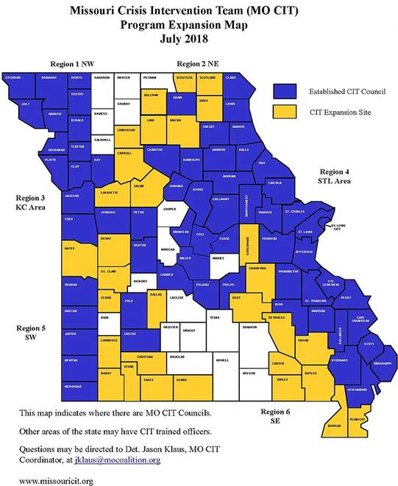
Crisis Intervention Team (CIT) Officers are vital to our communities’ efforts to respond effectively to individuals in a mental health crisis so that they receive appropriate assistance.
CIT program is a model for community policing that brings together law enforcement, mental health providers, hospital emergency departments and individuals with mental illness and their families to improve responses to people in crisis. CIT programs enhance communication, identify mental health resources for assisting people in crisis and ensure that officers receive the training and support to stand ready when the need arises.
This banquet is a celebration of the hard work that has already taken place through CIT and to recognize those officers who are on the front lines every day trying to help our communities be safe.
3rd Annual
Crisis Intervention Team
Officer Appreciation Banquet
Sponsored by
Community Counseling Center
Thursday, August 23, 2018
Robinson Construction Event Hall
2411 Walters Lane
Perryville, MO

Slide 2
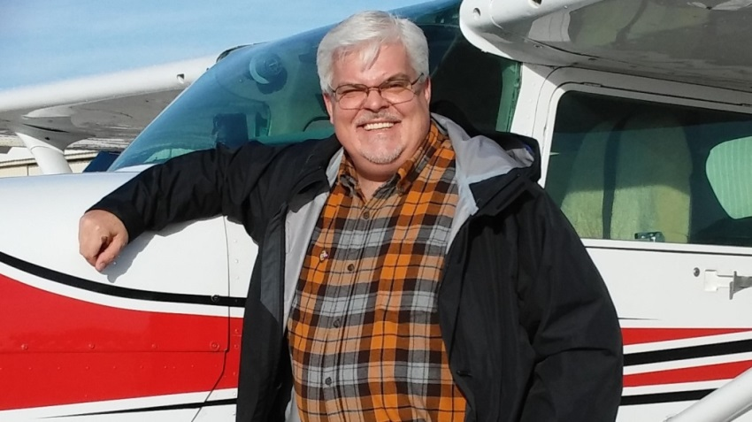
Program
AUDREY BURGER COCKTAIL HOUR
WELCOME . . . . . . . . . . . . . . . Detective Corporal Jason Klaus
MO State CIT Coordinator
PRESENTATION OF COLORS . . . . American Legion Post #133 PLEDGE OF ALLEGIANCE
CCC APPRECIATION . . . . . . . . . . . . . . . . . . . John Hudak, CEO
Community Counseling Center
INVOCATION. . . . . . . . . . . . Honorable Judge Timothy Inman
DINNER
KEYNOTE ADDRESS . . . . . . . Timothy D. Conroy MLSLT, CPS
COUNCIL UPDATE . . . . . . . . . . . . . . . . . . . . . . Bobby Bollinger
Training Coordinator
SEMO Law Enforcement Academy
AWARD PRESENTATIONS
CIT COMMUNITY PARTNER OF THE YEAR
CIT SPIRIT OF CIT AWARDS
CIT OFFICER AWARD OF EXCELLENCE
CIT OFFICER OF THE YEAR
CLOSING REMARKS . . . . . . . . . . . . . Detective Corporal Klaus
CIT OFFICER
APPRECIATION BANQUET
Tim has been a Certified Peer Specialist for 6 years and is now in his second year as a Peer Specialist Trainer for the Missouri Credentialing Board.
He is also involved with the Missouri Crisis Intervention Team (CIT) and sits on the St. Louis City/County CIT Council, the State CIT Council, and the State CIT Working Committee as the State Lived Experience Representative.
He has also helped with officer training in the St. Louis Area for the last 3 years focusing on suicide intervention.
Tim is passionate about Recovery and has devoted his life efforts to helping others find and walk their personal recovery paths.
Tim is also certified in Mental Health First Aid, is a QPR Instructor, and is trained in Trauma Informed Care and Suicide Intervention and Prevention.
Tim has received multiple awards for his work as a Certified Peer Specialist and envisions a collaboration of Law Enforcement, Corrections and Mental Health workers that will allow those with behavioral health disorders to not only integrate with their communities, but be given the opportunity to strive to reach their full potential.
WELCOME
Officer Jason Klaus
PRESENTATION OF COLORS &
PLEDGE OF ALLEGIANCE
American Legion Post # 133 Color Guard
OPENING REMARKS
Honorable Judge Inman
BLESSING & DINNER SERVED
KEY NOTE
Timothy D. Conroy MLSLT, CPS
SOUTHEAST MISSOURI CIT
Audrey Burger, Clinical Operations Director
Community Counseling Center
AWARD PRESENTATIONS
CIT Appreciation Awards
CIT Community Partner of the Year
Spirit of CIT Awards
CIT Officer Award of Excellence
CIT Officer of the Year
CLOSING REMARKS
Officer Jason Klaus
SEMO CIT COUNCIL PARTICIPATING DEPARTMENTS
Cape Girardeau PD ● Cape Girardeau County Sherriff’s Dept ●
Perry County Sherriff’s Dept ● Perryville PD
SEMO CIT COUNCIL REPRESENTED DEPARTMENTS
Bollinger County Sherriff ● Fredericktown PD ● Jackson PD ● Madison County Sherriff’s Dept ● Marble Hill PD ● Southeast Missouri State University DPS ● Ste. Genevieve County Sherriff’s Dept ● Ste. Genevieve PD
SEMO CIT COMMUNITY PARTNER AGENCIES
Community Counseling Center ● Cape Girardeau School District ● Coalition for Heroin & Opioid Prevention ● Community Mental Health Liaison ● Gibson Recovery Center ● Juvenile Office 32th Judicial Circuit ● Missouri Department of Health & Senior Services ● Missouri Department of Mental Health ● Missouri Department of Probation & Parole ● New Life Mission Inn ● New Vision ● Perry County Ambulance Service ● Perry County Associate Circuit Court 32th Judicial Circuit ● Perry County Community Task Force ● Perry County Memorial Hospital ● Regional Family Crisis Center ● Saint Francis Medical Center ● SoutheastHEALTH ● Semo Law Enforcement Academy ● Southeast Prevention Resource Center ● Ste. Genevieve County Memorial Hospital ● Substance Use Disorder Liaison

Slide 3
Law Enforcement Academy
Law Enforcement Academy
Bronze
Back the Blue
Supporters
Friends of Law Enforcement
Bronze
Back the Blue
Supporters
Friends of Law Enforcement
Citizens Electric Corporation
Elk’s Lodge
Simon & Doris Irvin
Perryville Healthcare Corp
Warren & Kendra Skinner
Soto Property Solutions
Mark & Therese Unverferth
Wesbecher Construction Co., Inc.
Equipment Pro Inc.
Perryville Outdoor Products
Regional Family Crisis Center
Richardet Floor Covering Co.
The Webb Law Firm
Citizens Electric Corporation
Elk’s Lodge
Simon & Doris Irvin
Perryville Healthcare Corp
Warren & Kendra Skinner
Soto Property Solutions
Mark & Therese Unverferth
Wesbecher Construction Co., Inc.
Equipment Pro Inc.
Perryville Outdoor Products
Regional Family Crisis Center
Richardet Floor Covering Co.
The Webb Law Firm
Other Supporters
Other Supporters

Slide 4
