Slide 1
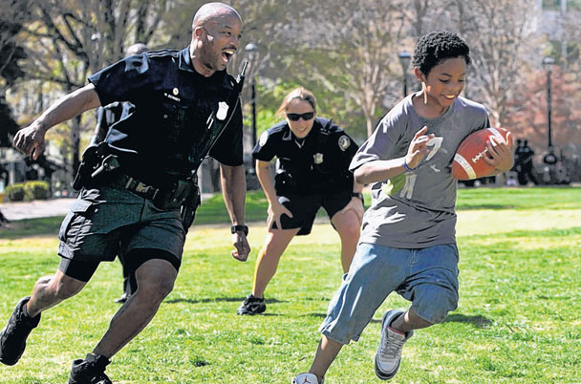
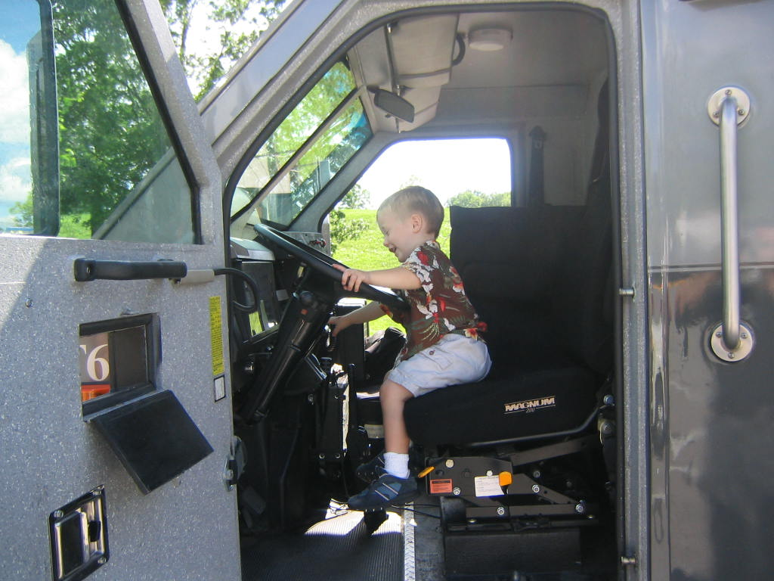
Building Trust and Legitimacy In Diverse Communities
Notes:
Originally looking at creating cultural diversity piece looked at talking about different cultures and groups, but you can never talk about every group
Understand that everyone brings their own experiences both good and bad to your interaction.
LE officers have to appreciate that and consider it.
Morley – South America, Iraq, Mexico.

Slide 2
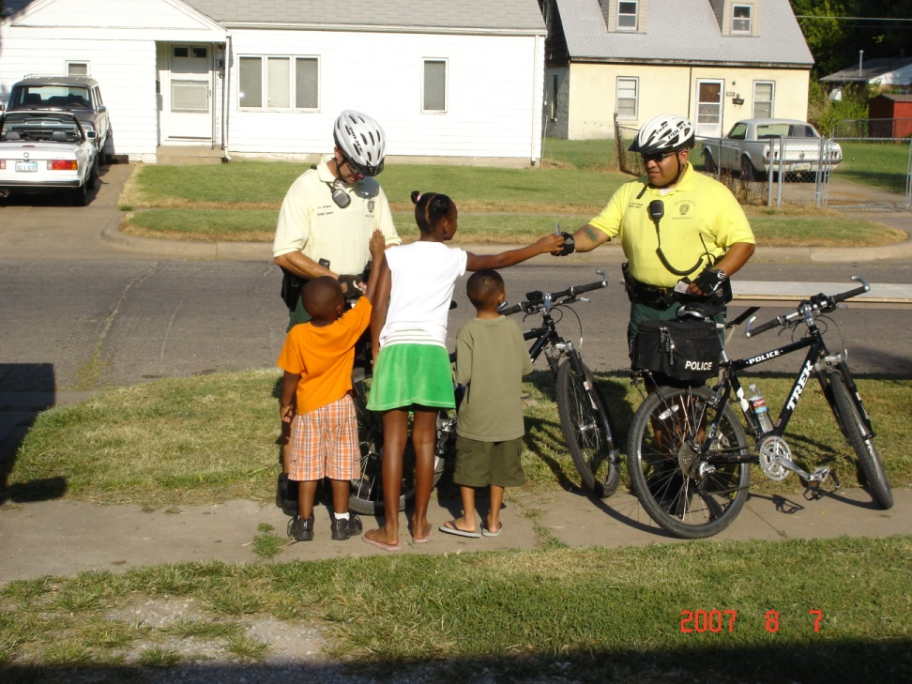
Objectives
Explain the concept of law enforcement legitimacy
Explain how to establish law enforcement legitimacy
Describe how having law enforcement legitimacy in the community contributes to the de-escalation of individuals in mental health crisis
Notes:
Ask about Sir Robert Peel
1829 Metropolitan Police Force in London

Slide 3
Peel’s Principles
The basic mission of the police is to prevent crime and disorder.
The ability of the police to perform their duties is dependant upon public approval of police actions.
Police must secure the willing cooperation of the public in voluntary observance of the law to be able to secure and maintain the respect of the public.
To recognize always that the extent to which the cooperation of the public can be secured diminishes proportionately the necessity of the use of physical force and compulsion for achieving police objectives.

Slide 4
Peel’s Principles
Police seek and preserve public favor not by catering to public opinion but by constantly demonstrating absolute impartial service to the law.
Police use physical force to extent necessary to secure observance of the law or to restore order only the exercise of persuasion, advice, and warning is found to be insufficient.
Police should always direct their action strictly towards their functions and never appear to usurp the powers of the judiciary.

Slide 5
Peel’s Principles
Police, at all times, should maintain a relationship with the public that gives reality to the historic tradition that the police are the public and the public are the police, the police being only members of the public who are paid to give full time attention to duties which are incumbent on every citizen in the interests of community welfare and existence.
The test of police efficiency is the absence of crime and disorder, not the visible evidence of police action in dealing with it.

Slide 6
Law Enforcement Legitimacy
The belief that the police should be allowed to exercise their authority to maintain social order, manage conflicts, and solve problems in their communities
Law enforcement legitimacy comes from:
Public’s trust and confidence in the police
A willingness to defer to the law and police authority
Belief that law enforcement’s actions are morally justified and appropriate to the circumstances
Notes:
Trust and Confidence – police are honest, try to do job well, trying to protect the community
Defer to law and police authority –
Morally justified and appropriate to the circumstances

Slide 7
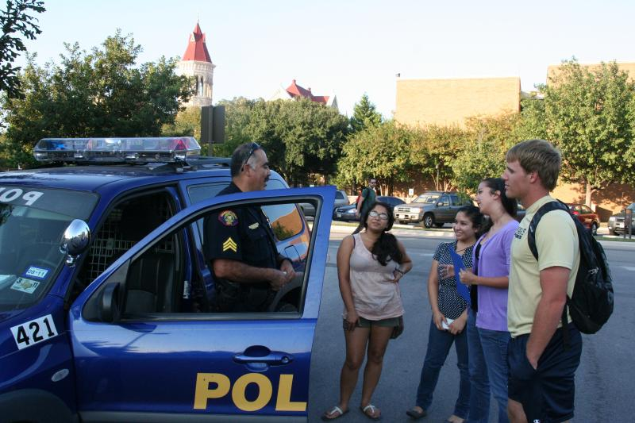
We, as police, should be professional and courteous to a fault.
Notes:
This is much easier said then done in the current climate of our country and the blatant disrespect from the some people in our society towards law enforcement
Helps with complaints
Gates ?Crowley incident

Slide 8
Procedural Justice
A means for law enforcement officer and agencies to gain legitimacy
Give people the opportunity to explain their situation before a decision is made what to do (if safe to do so)
LE Officers decisions based on consistently applied legal principles and the facts of the incident
Treat individuals with dignity and politeness
*Regardless of action taken communicate in a respectful manner why you are taking the action you have chosen
Notes:
Consider situation before writing a ticket. What do we get in return that we cannot hold in our hand.
**People react favorably when they believe the police are sincerely trying to do what is best for the people with whom they are dealing. LISTEN AND EXPLAIN YOUR ACTIONS in a way that shows awareness and sensitivity to the people’s needs and concerns
Letting someone call from the station to family

Slide 9
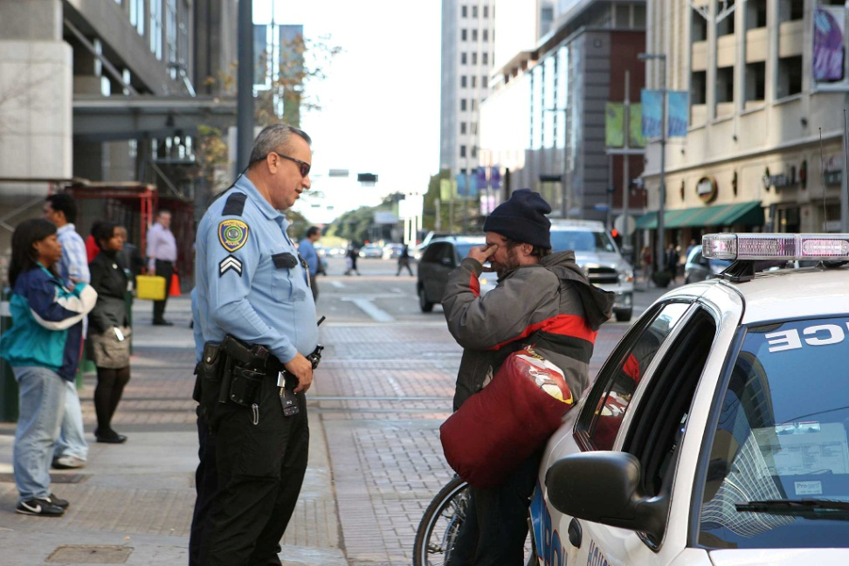
Discretion
It is important to remember that a timely word of advice rather than arrest which may be correct in appropriate circumstances – can be a more effective means of achieving a desired end.
Notes:
Mentally ill person with warrant
Minor offense of shoplifting
Use discretion to get help

Slide 10
A Formula for Gaining Legitimacy
A+B=C
A= Outcome of interaction with the police (e.g., warning, ticket, arrest)
B= The process used by the police during the interaction (e.g., respectful, fair)
C= A community member’s assessment of the officer and the organization

