Slide 1
Substance Abuse/Dependency (Co-Occurring Disorders)
Basic information regarding drugs and the impact
on mental health.

Slide 2
Objectives
Identify the approximate percentage of adult Americans with substance abuse problems.
Recognize that substance use disorders and mental health disorders frequently co-exist.
Recognize the major signs and symptoms of stimulant, depressant, narcotic and hallucinogenic use, acute risks, and after effects.
Define substance abuse and substance dependence
Understand the concept of substance dependence as a brain disease.
Discuss some of the tasks of treatment, and the fears and problems faced by those people struggling with achieving abstinence

Slide 3
Substance Abuse/Dependency
A “chronic, often progressive disease. Left untreated, alcohol and drug addiction can be fatal.”
Alcoholism and drug abuse cause major social, economic and public health problems. Various treatments are available, and self-help groups can provide ongoing support for people recovering from alcoholism and drug addiction.

Slide 4
Prevalence of Substance Abuse
One in 10 adults has a substance abuse problem.
At least 40% of adults with a substance abuse problem also have co-occurring mental health disorder.
Research shows that susceptibility to alcohol dependence can be inherited

Slide 5
Prevalence of Substance Abuse
About 1 in 5 adults lived with an alcoholic while growing up.
More than 20% of deaths are attributable to tobacco, alcohol and other drug use
• Addiction and risky use are causal and contributing factors in more than 70 other conditions requiring medical care and drive a wide range of costly social consequences

Slide 6
RISK FACTORS
Clear Risk Factors*
Genetic predisposition
Structural/functional brain vulnerabilities
Psychological and environmental influences
• 96.5% of cases of addiction start with substance use before age 21 when brain is still developing
*The National Center on Addiction and Substance Abuse at Columbia University.

Slide 7
Initiates of Illicit Drugs

Slide 8
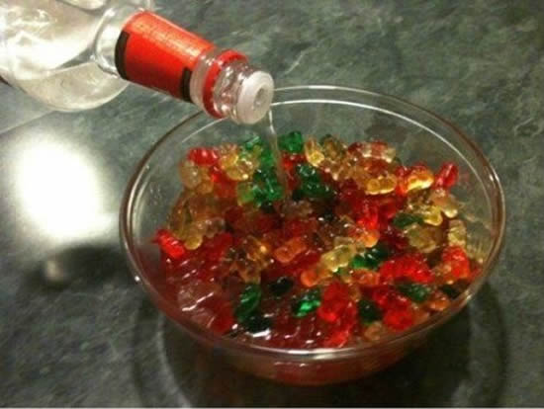
Alcohol-Depressant (beer, wine, hard liquor, craft beers, hand sanitizers, mouthwash)
Physically Addictive
Depressant Intoxicant
Symptoms
Withdrawals
The most common comorbid diseases with alcohol are depression, anxiety, and bipolar.
Drunken Gummies

Slide 9
Alcohol- Depressant
Alcohol-related deaths reached a 35-year high in 2014, when more than 30,700 Americans died from such causes as alcohol poisonings and cirrhosis.
In 2014, more people died from alcohol-induced causes than from overdoses of prescription pain-killers and heroin combined, according to the CDC

Slide 10
Alcohol- Depressant
Effects
Poor judgment, impulsiveness, clumsiness and slowed reflexes, lack of attentiveness and concentration, loss of memory, sedation, slurred speech, confusion, inappropriate emotional responses and behaviors.
Aftereffects and withdrawal symptoms:
Vomiting and Urination indicates toxic level of alcohol.
May include tremors, nervousness, high blood pressure, increased heart rate, irritability, and an inability to sleep.
Physical Dependence
Notes:
physiological adaptions in the central nervous system and the brain due to chronic exposure to a substance. Symptoms which may be experienced during withdrawal or reduction in dosage include increased heart rate and/or blood pressure, sweating, and tremors. More serious withdrawal symptoms such as confusion, seizures, and visual hallucinations indicate a serious emergency

Slide 11
Alcohol- Depressant
Some people may have severe alcohol withdrawal including seizures and delirium tremens, which may lead to death.
This is a medical emergency requiring rapid evaluation.
Alcoholism is a progressive brain disease and left untreated one will die from it.

Slide 12
Benzodiazepine
Physically addictive
Fatal overdoses in addicted patients often involve the combination of benzodiazepines and alcohol, with or without opiates.
Benzodiazepines are widely prescribed, with four of them--alprazolam (Xanax), clonazepam (Klonopin), diazepam (Valium) and lorazepam (Ativan)--listed among the top 100 most commonly prescribed medications.

Slide 13
Benzodiazepines
Gradually become to "need" benzodiazepines to carry out normal, day-to-day activities.
Continued to take benzodiazepines although the original indication for prescription has disappeared.
Contact their doctor regularly to obtain repeat prescriptions.

Slide 14
Benzodiazepines
Become anxious if the next prescription is not readily available
Dosage has increased since the original prescription.
They may have anxiety symptoms, panics, agoraphobia, insomnia, depression and increasing physical symptoms despite continuing to take benzodiazepines

Slide 15
Benzodiazepines
Withdrawal effects from therapeutic dosages of benzodiazepines are mainly anxiety symptoms.
In addition, autonomic instability (i.e., increased heart rate and blood pressure level, tremulousness, diaphoresis), insomnia and sensory hypersensitivity are common.
The most serious acute withdrawal symptoms are seizures and delirium tremens, which most commonly occur with abrupt discontinuation. The time frame for the emergence of acute withdrawal symptoms corresponds to the half-life of the particular agent being used.
Notes:
The higher the dose used, the greater the duration of use, and the earlier age use began are predictive of worsened physical dependence and thus more severe withdrawal syndromes. Acute withdrawal syndromes can last days, weeks or months.
Benzos=High risk for Post Acute Withdrawal Syndrome-a low-grade continuation of some of the symptoms of acute withdrawal, typically in a remitting-relapsing pattern--can last for months, years, or depending on individual factors, indefinitely.

Slide 16
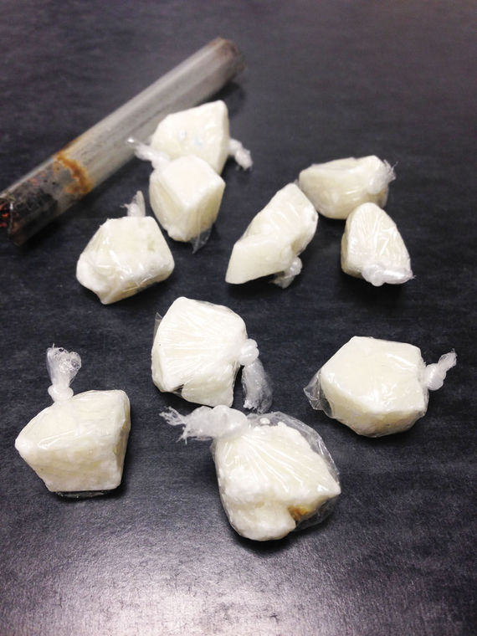
Crack/Cocaine
Stimulant
Psychological addiction
Increased arousal
Depression/Paranoid
Restlessness
Anxiety

Slide 17
Crack/Cocaine
Crack= Cocaine base mixed with Baking Soda and water; may microwave or cook on stove top
Equipment-include any pop cans; antennas; spoon; lightbulb; etc.
Increased alertness, activity, and talking; feelings of euphoria, giddiness, decreased appetite, nervousness, and increased blood pressure; irrational, and physically assaultive

Slide 18
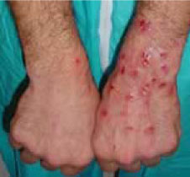
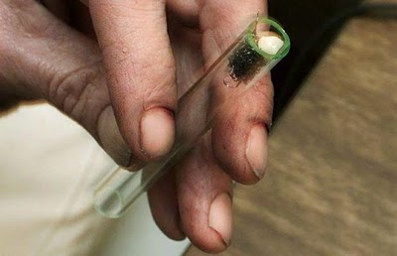
Crack/Cocaine
Withdrawal symptoms of cocaine use include mood swings, depressed feelings, paranoia, suicidal behaviors.
Often mimics that of Bipolar and Major Depression with psychosis and suicidal thoughts.
Tactile Hallucinations most common.

Slide 19
Methamphetamine
Ingredients
ephedrine
vodka
acetone
heet
Coleman fuel
red phosphorus
black iodine
lye
drain-o

Slide 20
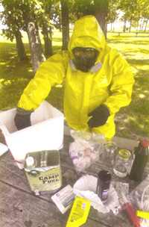
Methamphetamine

Slide 21
Methamphetamine
Stimulant/Desoxyn (ADHD)
When smoked effects instantaneous; 4-8 hours in duration.
Notes:
Desoxyn (Methamphetamin Hydrochloride) is a central nervous system stimulant prescription medicine. It is used for the treatment of Attention-Deficit Hyperactivity Disorder; (ADHD). Desoxyn may help increase attention and decrease impulsiveness and hyperactivity in patients with ADHD.

Slide 22
Effects of Meth Use
Chronic use can lead to what is called 'Amphetamine Psychosis', resulting in paranoia, auditory and visual hallucinations, self-absorption, irritability, aggressive and erratic behavior, and picking at the skin. This can be magnified by lack of sleep which often accompanies heavy use of meth.

Slide 23
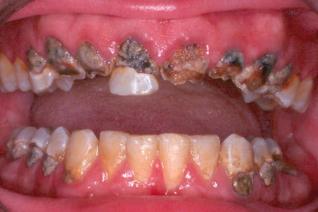
Meth Mouth

Slide 24
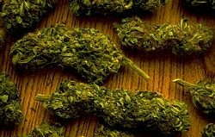
Cannabis
Intoxicant, Stimulant, Hallucinogenic, and Depressant
Effects include:
paranoia, dry mouth, respiratory problems and nervousness/racing heart; reduced ability to concentrate, impaired memory, tiredness, and confusion. Side effects tend to increase with lifetime use; as users age, they often report the anxiety-producing and uncomfortable effects increase and the euphoria decreases.
Withdrawals:
Most people do not experience signs of physical addiction, but with regular daily use, mild to medium withdrawal symptoms usually occur for less than a week, but can extend for as long as 6 weeks.

Slide 25
Cannabis
20 million Americans reportedly used Marijuana in the past year.
Poor cognitive function
IQ declines with long term use
Anxiety, depression, and psychosis
Indica – Relaxing, less psychoactive, lower THC %
Sativa- Energizing, more psychoactive, higher THC%
Notes:
two different species: Cannabis indica and Cannabis sativa
large longitudinal study conducted in New Zealand, which found that frequent and persistent marijuana use starting in adolescence was associated with a loss of an average of 8 IQ points measured in mid-adulthood.²⁶ Significantly, in that study, those who used marijuana heavily as teenagers and quit using as adults did not recover the lost IQ points.

Slide 26
Cannabis
Potency
60s, 70s, 80s 1-2% potency
Now avg THC is 13%
Marijuana oil low 30s
Distillation using butane 80-90% THC

Slide 27
Marijuana Continued
A series of large prospective studies also showed a link between marijuana use and later development of psychosis. This relationship was influenced by genetic variables as well as the amount of drug used and the age at which it was first taken—those who start young are at increased risk for later mental health issues. (schizophrenia).

Slide 28
Brain scan of marijuana user

Slide 29
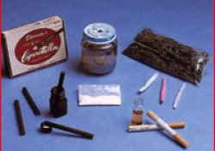
Phencyclidine (PCP)
Psychologically addictive.
Dissociation, perceptual alterations and loss of coordination
Intense hallucinations and delusions
Loss of physical control and coordination
Long-term use has been known to lead to schizophrenia-like psychotic episodes, severe lasting memory loss, disorganized thinking, depression, weight loss, liver abnormalities and rhabdomyolysis (skeletal muscle breakdown).
Sernyl- Prescription Med from the 50s
Notes:
Sernyl=phencyclidine= a central nervous system depressant, introduced as an anesthetic in the early 1950s but later abandoned because of unpredictable side effects such as agitation, disorientation, and hallucination. The drug is easily synthesized by anyone with a basic knowledge of chemistry and has become one of the drugs most frequently used by drug abusers.

Slide 30
Water/Wet
Formaldehyde, “Embalming Fluid”, or PCP?
Most recently became confused when using the term “embalming fluid”
Formaldehyde does not contain PCP-two different substances.
New Trend-mixing PCP with formaldehyde.
“Sticks”, “Sherm”, “Water” or “Wet” may be street terms for marijuana or tobacco cigarettes that are dipped in PCP (phencyclidine) and/or embalming fluid, and then dried.
Notes:
“Embalming fluid” is a compound of formaldehyde, methanol, ethanol (ethyl alcohol), and other solvents. Embalming fluid reportedly produces a hallucinogenic effect and causes the cigarette to burn more slowly, potentially resulting in a prolonged high.

Slide 31
Hallucinogenics
LSD, Mescaline, M-Bombs (synthetic)
Effects:
Produces dream-like states, sense of unreality, spiritual experiences, distortion of body image and loss of body boundaries, disorganized thinking, loneliness, isolation, negativism, agitation, hostility, may progress to catatonia or psychosis.
Delusional thought content.
Increase body temperatures (can be deadly)
Notes:
The recreational use of synthetic (designer) psychoactive substances with stimulant, euphoric, and/or hallucinogenic properties has risen dramatically in recent years." M-Bomb or N-Bomb, also marketed as “legal” or “natural” LSD, is a relatively new synthetic drug
D-lysergic acid diethylamide (LSD) is one of the most powerful mood-changing chemicals. It is a clear or white odorless material made from lysergic acid, which is found in a fungus that grows on rye and other grains. LSD has many other names, including Acid, Blotter, Dots, and Yellow Sunshine.
Peyote (mescaline) is a small, spineless cactus with mescaline as its main ingredient. Peyote can also be synthetic. Buttons, Cactus, and Mesc are common names for peyote.

Slide 32
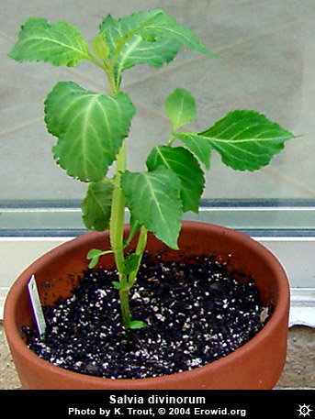
Designer Drugs
Salvia
Overly-intense experiences
Fear, terror and panic
Increased perspiration
Possible difficulty integrating experiences
Higher doses can cause inability to control
muscles and maintain balance: falls are reported.
Mild to moderate headache, usually starts after effects wear off
Smoked-Total Duration 20 - 45 mins; may also be consumed, or brewed in a tea
Notes:
Salvia divinorum (salvia) is a plant common to southern Mexico and Central and South America. Other names for salvia are Diviner's Sage, Maria Pastora, Sally-D, and Magic Mint.
Hallucinogen

Slide 33
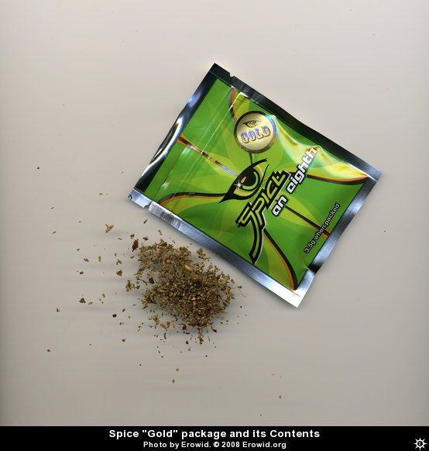
K2/K3
“Spice" is a product line sold as a legal herb-based
alternative to cannabis. The ingredients list
contains only herbs and no cannabinoid constituents.
Testing has shown three chemicals identified in
various Spice products including
JWH-018, HU-210, and a homologue of CP-47,497.
1990s, J.W. Huffman et al. at Clemson University, USA created a large series of naphthoylindoles, naphthylmethylindoles, naphthoylpyrroles, naphthylmethylindenes and phenylacetylindoles (i.e. benzoylindoles) (known as aminoalkylindoles or JWH compounds — after the name of their inventor).
Notes:
There are over 700 “Synthetic cannabinoids”. They happen to fit into the same receptors that THC latches onto in the brain, so they can have an effect similar to THC. However, some synthetic cannabinoids are 100X stronger than THC and many operate on other brain receptors, too.
Many of the chemicals are produced in cheap basement labs in China or Russia.

Slide 34
K2/K3- Effects
increased heart rate,
high blood pressure;
pale skin;
vomiting,
change in body temperature,
paranoia,
psychotic behavior and
even loss of consciousness.
Notes:
Freqently end up in the ER

Slide 35
Bath Salts/Plant Food
Akin to synthetic cocaine or methamphetamine – and very dangerous.
Contains one or more synthetic chemicals related to cathinone, amphetamine like (stimulant found naturally in the Khat plant).
Cause increased blood pressure, increased heart rate, agitation, hallucinations, extreme paranoia and delusions.
Bath salts’ contain powerful stimulants methedrone and methylenedioxypyrovalerone, also called MDPV, and there have been scattered reports across the country of drug-induced deaths accidental overdose or suicide.
Notes:
Khat—plant from africa, natural stimulant, chewed

Slide 36
Bath Salts- Effects
Tightened jaw muscles, grinding teeth (trismus and bruxia)
Euphoria, increased sex drive, experience paranoia, agitation, hallucinatory delirium.
Some even display psychotic and violent behavior, and death.
Involuntary body movements (twitching, lip-smacking, etc.)
Confusion and/or scrambled thoughts
Gastrointestinal disturbance

Slide 37
Bath Salts- Effects
Muscle tension
Nystagmus / eye spasm
Anxiousness / nervousness
Fiending (re-dosing repeatedly without planning to do so)
Excessive excitation / hyperactivity
Headache
Very elevated heart rate

Slide 38
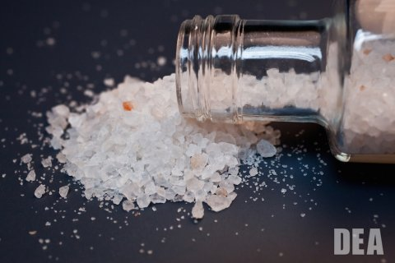
Flakka-Gravel
Alpha PVP chemical – chemical cousin of cathinone (native to Khat plant)
Increases dopamine (feel good chemical) and norepinephrine (raises heart rate and blood pressure)
Effect
Extreme anxiety
Paranoia and hallucinations
Violent episodes
High body temperatures
Can be smoked, vaped, snorted, injected
Notes:
"Flakka," is surging in Florida and is also being reported in other parts of the country, according to news reports.
Chemically similar to other synthetic cathinone drugs popularly called "bath salts," and takes the form of a white or pink, foul-smelling crystal
Like other drugs of this type, alpha-PVP can cause a condition called "excited delirium" that involves hyperstimulation, paranoia, and hallucinations that can lead to violent aggression and self-injury. The drug has been linked to deaths by suicide as well as heart attack. It can also dangerously raise body temperature and lead to kidney damage or kidney failure.

Slide 39
Narcotics
Heroin, Codeine, Morphine, Opium, Methadone.
In recent years Local High Schools have an increasing rate of heroin use.
Prescription Narcotics:
Oxycodone (OxyContin®)
Oxymorphone (Opana®)
Propoxyphene (Darvon®)
Hydromorphone (Dilaudid®)
Hydrocodone (Vicodin®)

Slide 40
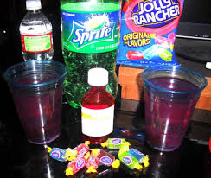
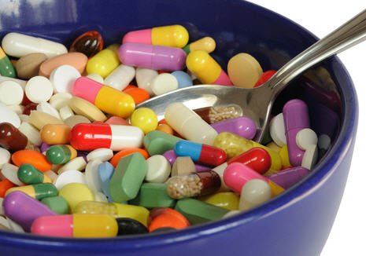
Narcotics
Purple Drank/Lean/Sizzurp
Promethazine/Codeine cough syrup
Jolly ranchers/Soda
Cough Syrup
Parents, Grandparents medications
Pharming Parties, Pill Parties

Slide 41
Heroin
Heroin is a powerful opiate pain-killer :
Produces euphoria and blissful apathy. It is known for leading to addiction and difficult physical withdrawal symptoms. It is a Euphoric Depressant and Analgesic (pain killer)
Possible effects:
Feelings of euphoria and well-being, relaxation, sedation, and analgesia.
Negative effects:
Nausea or vomiting (sometimes severe), constipation, dizziness, and blackout.
Withdrawal:
Extremely unpleasant symptoms such as nausea, vomiting, insomnia, diarrhea, and sweating.

Slide 42
Heroin
Prescription medications (narcotics) most often the first narcotic prior to Heroin.
Athletes, chronic pain, surgeries, etc.
Black Tar Heroin is prevalent
Brought in by Mexican Cartel
In Ohio 1 person dies every four hours from a Heroin overdose.
Naloxone (generic for Narcan) is being provided to several community providers to reverse the heroin overdose.
Notes:
Narcan Nasal Spray is indicated for the emergency treatment of known or suspected opioid overdose, as manifested by respiratory and/or central nervous system depression.

Slide 43
Heroin
Between 2000 and 2010, heroin-related deaths rose at an average rate of 6 percent per year in the U.S. Then, from 2010 to 2013, the average annual increase suddenly jumped to 37 percent.
According to CDC Director Dr. Thomas Frieden, opioid painkillers like Vicodin, Oxy-Contin, and Percocet increase your susceptibility to heroin addiction, and the report found that the vast majority — 75 percent — of heroin users started out on prescription painkillers.

Slide 44
Narcotics

Slide 45
Ecstasy
Psychedelic amphetamine
Psychologically addictive
Cuddle puddles
Increased senses/release of emotions
Appetite loss
Body temp. increases/vomiting/jaw-clenching/dizzy
Depression/psychotic episodes/panic attacks.

Slide 46
Ecstasy (MDMA)
Effects - Feelings of warmth, openness, and relatedness with others, increased sensual experience, marked time distortion, decrease in task-oriented or cognitive behaviors.
Usually do not display aggression or hostility
Release hormones oxytocin and vasopressin, which play important roles in love, trust, sexual arousal, and other social experiences.

Slide 47
Ecstasy (MDMA)
Aftereffects - Hang-over: fatigue, lethargy, loss of interest and appetite, increased sleeping, depression, anxiety
Occasionally may cause severe psychiatric illness in predisposed people.
No known withdrawal pattern
It is currently in clinical trials as a possible pharmacotherapy aid to treat post-traumatic stress disorder (PTSD) and anxiety in terminal cancer patients.

Slide 48
GHB
Date Rape drug
Relaxation/sleep
Temporary non-arousal sleep.
Peak one to two hours

Slide 49
Ketamine
Dissociative anesthetic
Veterinary medicine
Extreme difficulty moving; erotic feelings; classic NDE.
Black outs
“Special K”

Slide 50
Inhalants
Paint; glue; gas; white-out; duster, butane
Symptoms
Withdrawals
Notes:
Repeated inhalant abuse may result in symptoms such as: loss of inhibitions. lack of control. periods of drowsy feelings that last several hours. lingering headache. confusion. nausea. Vomiting
Inhalants can be physically and psychologically addictive. Users report a strong urge to continue using inhalants, especially after continued usage over many days.
Habitual users coming off inhalants suffer withdrawal symptoms which can include nausea, excessive sweating, muscle cramps, headaches, chills, agitation, with shaking and hallucinations. In severe cases, withdrawal can cause convulsions.

Slide 51
Substance Abuse to Dependency
Stage One - Experimenting
Stage Two - Seeking a Mood Swing
Stage Three - Preoccupation
Stage Four - Powerlessness/ Addiction

Slide 52
Substance Dependency
Definition - Substance dependence is a brain disease that is expressed behaviorally in a social context. The most obvious symptom of dependence or addiction is loss of control. The most common behavior in addiction is that once an addict starts using, they can’t consistently stop

Slide 53
Addiction Results in Brain Damage
Drug dependence does cause long lasting and sometimes permanent changes in brain functioning. However, most persons are able to repair the damage that has occurred to their brain if they stop using and begin living a healthier life.

