Slide 1
Person in crisis, no beds…now what?
jeanette M Simmons, psyd
Director of forensic services
Missouri department of mental health

Slide 2
Objectives
1) Participants will gain knowledge about the mental health resources available in Missouri
2) Participants will gain knowledge about how to access available mental health resources
3) Participants will gain knowledge about development and utilization of mental health resources

Slide 3


Slide 4
Mental Health Resources
Inpatient
  State
  Private
Outpatient
  Community Mental Health Centers
  Other Community Mental Health Treatment Providers

Slide 5
Department of mental health
DIVISION OF BEHAVIORAL HEALTH-State Operated Facilities
  858 adult beds; 582 minimum security* & 276 high security**
    Southeast Missouri Mental Health Center*
    St Louis Psychiatric Rehabilitation Center*
    Metropolitan Psychiatric Rehabilitation Center*
    Fulton State Hospital* **
    Center for Behavioral Medicine*
    Northwest Missouri Psychiatric Rehabilitation Center*
  28 youth beds
    Hawthorn Children’s Psychiatric Hospital

Slide 6
Department of mental health
DIVISION OF BEHAVIORAL HEALTH-State Operated Facilities
  POPULATION SERVED
    Chapter 552 RSMo.
      Pretrial Evaluations
      IST Commitment
      NGRI

Slide 7
Department of mental health
DIVISION OF BEHAVIORAL HEALTH-State Operated Facilities
  POPULATION SERVED (Chapter 552 RSMo.)
    Pretrial Evaluations
      Assigned based upon catchment area
      Outpatient Examination
      Completed report filed with Court
Notes:
18 Certified Forensic Examiners in Missouri—Psychiatrist or Psychologist trained in forensic evaluation

Slide 8
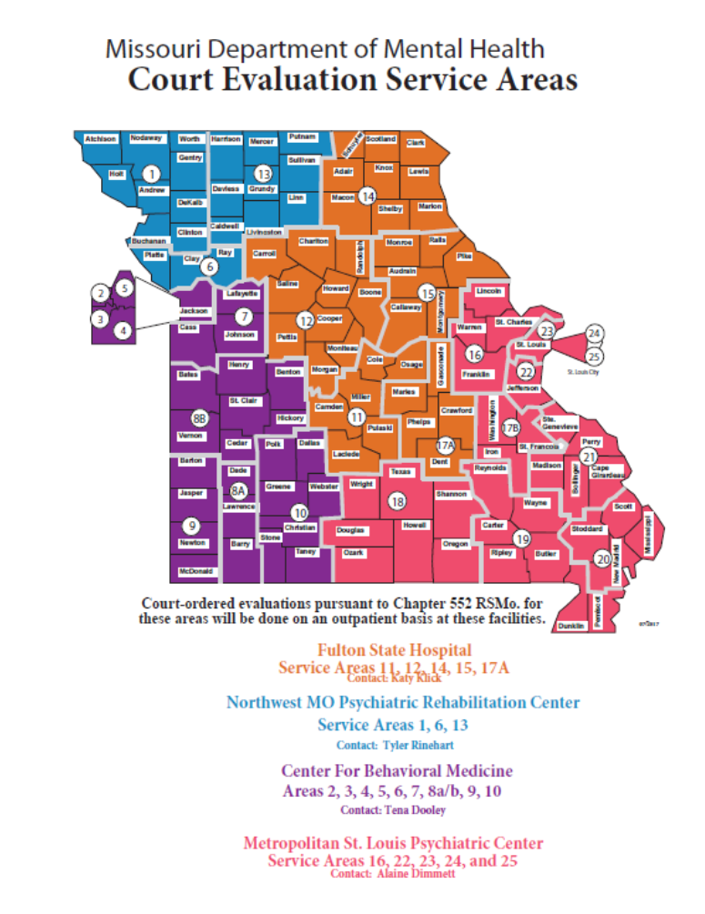
Notes:
Discuss # of examiners in each region—amount of referrals each year (and how they are increasing)

Slide 9
Department of mental health
DIVISION OF BEHAVIORAL HEALTH-State Operated Facilities
  Pretrial Evaluation Chapter 552 RSMo.
    An opinion as to whether the accused has a mental disease or defect
    An opinion based upon a reasonable degree of medical or psychological certainty as to whether the accused, as a result of a mental disease or defect, lacks capacity to understand the proceedings against him or to assist in his own defense
    An opinion as to whether the accused, at the time of the alleged criminal conduct, the Defendant, as a result of mental disease or defect, was incapable of knowing and appreciating the nature, quality, or wrongfulness of such person's conduct
Notes:
Two things:
Mental Disease or Defect—legal term: congenital and traumatic mental conditions as well as disease. They do not include an abnormality manifested only by repeated criminal or otherwise antisocial conduct, whether or not such abnormality may be included under mental illness, mental disease or defect in some classifications of mental abnormality or disorder. The terms "mental disease or defect" do not include alcoholism without psychosis or drug abuse without psychosis or an abnormality manifested only by criminal sexual psychopathy as defined in section 202.700, nor shall anything in this chapter be construed to repeal or modify the provisions of sections 202.700 to 202.770.
Just because you have a mental illness or an intellectual disability DOES NOT mean you have a mental disease or defect
You must be competent to plea NGRI
NGRI is an indefinite commitment to the DMH

Slide 10
Department of mental health
DIVISION OF BEHAVIORAL HEALTH-State Operated Facilities
  POPULATION SERVED Chapter 552 RSMo.--Commitments
    IST (Incompetent to Stand Trial/Incompetent to Proceed)
    NGRI (Not Guilty by Reason of Mental Disease or Defect/Insanity)
  Admission based upon offense & catchment area

Slide 13
Department of mental health
DIVISION OF BEHAVIORAL HEALTH-State Operated Facilities
  Chapter 552 RSMo.—IST/NGRI
  IST:
    Provide necessary treatment including education regarding legal proceedings and charges; return to jail/bond & proceed with legal proceedings
  NGRI:
    Provide necessary treatment with goal of returning to community
Notes:
Goal for both populations: RETURN TO THE COMMUNITY

Slide 14

“You’re gonna need a bigger boat”
Notes:
Admissions are triaged—there are 60+ awaiting beds…example of those waiting and who gets the bed: eating own feces VS pancakes and syrup on head

Slide 15
Acute psychiatric hospitals
Privately Operated Facilities
  Facilities that are recognized by the Department of Mental Health to provide civil involuntary detention services have mental health professionals who are designated and approved to initiate on-site civil involuntary detention for individuals in need of emergency evaluation and treatment.
    50 Facilities (excludes 5 Veterans Facilities)
      1965 Beds
        5 Geriatric Only
        2 Child/Adolescent Only

Slide 16
Acute psychiatric hospitals
POPULATION SERVED
  Children/Adolescents
  Adults
    Civil Involuntary Commitment (Section 632.005 RSMo.; Section 632.300-632.455 RSMo.)
      aka: 96-hour hold
        Probate Court Commitment
        Imminent Harm Commitment
      Facility shall evaluate the person and admit or release the person according to statute
Notes:
Probate Court:
Commitment can be sought by filing the proper application in the probate court. This application can be filed by any adult person. The probate Judge will review the application and if the Judge finds probable cause to order the commitment, the Judge will order a Peace Officer to take the person into custody and transport the person to a recognized facility.
Imminent Harm:
For a person in the community who presents an imminent likelihood of serious harm due to a mental disorder or alcohol or drug abuse unless the person is immediately taken into custody, a Peace Officer may complete an application for imminent harm, take the person into custody and transport the person to a recognized facility.

Slide 17
Acute psychiatric hospitals
Section 630.005 (22) RSMo.
Mental Disorder
  any organic, mental or emotional impairment which has substantial adverse effects on a person's cognitive, volitional or emotional function and which constitutes a substantial impairment in a person's ability to participate in activities of normal living

Slide 18
Acute psychiatric hospitals
Section 630.005 (10) RSMo.
Likelihood of Serious Harm: means any one or more of the following but does not require actual physical injury to have occurred:
  (a) A substantial risk that serious physical harm will be inflicted by a person upon his own person, as evidenced by recent threats, including verbal threats, or attempts to commit suicide or inflict physical harm on himself. Evidence of substantial risk may also include information about patterns of behavior that historically have resulted in serious harm previously being inflicted by a person upon himself

Slide 19
Acute psychiatric hospitals
Likelihood of Serious Harm (con’t)
  (b) A substantial risk that serious physical harm to a person will result or is occurring because of an impairment in his capacity to make decisions with respect to his hospitalization and need for treatment as evidenced by his current mental disorder or mental illness which results in an inability to provide for his own basic necessities of food, clothing, shelter, safety or medical care or his inability to provide for his own mental health care which may result in a substantial risk of serious physical harm. Evidence of that substantial risk may also include information about patterns of behavior that historically have resulted in serious harm to the person previously taking place because of a mental disorder or mental illness which resulted in his inability to provide for his basic necessities of food, clothing, shelter, safety or medical or mental health care

Slide 20
Acute psychiatric hospitals
Likelihood of Serious Harm (con’t)
  (c) A substantial risk that serious physical harm will be inflicted by a person upon another as evidenced by recent overt acts, behavior or threats, including verbal threats, which have caused such harm or which would place a reasonable person in reasonable fear of sustaining such harm. Evidence of that substantial risk may also include information about patterns of behavior that historically have resulted in physical harm previously being inflicted by a person upon another person

Slide 21

Notes:
If hospitalized—96-hours (not including weekends or holidays)
Remember the goal for 96…no longer meet criteria for “likelihood of serious harm” NOT complete stabilization
statute allows for applications for 21-day & 90-day—not frequently granted
Calm before the storm…hospitalization is only a small part of the bigger treatment picture
The goal for all inpatient clients=return to the community

Slide 22
Department of mental health
DIVISION OF BEHAVIORAL HEALTH—Community Mental Health Centers
  29 Providers/Affiliates
  https://dmh.mo.gov/mentalillness/helpinfo/county.html#1
    103,873 clients served

Slide 24
Department of mental health
DIVISION OF BEHAVIORAL HEALTH—Community Mental Health Centers
  Children's Programs and Services
    Intensive Community Psychiatric Rehabilitation
    Treatment Family Home
    Professional Parent Home
    Respite
    Family Support & Assistance
    Community Support

Slide 25
Department of mental health
DIVISION OF BEHAVIORAL HEALTH—Community Mental Health Centers
  Targeted Case Management
    Assist individuals in obtaining psychiatric, medical, social, and educational services
  Community Psychiatric Rehabilitation (CPR)
    Flexible community-based services and supports
    Uses existing community resources and natural support systems
    Promotes independence and the pursuit of meaningful living
  Residential Services
    Housing alternatives: Residential Care Facility (RCF), Intensive Residential Treatment Services (IRTS), Clustered Apartments, Semi-Independent Apartments

Slide 26


“Locked” behavioral units not always the best option
Notes:
“Locked” behavioral units …Many/most such units are located in SNF—not designed for clients without medical conditions
For many, these units are not appropriate…and are not “secure” in the sense that we think…key pads (codes known to residents), no fencing, etc. We know that many/most clients can be supported in the community and will have better outcomes if these services/supports are provided in the least restrictive setting.

Slide 27
Department of mental health
DIVISION OF BEHAVIORAL HEALTH—Community Mental Health Centers
  Assertive Community Treatment (ACT)
    Serious & Persistent Mental Illness
    24/7; 365
    Teams trained in : Psychiatry, social work, nursing, substance use disorders, and supported employment
  https://dmh.mo.gov/mentalillness/provider/documents/missouriactteams.pdf

Slide 28
Department of mental health
DIVISION OF BEHAVIORAL HEALTH—Community Mental Health Centers
  Disease Management (DM) 3700
    18 years +
    Medicaid eligibility
    Diagnosis of SMI or SUD: schizophrenia, schizoaffective disorder, bipolar disorder, major depressive disorder; alcohol, opioid, sedative hypnotics/anxiolytics, stimulant, cannabis, hallucinogen; other (unknown)
    Not currently being served
    High ($20K or more) Medicaid pharmacy & medical cost
Notes:
The project targets Medicaid-eligible adults with high medical costs who have a serious mental illness or substance use disorder and who are not currently receiving behavioral health services. The goal is to locate and enroll these individuals in services, who frequently have impactful chronic medical conditions, in order to improve health outcomes and reduce related medical costs.

Slide 29
Department of mental health
DIVISION OF BEHAVIORAL HEALTH—Community Mental Health Centers
  Emergency Room Enhancement (ERE)
    Developed to target individuals seeking help for behavioral health concerns in hospital emergency departments (EDs)
    The primary goals: prevent repeated ED visits and hospitalizations and decrease rates of homelessness, unemployment and arrests/law enforcement involvement
  13 Regions
    80 of Missouri’s 114 counties
    Partnered with local hospitals, community mental health centers, law enforcement agencies, substance use treatment facilities, and social service providers

Slide 30
Department of mental health
DIVISION OF BEHAVIORAL HEALTH—Community Mental Health Centers
  Community Mental Health Liaisons
    Community Mental Health Centers, Law Enforcement, and Courts
    Improve access to Behavioral Health Treatment
    Avoid jail/prison and/or hospitalization
    Follow-up to track progress and ensure success
Notes:
31 across the state

Slide 31
Mental health 2.0
Mental Health Courts
  Clients on Bond/Supervision
  Treatment Requirements
DMH-Center for Behavioral Medicine (CBM) & Jackson County
  Outpatient Competency Restoration
    On Bond but “Committed”
      Conditions for Participation
    Community Treatment Services
Notes:
Slow start…5 currently, two CST after six months

Slide 32
Mental health 2.0
Kansas City Assessment & Triage Center (KC-ATC)
  Public and private partnership between Kansas City stakeholders (Courts, Law Enforcement, Hospitals, City Officials, & DMH)
  Multi-disciplinary team that includes registered nurses, case workers, mental health technicians, licensed social workers and nurse practitioners
  Divert persons with mental health and substance use disorders away from jails and area emergency rooms to a safe place where they can be assessed and stabilized
  If needed, referred to behavioral health outpatient or residential services for treatment
Notes:
St Louis is also looking at developing 2 similar sites in their area

Slide 33
Mental health 2.0
Kansas City Assessment & Triage Center (KC-ATC)
  Persons Served:
    18 years and older
    Referred Kansas City Police Department or approved area hospital ED
    No walk-ins are accepted
  Immediate triage by a nurse and licensed team leader
    Comprehensive mental health assessment
    Shower, change of clothes and a meal
  Clients stabilize for up to 23 hours in an observation room where they engage with a licensed social worker and case manager to determine a successful discharge plan

Slide 34
Mental health 2.0
Kansas City Assessment & Triage Center (KC-ATC)
  Discharge
    Linkage back to home/family or friends
    Follow-up with a behavioral health provider and/or support services
    Bridge case management/medications
    Emergency housing until permanent housing is available
    Attend all scheduled court hearings, court monitoring and treatment appointments as directed
    Collaborative development of a crisis plan

Slide 35
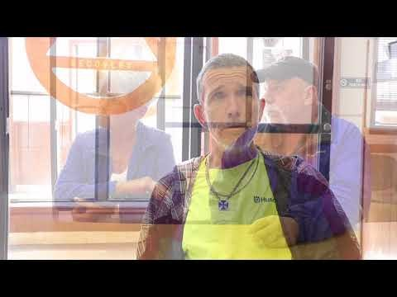
Mental health 2.0 https://youtu.be/radicrocwi8

Slide 36
Mental health 2.0
Law Enforcement & Crisis Intervention Team (CIT)
  Numerous in CIT Councils Missouri
  For example: Southeast CIT (Ste. Genevieve, Perry, Madison, Bollinger, Cape Girardeau)
    Law Enforcement Agency Members:
      Perry County Sheriff's Office
      Perryville Police Department
      Cape Girardeau County Sheriff's Office
      Cape Girardeau Police Department
Notes:
Law Enforcement has been an BIG part of the MH picture for a long time…CIT has grown and is vital to the overall picture—I’ve had the opportunity to assist in trainings (Kansas City & St. Joseph) and been a guest at some including: Ozarks Area, Tri-CIT, and most recently Southeast CIT in Peeryville—as they were the last one I attended (and Det. Klaus is from this region) I will use them as an example…

Slide 37
Mental health 2.0
Example: Southeast CIT (Ste. Genevieve, Perry, Madison, Bollinger, Cape Girardeau)
  Community Partners:
    Community Counseling Center
    CMHL
    Gibson Recovery Center
    Juvenile Office
    DHSS
    DMH
    Probation and Parole
    Perry Co Community Task Force
    SEMO University Law Enforcement Academy
    Perry County Circuit Court/32nd Judicial Court
    Perry County Memorial Hospital
    Coalition for Heroin and Opioid Prevention
    Cape Girardeau School District
    Perry County Ambulance Service
    New Life Mission Inn
    Saint Francis Medical Center
    New Vision
    Southeast Hospital
    Southeast Prevention Resource Center
    Regional Family Crisis Center
Notes:
Discussions like the ones I observed in Perryville (similar to those heard other parts of the state) address the MH needs of the clients in our communities. These persons and often their families are known to us--some are better known than others –but this type of communication is really the direction that MH services needs…discuss growing up in farming community—how everyone helps to pitch in…same thing here!

Slide 38


Slide 39
Contact numbers—where to find?
Community Mental Health Center
  https://dmh.mo.gov/mentalillness/helpinfo/county.html#1
Community Mental Health Liaison
  https://www.mocoalition.org/community-mental-health-liaison
Access Crisis Intervention
  https://dmh.mo.gov/mentalillness/progs/acimap.html
Civil Involuntary Detention
  https://dmh.mo.gov/mentalillness/helpinfo/civil.html
Notes:
These links will take you to webpages that have updated names, numbers and information

Slide 40


