Slide 1
CIT Policy Considerations, Supervision of CIT Officers and CIT Report Writing
Detective Jason Klaus
Perry County MO Sheriff’s Office

Slide 2
Objectives
Describe what should be in a crisis intervention team program policy
List the responsibilities of a CIT officer
Explain the responsibilities of a supervisor with regard to CIT officers
Explain what a CIT report should contain and how to properly complete a CIT report

Slide 3
Responsibilities of CIT Officer
Use specialized skills to de-escalate situation and decide the appropriate solution
If hospitalization is necessary, arrange for transportation (ambulance or patrol unit)
If transporting to Justice Center or Jail Detention, notify jail staff
Complete Computer Aided Dispatch (CAD) Alert
Notes:
Appropriate Solution - Release to family, refer to services, mobile outreach, hospitalization

Slide 4
Transportation of Consumers
Preferred method of transporting an individual with a mental health disorder is by ambulance
Non-violent consumer may be transported to mental health facility in patrol car with supervisor permission
If necessary, an officer can ride in the ambulance with the consumer (if policy allows)

Slide 5
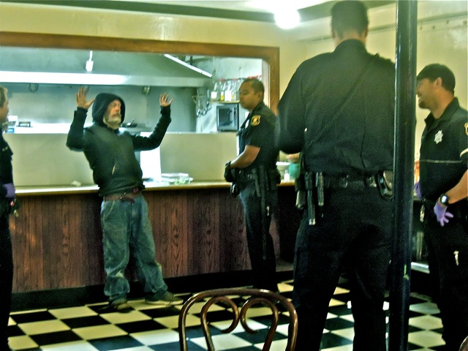
CIT Reporting Procedures
Primary officer completes original incident report
CIT officer completes the CIT report and affidavis, if necessary
Mental Health Court Warrant application procedure

Slide 6
Supervision of CIT Officers
Ensure CIT officers complete the CIT Report
Review CIT Reports
Ensure CIT officers refer consumers to resources (CMHL)
Ensure CIT officers complete warrant applications on consumers
Attend local CIT Council Meetings
Notify CIT Unit Supervisor of successes and issues
Notes:
This is a section of our CIT policy

Slide 7
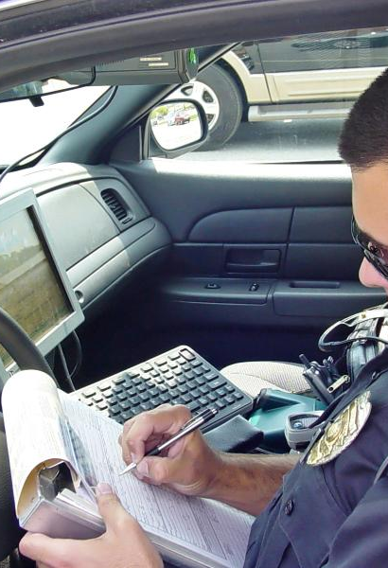
CIT Report Writing

Slide 8
CIT Reports
Complete CIT reports
(Even if it is a Voluntary Admission)
Be Detailed in your reports
Contact family, friends, neighbors, etc. for previous history
Medication
Do a suicide assessment and document information
Think beyond suicidal or homicidal (self care)

Slide 11
Notes:
NEW CIT REPORT PROGRAM

Slide 12
Why is it important to document CIT Incidents?
Connect consumers with appropriate care
Funding
Community Relations
LIABILITY

Slide 13
QUESTIONS
Detective Jason Klaus
Email: Jklaus@Mocoalition.org
Phone:573-768-6179

