Slide 1

Crisis Intervention Team (CIT) Training
Overview
Detective Jason Klaus
Perry County Sheriff’s Office
Missouri CIT Coordinator
Missouri Crisis Intervention Team (MO CIT) Council

Slide 2
Crisis Intervention Team:
Law Enforcement Partnering with Communities.
Objectives:
Explain the history and objectives of CIT in Memphis and Missouri
Describe CIT as collaboration and an example of a successful community policing program
Describe the benefit of CIT for the officer/deputy/trooper and the community
Provide the trainees an entry survey/test to establish baseline knowledge of behavioral health disorders, services and interventions

Slide 3
The Memphis Model: The Beginning
The first CIT Model was developed in Memphis, TN in 1988
In response to a lethal use of force by police involving a person with a mental illness
A local effort to bring together law enforcement personnel, mental health professionals and advocates
Goals of the CIT program are to recruit, train and support police officers to respond effectively to individuals experiencing a mental health crisis

Slide 4
Missouri Model of Crisis Intervention
The MO CIT Council is a partnership of law enforcement, mental health professionals, hospitals, individuals and their families living with mental illness and/or substance use disorders and community partners dedicated to helping individuals in crisis by implementing the Missouri Model of CIT.

Slide 5
Anticipated Outcomes of CIT
Diversion to mental health care rather than the criminal justice system for those in crisis;
Improved safety of individuals living with mental illness and/or substance use disorders;
Improved officer safety;
Extended skills for officers;
Decreased repeated law enforcement interactions with same individuals in crisis;
Increased community resources for law enforcement officers;
Decreased liability and litigation for officers;
Improved relations with community

Slide 6

GOALS of Missouri Model of CIT
Promote more effective interactions between law enforcement and those living with mental illness and/or substance use disorder;
Help individuals in crisis by connecting them with appropriate mental health resources, and try to prevent future involvement in the criminal justice system;
Improve the safety of the officer and those in crisis;
Reduce stigma; and
Expand CIT across the state, especially to the rural areas

Slide 7
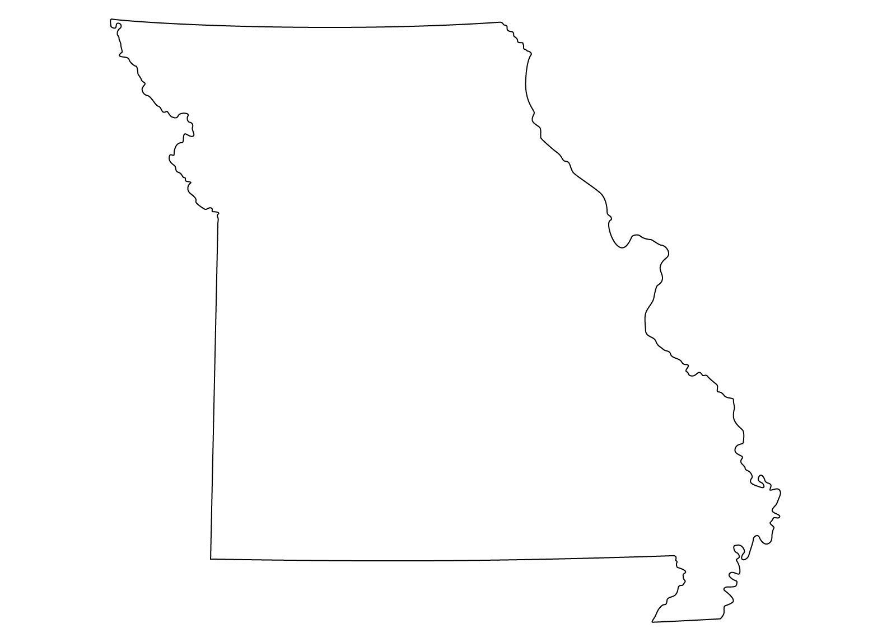



Taking Missouri CIT to the Next Level
DMH funded a State CIT Coordinator Position
Beginning January of 2016, DMH contracted with the Missouri Coalition for Community Behavioral Healthcare to provide support for CIT.
Better accountability for funding and support.
Development and implementation of the Missouri Model.
Expansion

Slide 8
Missouri CIT Council:
Law enforcement agencies with established CIT Programs
Law enforcement agencies working to develop CIT programs
Department of Mental Health
Missouri Coalition for Community Behavioral Healthcare
Community Behavioral Health Agencies
Hospitals
National Alliance on Mental Illness (NAMI)
Other state agencies: Corrections, Health and Senior Services, Social Services
Notes:
Law Enforcement agencies from throughout Missouri with established CIT Programs
Law Enforcement agencies that are actively working to start CIT Programs
Missouri Department of Mental Health
Hospitals
Community Mental Health Agencies
Missouri Department of Corrections
Missouri Division of Health and Senior Services
National Alliance on Mental Illness

Slide 9
Missouri CIT Council
A standardized 40 hour curriculum that is being utilized state wide
Access to online resources (Toolkit)
Defining a local council and its expectations
Consistent branding
Provide a standardized CIT pin
Fostering CIT as key component of crisis response
9
Notes:
Data: (#of people trained, #of CIT Reports, CIT Outcomes, etc.).

Slide 10
Advanced
Dispatch/
  Telecommunications
Veterans
Youth
Created Standardized Curriculum
Advanced CIT Courses

Slide 11
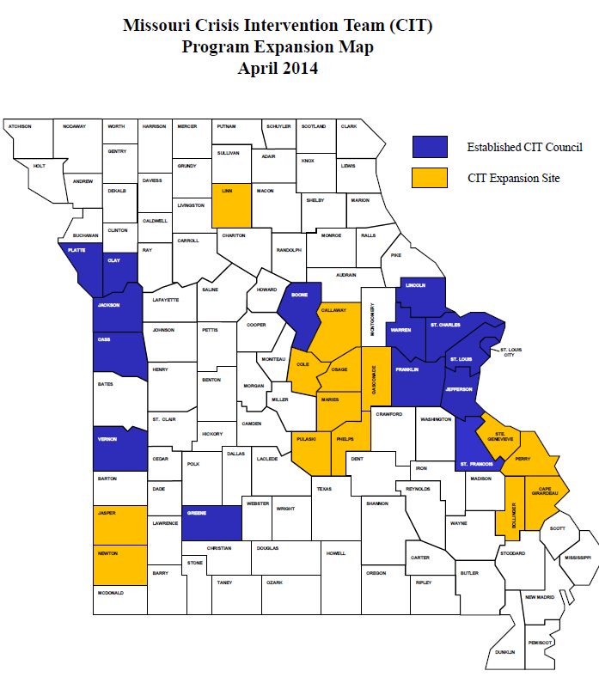
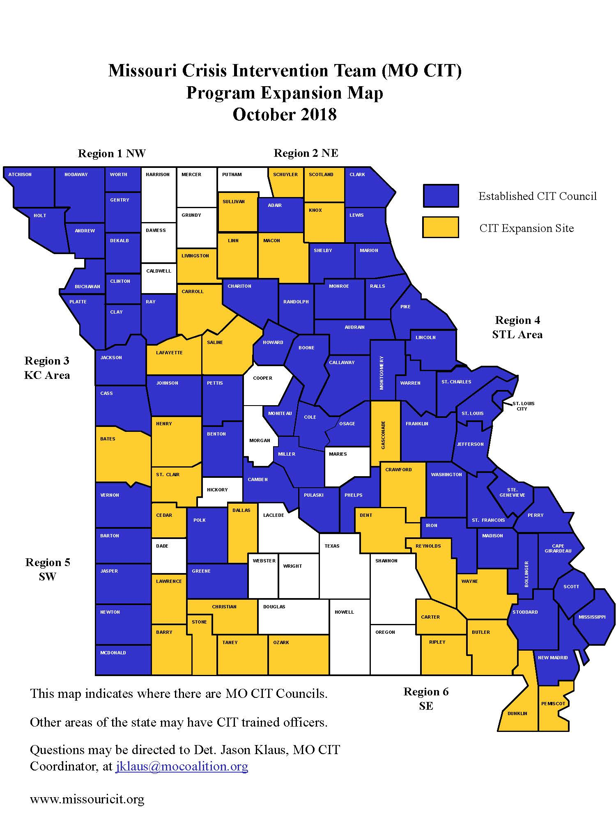
Missouri CIT Council Expansion
Then and Now

Slide 12

28 Local Councils make up the MO CIT Council
Bootheel Area
Callaway
Capital Area
*Current River
East Central
Four Rivers
Franklin County
Great Rivers
*Green Hills Regional
Jefferson County
Johnson County JOCOMO
Mid-America
Mid-Missouri
Mineral Area
*Missouri River
North Central
Northeast
Northwest
Ozarks Area
Polk
Saints Avenue
South Central
Southeast
Southwest
St. Louis Area
*Three Rivers
Tri CIT
West Central
* = expansion site
Notes:
26 councils, What the * means.

Slide 13
Definition of a Local CIT Council
1. Meets regularly for at least a year (the recommendation is monthly meetings, but at least quarterly meetings are required).
2. Have CIT trained officers/deputies in their area. (The local council does not have to provide CIT training. The Council can send officers/deputies to established CIT trainings in other areas).
3. Council is implementing the “Missouri Model” of CIT, including using the Missouri CIT Curriculum, following standardized data collection practices, etc.
4. Must have active participation by a member of the local Council (in person, by teleconference) in four of the six state MO CIT meetings annually.
5. Requesting council submits a letter explaining how your council meets the criteria to the MO CIT Council for approval.

Slide 14
Local CIT Councils in the Southeast Missouri Area
Bootheel Area Council- Mississippi, New Madrid, Scott and Stoddard
Current River Council- Carter and Reynolds
Mineral Area Council- Iron, St. Francois and Washington
SEMO Council- Bollinger, Cape Girardeau, Madison, Perry and Ste. Genevieve
Three Rivers Council- Butler, Carter, Dunklin, Pemiscot, Ripley, Reynolds, and Wayne

Slide 15

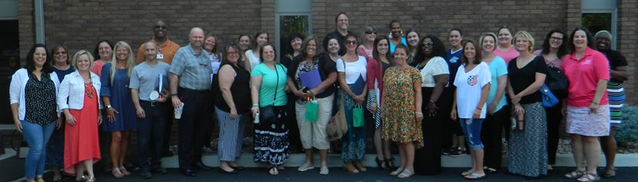
Missouri Community
Mental Health Liaisons (CMHLs)
31 CMHL’s
Every Missouri County assigned CMHL
Only work with Law Enforcement
Assist in CIT Expansion
Notes:
Co-Responder model is a good concept, but traditionally only available to large law enforcement agencies with large budgets.
STATS
INFO Graphic

Slide 16
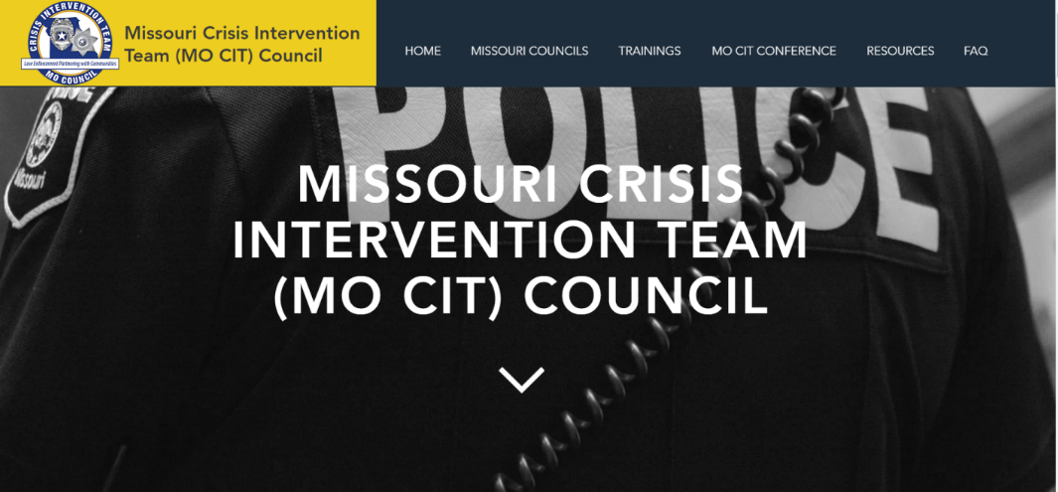



VISIT MISSOURI CIT COUNCIL
www.missouricit.org
https://www.facebook.com/
MO-CIT-Council-1822567521329387/
Twitter
https://twitter.com/MOCIT4

Slide 17

17

Slide 18
Detective Jason Klaus
Perry County Sheriff’s Office
Missouri CIT Coordinator
573-768-6179
JKlaus@mocoalition.org

Slide 19

Let’s Get Started
Pre-Test

