Slide 1
Alzheimer’s and Dementia
Crystal Kent
Fulton Police Department

Slide 2
Objectives
Explain symptoms, progression and characteristics of people of Dementia, Alzheimer’s and related brain disorders
Discuss how to interact with people with Dementia, especially when frightened, threatened or in a rescue or crisis situations.
Discuss prevention of future crisis situations, including referrals to community agencies

Slide 3
Difference between Alzheimer’s and Dementia
Dementia
Alzheimer’s
Not a disease
Set of symptoms
Gradual loss of memory
A disease
One Cause of Dementia
Most common cause of Dementia
Notes:
Many people will use these two terms as if they mean the same things. So these are some basic differences, and things to keep in mind when dealing with people who have Dementia or Alzheimer’s, and something to remember when talking with their families or friends.
Dementia is general a term which means without mind
Alzheimer’s disease is just of cause of Dementia, but it accounts for 60-80% of Dementia cases
Dementia is a set of symptoms which result from a disease or a condition affecting the brain
Dementia is a symptom of Alzheimer’s
Dementia is a gradual loss of thinking, remembering or reasoning

Slide 4
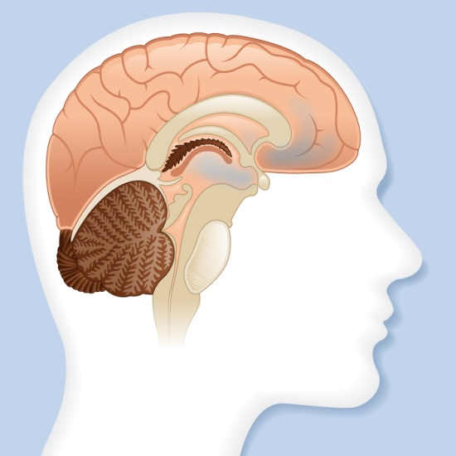
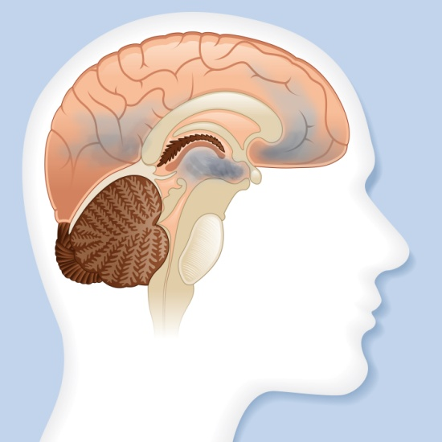
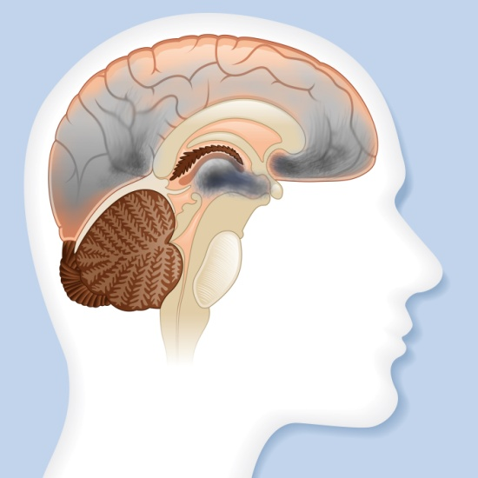
Three Stages of Alzheimer’s
Early Stages
(Mild Stage)
Middle Stages
(Moderate Stage)
Late Stages
(Severe Stage)
Notes:
Alzheimer’s is broken down into three basic stages. A couple things to remember:
Memory problems are one of the first signs of Alzheimer’s disease, usually presenting well before any other symptom
As Alzheimer’s progresses, memory loss will get worse, and other symptoms will begin to show.
3. The memory will never improve for someone with Alzheimer’s disease.

Slide 5
Symptoms during Early Stage
Forgetfulness
Speech Issues
Taking Longer to complete daily activities
Poor Judgement
Losing things
Notes:
-The physical person will likely no change, they will probably be neatly dressed, proper hygiene and my even communicate well enough to evade questions they are uncomfortable with.
-Repeating questions, pauses in speech and poor eye contact may occur
-They may also misplace things more often or think they are loosing things because they can’t remember where they put them.

Slide 6
Observations during Early Stage
Driving problems
Speech problems
Difficulty locating documents you request
Shoplifting
Notes:
Driving problems:
Getting lost in familiar areas to the driver
Poor driving in general (as in the rules of the road make less sense than before)
Poor judgements in making turns, or around entrance and exit ramps
may appear drunk/impaired
DENIES ERRORS WHILE DRIVING
Speech Problems:
Repeating words or statements
slow response to directions or confusion with basic questions
Word- finding problems
Difficulty locating documents you request (IE license, proof of insurance etc.)
Shoplifting:
May argue they have already paid for the items, because they have forgotten they haven’t paid
May believe they own a store or shop so they don’t have to pay

Slide 7
Symptoms during Middle Stage
Memory Loss and confusion
Poor motor skills
Unbalanced walking
Unable to learn new things
Problems recognizing people
Notes:
The symptoms between Early and Middle stages are very similar, but the severity of the symptoms has progressed.
Middle Stage is usually the longest stage and can last as long as 7 years if not longer
During this stage the areas of the brain which control language, reasoning, sensory processing and conscious thought are affected the most.

Slide 8
Observations during Middle Stage
Speech problems
Driving Impairment
Wandering
Being uncooperative
Issues with basic needs
Notes:
Broken speech patterns, losing track of the questions you asked/ or how to answer, swearing and using cuss words
They could have taken the car without permission, so think about that when dealing with the person, plus they may be confused on where they are, or forget something is no longer where it use to be
- During this stage there is a HIGH risk of wandering
60% of patients wanders, of those 72% will be repeat wanders
May have unprovoked outburst. They don’t mean any harm necessarily, but they are confused and don’t understand what is going on
May have issues with basic needs such as bathroom use, being hungry or thirsty. This is where personal hygiene may appear to be going down hill or start to see a decline in self care.

Slide 9
Symptoms during Late Stage
Unable to recognize oneself or family
Difficulty swallowing
Increased sleeping
Lack of control over bodily functions
Unable to communicate
Notes:
-Imagine looking in the mirror and not knowing the person looking back at you. May not recognize their own children, but mistake grandchildren as their children
Unable to control their bowel and/or bladder
Weight Loss- unable to remember if they ate , or being unable to chew foods, or can’t remember how to use a straw
Complete loss of language skills at this point

Slide 10
Observations of Late Stage
Signs of elder abuse or neglect
Suicide or homicide
Calls for assistance by family or caregiver
Wandering
Notes:
- Due to the brain detartrating so much at this point, family may believe their loved one is being abused or neglected, but the fact that the person can’t remember if they ate, or took the medications could be the cause.
Suicide or homicide of the care taker. Think about a husband who has watched his wife go through all three stages of Alzheimers. He could kill her then kill himself because he doesn’t want to watch her suffer any more.
Since these people are becoming more forgetful, they may also become more aggressive and refuse help from family or caretakers. They also may be their own guardian and refuse to accept there is anything wrong with them, and not allow for medical help.
Very unlikely you will see them wandering at this point, however if you do, remember their communications may be little to none.

Slide 11
What to do in situations involving a person with Alzheimer’s
Introduce yourself
Use friendly facial expressions
Keep it simple
Look for medical alert devices
Face them directly
Always tell the person what you will be doing
Use gestures to direct the person
Provide security and comfort
Notes:
- Introduce yourself and explain you are there to help the person
Keep it simple when giving directions or ask simple basic questions, with one question at a time
While speaking with the person, check for necklaces, bracelets, ankle bracelets or tracking devices
Use a low calm voice, even if the person gets agitated or combative, stay calm it may help diffuse the situation and help to keep the person from becoming scared
Face them directly so they know you are speaking to them and it removes some of the confusion
Always tell the person what you are doing, or what you are going to do. Explain this again while you are doing it.
If you ask the person to go over to your patrol car, point to the car or the area which you want them to move to
Provide the person with a drink or someplace to sit, if possible provide them with a blanket and make the person feel safe

Slide 12
Prevention of future crisis
Tickets
Make a connection with the family members
Educate the public and department
Driver’s contract
Department of Senior Services
Local resources
Alzheimer’s organization (http://www.alz.org/)
CIT referral
Notes:
Ticket-
this allows for a paper trail,
this is a CYA for the department and the officer
could open the eyes of the family as well to see there is a problem
allows the courts to get involved and maybe start the process to get the family help (need to communicate with your local PA though)
Driver condition report
Make a connection with the family
especially in cases for wanders
take the time to sit down with the family and give suggestions like placing locks in abnormal places
place a black rug in front of the door
REMEMBER THE FAMILY MAY NOT BE ACCEPTING OF THIS DUE TO STIGMA
Provide the family with a driver’s contract
Hang on the fridge, so family can remind the person they can’t
Department of Senior Services
They have a hotline just like children’s division, when in doubt contact them and get them involved. They have more resources than we know about.
Local Resources
National Alzheimer’s website is listed- have them come talk to your dept.
CIT referral to your local CMHL

Slide 13
Community Resource Mapping
FAMILY ADVOCACY
CAREGIVER SUPPORT
MENTAL HEALTH
SOCIAL SERVICES
RESPITE
CRITICAL CARE CLINICS
HOUSING SUPPORTS
Persons with
Alzheimer’s
And
Caregivers
SERVICE ORGANIZATIONS
ELDER CARE FACILITIES
HOSPITALS
STATE OFFICES
FAITH COMMUNITY
OFFICE OF AGING
MOTOR VEHICHLE DEPARTMENT
BUSINESS ASSOCIATIONS
ALZHEIMER’S ASSOCIATION
Notes:
Provide a copy of this to the class, give the class the opportunity to break into groups and fill out the map

Slide 14
Questions????

