Slide 1
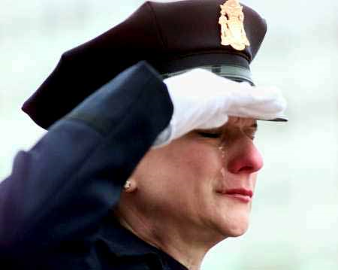
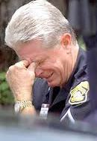
Officer/Deputy/Trooper Wellness With Duty Comes Hardship
Presented by: Sgt. Ed Curtis
Cape Girardeau County Sheriff’s Department
Created by:
Rick Strait, LPC, CRDAC Community Counseling Center
Notes:
Module 7; Assignment 2: Review Paper – Power Point Presentation

Slide 2
Objectives
List the unique stressors associated with a career in law enforcement for both the officer/duputy/trooper and his or her family members
Identify barriers that have traditionally prevented people in law enforcement culture from accessing mental health and/or substance use resources
List local resources for self-care

Slide 3
How this hour is different than rest of CIT training
This hour is about protecting yourself and each other
Protect the community protect each other
How many of you would take a bullet for your fellow officers?
How many of you would be willing to help a fellow police officer who may be struggling with anxiety, depression, PTSD and/or suicidal thoughts

Slide 4
Breaking the Silence video

Slide 5
Questions from the video
QUESTIONS:
What were you thoughts about the video?
Can this happen here?
Are we prepared to prevent a suicide within our agency?

Slide 6
Know the Facts
Police Officers are 2-3 times more likely to die by their own hand than by a felonious murder on the job
In 2012 there were 126 law enforcement suicides

Slide 7
According to the National Study of Police Suicides
Average age 42
91% were men 40-44 years old
16 average years on the force
63% were single

Slide 8
Don’t ignore the evidence Officers in distress often give clues
Talking about suicide
Looking for a way to kill oneself
Feeling like a burden, not having purpose or hopeless
Showing anxiety, agitation, increased or decreased sleeping
5. Increase in alcohol use
6. Withdrawing from family, friends, partner and other officers
7. Acting out of character anger, mood changes, reckless behavior
8. Experiencing new or more relationship problems

Slide 9
“Officer suicide and mental wellness needed to be addressed just as directly as officer vest”
– Tony West, Acting Assistant Attorney General

Slide 10
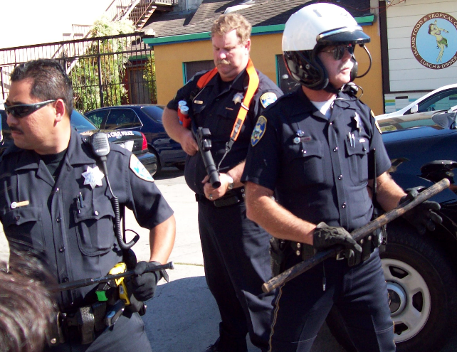
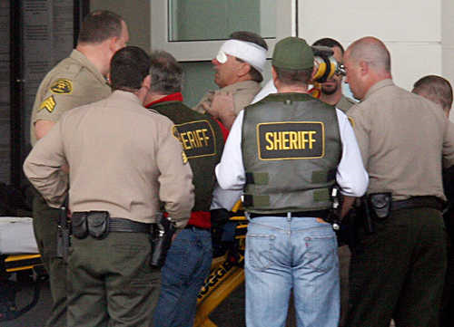
Introduction
Today’s modern world is saturated horrific acts of violence, terrorism, abuse, sexual assaults, child neglect, kidnapping, torture and tragic deaths.
It is the awful truth that people in our world frequently kill, murder, torture, rape, molest, sodomize, shoot, stab, rob, burglarize, trick, deceive, neglect, and steal from each other; as a means of enjoyment, self fulfillment, greed, lust, ignorance and even necessity.
Crime would take over our world completely if it were not for the efforts of law enforcement and the criminal justice system.
Notes:
Law enforcement personnel (or peace officers) are persons who have attended a Peace Officer Standard Training (POST) certified basic academy and graduated successfully with their POST certificate. Peace officers can include Police Officers, Deputy Sheriffs, (California) Highway Patrol, state/federal Marshal, State Park Ranger, District Attorney Investigator, FBI Agent, ATF agent, Department of Justice agent, CIA agent, etc. Law enforcement plays the “enforcement” role of the criminal justice system and is responsible for minimizing the criminal and deviant acts within society. Unfortunately, in order to minimize the most horrible and negative aspects of our society (crime and deviancy), law enforcement personnel must subject themselves directly to these events; physically and emotionally.

Slide 11
In close comparison to the military; law enforcement is currently considered to be one of the most dangerous, stressful and health-threatening occupations (Tanigoshi, Kontos, and Remley Jr, 2008).
Notes:
). In 1988, 78 law enforcement officers were killed in the line of duty and since then, hundreds of others been killed, exposed to a life threatening situation, witnessed traumatic events, or have had “near misses” in dangerous situations (Mann & Neece, 1990). Page (2010) describes that, “on any shift, police officers may be expected to shoot someone, be shot at, see a partner killed, use force to resist a physical attack, rescue a battered child, participate in a high-speed chase, and inform a parent that his or her child has been killed in a traffic accident.” Every person who signs up to be a peace officer is also signing up for a life-time of stress and negative psychological effects that occur as a result of being exposed to these traumatizing events day after day. Ramos (2010) notes that the nature of police work is inherently negative and the bulk of service calls are geared at taking care of others.

Slide 12
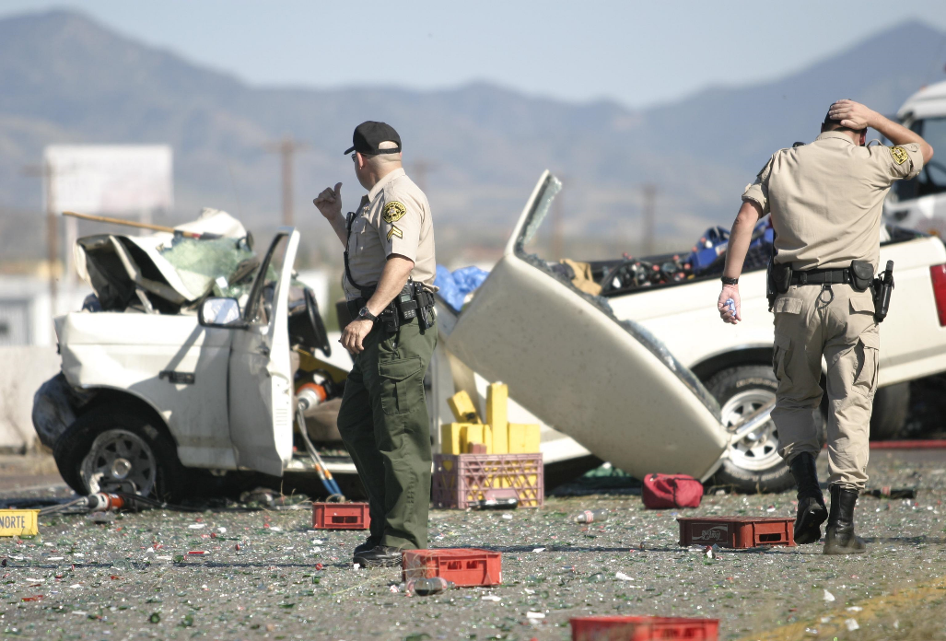
“Policing is psychologically stressful work, filled with danger, high demands, human misery and exposure to death (Page, 2010).”
(After Collapse of Worlds Trade Center)
Notes:
Therefore, operating in an environment that frequently exposes officers to high levels of frustration and danger can often lead to physical, emotional and psychological wear (Ramos, 2010). Chopko and Schwartz (2009) state that, officers are “especially vulnerable to both direct and vicarious traumatic events, because they must not only confront illegal and sometimes violent behaviors but they must also assist other first responders (e.g., fire fighters and paramedics) when they are called to duty.”

Slide 13
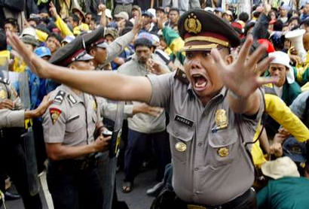
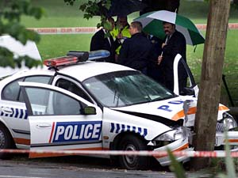
These job related stressors within law enforcement have a negative effect on officers and cause significant physical, emotional, social and psychological problems that can negatively impact their life and their ability to perform their job effectively.
Notes:
The duties of law enforcement involve a responsibility by each officer to dive head first into the most troubling and painful realities of our communities. Unfortunately, what we see, feel, do and experience on the job can cause not only physical pain and stress but also emotional distress and a variety of unhealthy medical and psychological problems. Research has shown that gender and race can be an important variable in predicting an officer’s outcome post trauma exposure (Shaffer, 2010; Page, 2010). Although every person reacts differently to what they see or experience on the job and the duration and intensity of the reaction can also vary drastically from person to person; indeed, every person in law enforcement is negatively effected by the job related stressors in some way.

Slide 14
Physical Symptoms
Research has shown that the stressors related to law enforcement can lead to physical and psychosomatic conditions; such as:
ulcers
Headaches
Heart disease
High blood pressure
psychological states such as burnout, depression, anger and frustration (Burke, 1998).
Notes:
It is important to tend to the physical, emotional, and psychological health of the law enforcement officers for multiple reasons. An officer’s physical, emotional, social and psychological health is a critical component in the officer’s ability to effectively live their life. Tanigoshi, Kontos, and Remley Jr. (2008) discuss that, officer wellness is a particularly important topic to address within the counseling profession, given the high occurrence of lifestyle-related diseases and disorders that lead to an officer’s likelihood of premature morbidity and mortality.

Slide 15
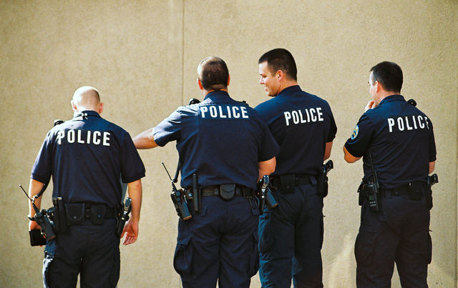
Social Effects
* 70 percent of all work related absenteeism is linked to stress-related illnesses.
* Often times, officers may feel torn between their commitment to their professional duties and their responsibility and loyalty to their families (Shaffer, 2010).
Notes:
An officer can be negatively affected socially within their personal lives, relationships and at work.

Slide 16
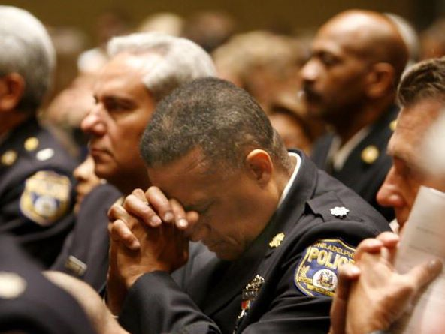
Emotional Effects
* law enforcement officers often have high levels of trauma-related stress due to responding incidents involving: destruction to physical property, violence, or death
Being exposed to such job related stressors develop increases risk of Post-Traumatic Stress Disorder (PTSD) and similar stress-related problems.
In order to be successful at their career, emergency care workers may often shut down their emotions
Notes:
Traumatic and/or disturbing events that officers encounter within their daily duties can lead to significant levels of stress, as well as emotional difficulties within officers. Additionally, officers may experience shock, disbelief, dread, anguish, anger and a pressing motivation to take action in response to the critical event (Shaffer, 2010).

Slide 17
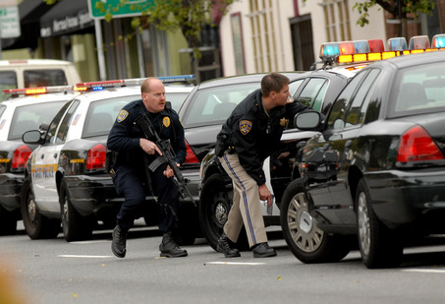
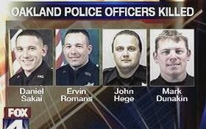
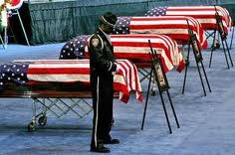
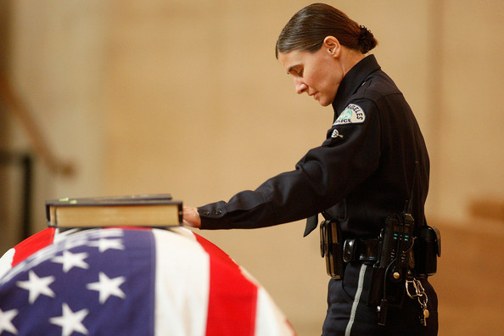
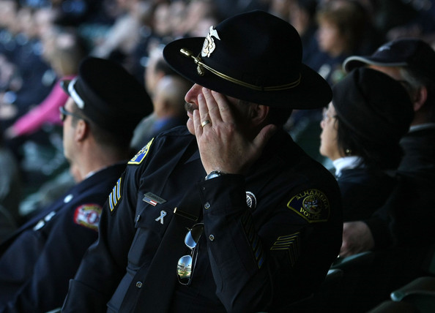
To Sum it Up…
An officer’s physical, emotional, social, and psychological health is a critical component in the officer’s ability to effectively do their job and to protect and serve the community.
Notes:
Tanigoshi, Kontos, and Remley Jr. (2008) also state that, “issues of wellness, adaptive coping responses, health promotion, and disease prevention are significant health-related areas to address within the profession of law enforcement given that police work is considered to be one of the most stressful and health-threatening occupations. An officer’s physical, emotional, social, and psychological health is a critical component in the officer’s ability to effectively do their job and to protect and serve the community. Therefore, society, law enforcement agencies, and the individual officer’s themselves need to be educated on the importance of the officer’s emotional and psychological health. Whether this occur through federally funded grants that educate and regulate law enforcement agencies on officer wellness and job related stressors or by hand delivering brochures to local agencies at roll call.
With great concern for the health of working law enforcement personnel within our communities, as well as the welfare and safety of our communities, I feel it necessary to address the negative effects that the stressors experienced within the career of law enforcement can have; not only on an individual, but on their families, friends, co-workers, employers, and the people they are sworn to protect.

Slide 18
What can you do
Its important that we focus on mental health self care. There is no one answer, but it is important that each officer discovers their own positive self care.

Slide 19
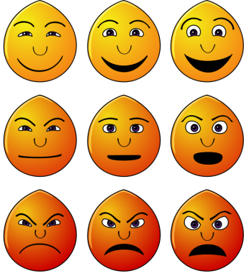
What does positive mental health look like?
Positive and respectful relationships
Identify, manage and understand emotion
Personal development
Communication
Solve problems, make decisions, take responsibility
Set goals

Slide 20
Why is positive mental health and wellbeing important?
Healthier lifestyles
Better physical health
Improved recovery from illness
Fewer limitations in daily living
Higher educational attainment
Greater productivity
Greater employment and earnings
Better relationships
Increased social cohesion
Improved quality of life.

Slide 21
Sgt. Kevin Briggs (retired CHP) Guardian of the Golden Gate Bridge

Slide 22
A balancing act
Overall Wellbeing
Mental Health
Physical Health
Social Health
Having a balance across mental, physical and social health leads to overall wellbeing!

Slide 23
What is self-care?
More than having a hot bath.
Self-care refers to activities undertaken with the intention of enhancing energy, restoring health and reducing stress.
Benefits:
greater capacity to manage stress
increased resilience
reduced symptoms of mental health problems.

Slide 24
Self-care: Looking after yourself
Physically:
Healthy diet, regular exercise and adequate sleep;
Monitor and manage your stress in positive ways;
Make time for relaxation and fun; and
Limit the use of alcohol and other substances.
Relationships:
Foster and maintain your personal relationships; and
Strive for balance between your work and your personal life.
Work/study:
Develop interests and friendships outside of your work/study environment.
Spirituality:
If you have spiritual beliefs, make time for regular spiritual practice, or relationships with others who share your philosophy.
Asking for help:
Reach out for support when you need it.
Wellbeing and self-care fact sheet www.responseability.org

Slide 25
Self-care…challenges
Carer mindset
Superhero mindset
Time
Competing priorities
Perceived value
Not part of routine
Workplace culture
Lack of role models/support
It is more important to help others, I’ll be ok

Slide 26
Self-care…challenges
Carer mindset
Superhero mindset
Time
Competing priorities
Perceived value
Not part of routine
Workplace culture
Lack of role models/support
I should be able to cope

Slide 27
Self-care…challenges
Carer mindset
Superhero mindset
Time
Competing priorities
Perceived value
Not part of routine
Workplace culture
Lack of role models/support
I’m too busy..
Or
I need to do XXX first

Slide 28
Self-care…challenges
Carer mindset
Superhero mindset
Time
Competing priorities
Perceived value
Not part of routine
Workplace culture
Lack of role models/support
I don’t believe I deserve it/am worth it
Or
Self-care has no benefit/waste of time

Slide 29
Self-care…challenges
Carer mindset
Superhero mindset
Time
Competing priorities
Perceived value
Not part of routine
Workplace culture
Lack of role models/support
I’m really motivated but…It’s hard to change habits and/or start doing things I've never done before

Slide 30
Self-care…challenges
Carer mindset
Superhero mindset
Time
Competing priorities
Perceived value
Not part of routine
Workplace culture
Lack of role models/support
…………………..
…………………..
No one I know is practicing self-care
Or
Lack of support/ encouragement from others in any attempt to make changes

Slide 31
It’s ok to ask for help
Reach out for support when you need it:
Friends
Family
Primary care doctor
Chaplain or spiritual leader
Copline 1-800-267-5463
Safe Call Now hotline 1-206-459-3020
Community Counseling Center
Private Counseling Office
Employee Assistance Program (if offered by your department)
Suicide Prevention Lifeline 1-800-273-TALK (8255)

Slide 32
My Strength
An anonymous self help tool that can be used for resources and self help free to CIT officers
www.mystrength.com click sign up
Enter Access Code: MOCCCcommunity

Slide 33
Resources
www.badgeoflife.com
http://copline.org
www.save.org
www.pst.org
www.iacp.org
http://safecallnow.org
http://thepainbehindthebadge.com

Slide 34
References
Burke, R. J. (1998). Work and Non-Work Stressors and Well-Being Among Police
Officers: The Role of Coping. Anxiety, Stress & Coping, Vol. 11. No. 4 (1). 345-362.
Chopko, B. A. and Schwartz, R. C. (2009). The Relation Between Mindfulness and
Posttraumatic Growth: A Study of First Responders to Trauma-Inducing Incidents. Journal of Mental Health Counseling, Vol. 31, No. 4 (1). 363-376.
Li-Ping Tang, T. and Hammontree, M. L. (1992). The Effects of Hardiness, Police Stress,
and Life Stress on Police Officers' Illness and Absenteeism. Public Personnel Management, Winter 1992, Vol. 21, No.4 (1). 493-510.
Mann, J. P. and Neece, J. (1990). Workers' Compensation for Law Enforcement Related
Post Traumatic Stress Disorder. Behavioral Sciences & the Law, Vol. 8 (1). 447-456.
Norvelle, N. and Belles, D. (1993). Psychological and Physical Benefits of Circuit
Weight Training in Law Enforcement Personnel. American Psychological Association. Journal Consulting and Clinical Psychology, Vol. 61, No. 3 (1). 520-527.
Page, D. (2010). Surviving Law Enforcement. Law Enforcement Technology, February
2010, Vol. 37(2). 26-32.
Ramos, O. (2010). Police Suicide Are You at Risk? FBI Law Enforcement Bulletin, May
2010, Vol. 21 (3). 21-23.
Shaffer, T. J. (2010). A Comparison of Firefighters and Police Officers: The Influence of
Gender and Relationship Status. American Counseling Association’s Adultspan Journal; Alexandria: Spring 2010, Vol. 9 (1). 36-50.

Slide 35
Hunter Institute Presentation
www.policesuicidestudy.com

