Slide 1
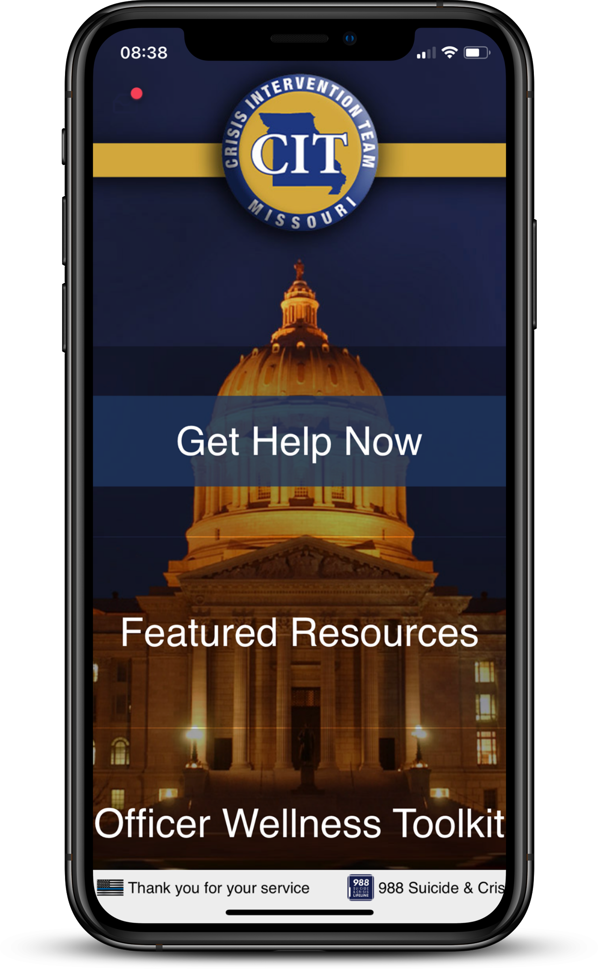
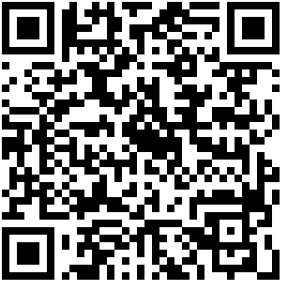
The Missouri crisis intervention team WELLNESS APP
Department ID: MOCIT (all caps)
Department Code: Wellness1

