Slide 1
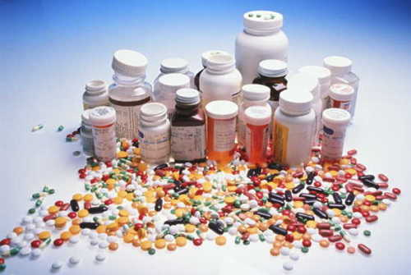
Medications

Slide 2
Objectives
List major classes of psychiatric medications and side effects
List psychiatric side effects of common non-psychiatric medications
List reasons for non-compliance

Slide 3
Mental Illness vs. Physical Illness
Naturally occurring chemicals in the brain
In Balance= Healthy Experiences
Out of Balance= Mental Illness

Slide 4
Chemical Imbalances
Norepinephrine (Adrenaline): Fight or Flight Anxiety, Phobias
Serotonin: Mood and Desire Regulation Obsessive Thoughts & Suicidal Ideation
Dopamine: Reward System (Love, Sex & Food) Depression
GABA: Police for the Other Chemicals Depression, Anxiety
Imbalances may occur due to:
Chemical producing synapses do not produce or release chemicals
Chemical receiving synapses do not receive
Chemicals are released in abundance or at inappropriate times

Slide 5
Notes:
What happens in the brain is there are too much of some chemicals and not enough of others. It takes a professional to help determine exactly what is going on in your brain. These imbalances can be treated with counseling and/or medication management. One of the questions we get asked is, “How does counseling help a physical chemical imbalance.” The same way walking can help improve your heart by oxygenating your blood and strengthening the heart muscle without the need for heart medication. Talk therapy, journaling, positive thinking, support networks and other counseling resources are all “exercises” for your brain that help keep it healthy and in balance. That said, medication is often needed to aid in the process or to speed up the process.

Slide 6
Mental Illness is a Physical Illness
Notes:
The important thing to remember about mental illness is that it is a physical imbalance of chemical sin the brain. When we have a chemical imbalance of insulin in our bodies, we aren’t stigmatized about getting treatment for diabetes, but for some reason, when the imbalance is in our brain, we are stigmatized about getting treatment from a mental health professional. These chemical imbalances happen for a number of reasons; sometimes receptors stop receiving, sometimes transporters stop transporting and sometimes these chemicals are released at the wrong times.

Slide 7
Reasons to Use Psychiatric Medications
Illnesses that effect everyday life or functioning
Depression
Anxiety/ Phobias
Impulsivity, Mood Swings
Addictions
ADHD
Severe and Persistent Mental Illness (SPMI): Ex. Schizophrenia, Bipolar
Delusions (Hardest to treat with medications.)
Medication for other illnesses causing a chemical imbalance

Slide 8
Psychiatric Side Effects of Non-Psychiatric Medications
Blood Pressure: Depressive symptoms
Over-the-Counter Cold Medications: Psychotic behavior (delusions, hallucinations, paranoia) or anxiety
Prednisone: Psychotic Behavior
Thyroid Medications: Anxiety, agitation, depressive symptoms
Diabetic Emergency (ketoacidosis): Delirious behavior

Slide 9
Types of Medications: Benzodiazepine Family
Downers
Usually end in “lam” or “pam” Ex. Xanax (alaprazoLAM), Valium (diazePAM), Klonopin (clonazePAM)
Dangerous but they have their place
May be essential in controlling: acute mania, severe anxiety, panic attacks
Used for treating alcohol withdrawal (Withdrawal can be life threatening!)
Sometimes used for insomnia

Slide 10
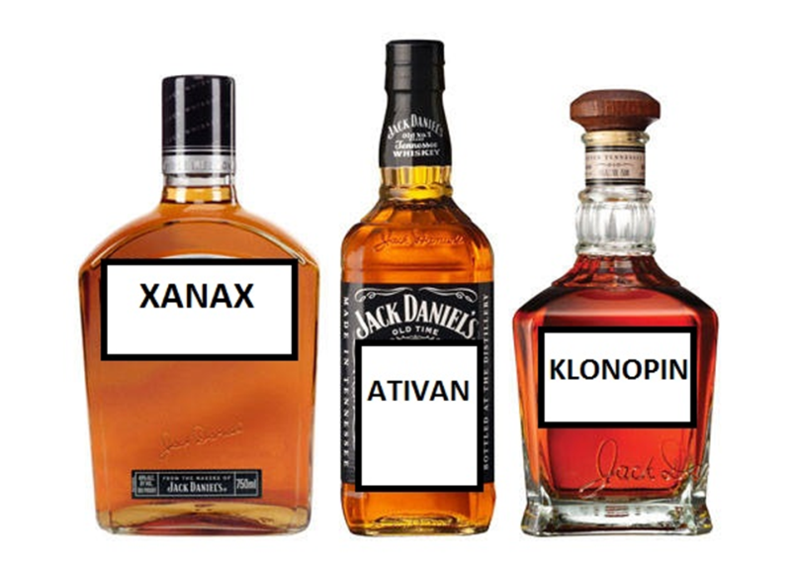
Types of Medications: Benzodiazepine Family
Acts similar to alcohol (Jack Daniels in a pill)
Build tolerance, cause withdrawal
Intoxication: Confusion, slurring of words, drowsiness
Affects memory, concentration, coordination
Withdrawal: Irritability, anxiety, racing heart

Slide 11
Types of Medications: Benzodiazepine Family
Federally controlled meds: Crime to dispense, use or possess without a valid prescription
Seductive, like the “Dark Side”
Abuse-able & do have street value
Often banned in jails & treatment centers

Slide 12
Types of Medications: Common Benzodiazepines
Brand Name
Generic
Valium
Librium
Klonopin
Ativan
Xanax
Diazepam
Chlordiazepoxide
Clonazepam
Lorazepam
Alprazolam

Slide 13
Types of Medications: Amphetamine Family
Uppers
Generic names usually end in “amphetamine” Ex. Vyvanse (dextroAMPHETAMINE)
Legal speed- Pill form of methamphetamine
Used to treat concentration problems (ADHD)
Intoxication: Rapid speech, irritability, psychosis
Withdrawal: Sedation, headaches, irritability
Withdrawal not fatal
Do have street value

Slide 14
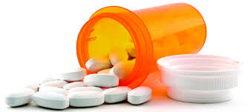
Types of Medications: Common Amphetamines
Brand Name
Generic
Adderall
Vyvanse
Dexedrine
D- and L-amphetamine
Lisdexamphetamine
Dextroamphetamine

Slide 15
Types of Medications: Antidepressant Family A
Newer medications since 1985 Ex. Paxil, Prozac
Not abuse-able
Not fatal, even in overdose
Attempted overdose should be treated as a suicide gesture or attempt
Overdose: Sedation, sweating
Withdrawal: (minimal) Physical symptoms such as nausea

Slide 16
Types of Medications: Antidepressant Family B
Older medications (1985 or older)
Not “happy pills”
Work over time- have to “kick in”
Best used for a biologically based sad mood
Not 100% effective- More effective for severe depression
Have drawbacks and side effects

Slide 17
Types of Medications: Antidepressant Family B
Typically not abused
Can be dangerous. Requires more monitoring
Overdose typically a suicide attempt but unintentional overuse does occur
Overdose: Confusion, flushed face, very little sweating

Slide 18
Types of Medications: Common Antidepressants
Trade Name
Generic
Prozac
Zoloft
Paxil
Celexa
Lexapro
Remeron
Cymbalta
Effexor
Pristiq
Wellbutrin
Fluoxetine
Sertraline
Paroxetine
Citalopram
Escitalopram
Mirtazapine
Duloxetine
Venlafaxine
Desvenlafaxine
Buproprion

Slide 19
Antidepressants
Tricyclic Antidepressants
Elavil (amitriptyline)
Tofranil (imipramine)
Sinequan (doxepin)
Lithium
Thyroid hormone
Amphetamines and other stimulants
And yes, caffeine

Slide 20
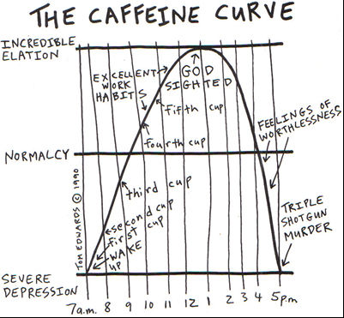

Slide 21
Types of Medications: Mood Stabilizer Family
Used to treat mood swings
Helpful to many but not a cure-all
In cases of psychosis, may need antipsychotics first to bring back to reality
Must build to a level, like antidepressants- have to “kick in”
Side effects/ long-term health effects
Often checked with blood draws

Slide 22
Types of Medications: Common Mood Stabilizers
Trade Name
Generic
Depakote
Lithobid/ Eskalith
Tegretol
Zyprexa
Lesser used agents
Lamictal
Neurontin
Topamax
Divalproate/ Valproic Acid
Lithium
Carbamazepine
Olanzapine
Lamotrigine
Gabapentin
Topiramate

Slide 23
Types of Medications: Antipsychotic Family
Used to treat breaks in reality
Not abuse-able drugs
Will cause sedation
Withdrawals are minimal

Slide 24
Types of Medications: Antipsychotic Family- First Generation
Brand Name
Generic
Haldol
Thorazine
Loxitane
Trilafon
Navane
Prolixin
Orap
Haloperidol
Chlorpromazine
Loxapine
Perphenazine
Thiothixene
Fluphenazine
Pimozide

Slide 25
Types of Medications: Antipsychotic Family- First Generation
PROS
CONS
Cheap
Available
Effective
Less Metabolic Effects?
Not promoted
Shortages
Side Effects
Tardive Dyskinesia/ NMS

Slide 26
Types of Medications: Antipsychotic Family- Second Generation (Atypical)
Brand Name
Generic
Risperdal
Invega (Really Risperdal)
Zyprexa
Geodon
Abilify
Latuda
Seroquel
Clozaril
Risperidone
Paliperidone
Olanzapine
Ziprasidone
Aripiprazole
Lurasidone
Quetiapine
Clozapine

Slide 27
Types of Medications: Antipsychotic Family- Second Generation (Atypical)
PROS
CONS
New and Improved
More effective?
Less EPS
Patient Friendly
Less used/ untried?
More expensive!
Metabolic Syndrome
Fewer long-acting options

Slide 28
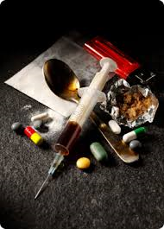
Substance Use Medications
Brand Name
Generic
Dolphine, Methadose: Opioids
Suboxone, Subutex: Opioids
Vivitrol: Opioids & Alcohol- Reduces cravings
Campral: Alcohol- Reduces withdrawal
Antabuse: Alcohol- Creates negative side effects to drinking
Methodone
Buprenorphine
Naltrexone
Acamprosate
Disulfiram

Slide 29
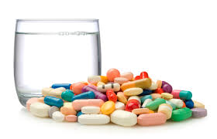
Medication Management
Difficult to find the “right” med(s) the first time.
Complexity of symptoms
Metabolism
May try several before finding the med(s) that works best.

Slide 30
Efficacy
Many patients benefit from medications.
Some patients do not get better and others receive partial benefit.
Meds are not perfect.
Non-compliance, even in studies, can be an issue.

Slide 31
Efficacy: How long does it take?
Varies greatly
If sure of compliance
Reduced aggression within a day or two
Hallucinations may stop in a few days
Delusions take longer and may never completely go away.
Some consumers say they are “no longer bothered by them” or they “don’t worry about them”.

Slide 32
Efficacy: How soon will they relapse?
Varies greatly
Once “steady state” is reached, “half-life” becomes important
Shhh… Don’t speak this out loud
One pill missed won’t hurt
And a couple extra glasses of pop won’t “flush”
But missed pills DO matter- Makes the next easier to miss

Slide 33
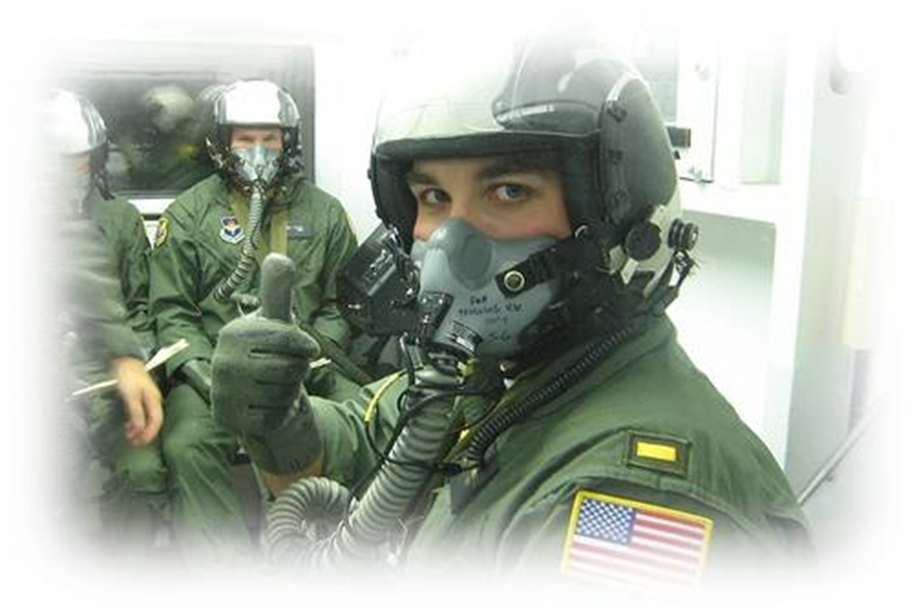
Efficacy: Judgement goes first

Slide 34
Compliance
How many people take medications as prescribed by their doctor?

Slide 35
Compliance

Slide 36
Compliance

Slide 37
Compliance
Non-mentally Ill People

Slide 38
Compliance
Injectables
Haldol decanoate- monthly injection
Prolixin decanoate- every 2-3 weeks injection
Risperdal consta- every 2 weeks injection
Invega sustenna- monthly injection
Zyprexa relprevv- (recent reports of deaths)

Slide 39
Compliance: Reasons for Noncompliance
Side Effects: “I don’t like the way my medicine makes me feel”

Slide 40
Restlessness – Hives - Insomnia - Agitation - Bloody Vomit
Anxiety – Chest Pain – Mania – Hot Flashes – Itching –
Blurred Vision – Coma – Abnormal Bleeding – Swelling
Confusion – Increased Appetite – Nightmares – Fever Delusions – Sweating – Dry Mouth – Dizziness - Rash
Would you want to take them?
Jaundice – Diarrhea – Impotence – Irregular Heartbeat
Twitching – Shaking – Violent Behavior – Constipation
Difficulty Breathing – Suicidal Thoughts – Stomach Pain
Painful Urination – Diabetes – Weight Gain – Blood Clots
Liver Failure – Cardiac Arrest – Fainting – Pancreatitis –
Spasms – Lactation – Lack of Energy – Joint Pain – Fear
Changes in Sex Drive – Disorientation - Hallucinations

Slide 41
Side Effects
Notes:
We tend to label those who do not take their medications as “resistant to treatment” and naively belief that if it treats the problem, it’s worth the side effects.

Slide 42
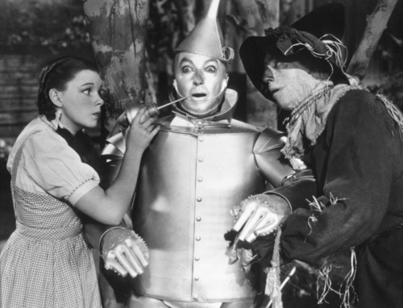
Extra Pyramidal Side-effects

Slide 43
Side Effects: What to Look For
Drowsiness
Dizziness
Rapid Heart Beat
Confusion
Unsteady Gait
Tremors
Muscle Weakness
Agitation
Tardive Dyskinesia
Facial Grimacing
Jaw Swinging
Finger Pointing
Repetitive Chewing
Tongue Thrusting

Slide 44
Compliance: Reasons for Noncompliance
Side Effects: “I don’t like the way my medicine makes me feel.”
Lack of Insight: “I’m not sick. I don’t need meds.”
Efficacy: “I feel so good I must be cured and can stop my medicine.”
High Cost: “My insurance doesn’t cover my meds” or “I don’t have insurance.”
Psychiatric Symptoms: “My doctor is trying to drug me” or “The government wants me doped up.”
Stigma: “I’m not crazy.”
Conflicting Information: “Susie’s husband ruined his liver taking those.”

Slide 45
Compliance: Effects of Noncompliance
Most dangerous 2-7 days after stopping.
Stopped meds abruptly a few days ago and was “normal” prior to that, should at least be evaluated by a nurse who can identify specific medication stopped.
Stopped meds 2 weeks ago, illness may surface but no concerns for withdrawal or med effects.

Slide 46
Overuse or Use of Non-Prescribed Meds
Always evaluate for suicidal intent
Most will cause confusion and delirium
Can cause pinpoint pupils, tremors, sweating, flushed face
Seek a hospital evaluation if:
Someone appears drunk or on drugs but there is no evidence of use.
Someone appears drunk but has an odd physical complaint or physical findings that police can see
If substance ingested and quantity are known, call Poison Control to seek guidance

