Slide 1
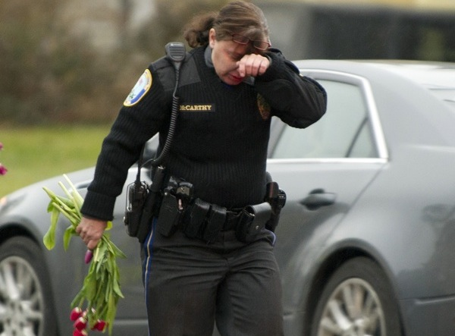
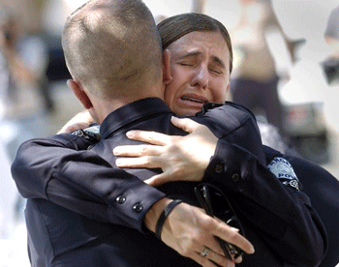
Officer Wellness
Sergeant Jeremy Romo
Supervisor, CIT Unit
St. Louis County Police Department

Slide 3
Signs of Stress
COMMON:
Difference in productivity
Absences/leaving work early
Tiredness, irritability, withdrawn
Reduced quality of work/uncommon mistakes
Indecisiveness and/or poor judgment
Loss of sense of humor/different personality
Somatic complaints i.e. headache, nausea, aches & pains
Poor timekeeping/work not completed on time
Complaining more often than usual
Notes:
Physical Complaints – common during Ferguson (let to our self-care efforts)
Physical complaints are recognized more often
Chest Pains Example.
Lack of motivation (Me)

Slide 4
Signs of Stress
NOT SO COMMON:
Unkempt/disheveled work space
Change in uniform appearance
Out-of-the-ordinary arguments with co-workers, supervisors
Tone, response, behavior on radio
More time in station (avoiding the street)
Change in language, more cursing
Cynical sense of humor/jokes crossing the line
Avoiding interaction with fellow officers

Slide 5
Common Police Officer Stressors:
Inadequate equipment
Excessive overtime (late calls)
Frequent rotating shifts
Regular changes in duties
Constant exposure to suffering
Constant exposure to death
Threats to their safety or health
Lack of manpower
Controlling emotions while being provoked
Inconclusive nature of police work
Quick alternating pace of police work
Responsibility of using a weapon
Inactivity/boredom
Negative attitude toward police
Lack of recognition

Slide 6
Common Police Officer Stressors:
Impending discipline
Favoritism
Promotions/lack of
Salary / No raises
Fellow officers not doing their part
Court leniency
Politics
“Life’s not fair.”
Co-worker conflicts
Paperwork
Big Brother watching
Lack of family time
Personal health problems
Secondary
Financial problems

Slide 7
Startling Statistics:
17 out of 1000 police officers in the U.S. complete suicide
60-70% of police marriages end in divorce
40% of police families experience domestic violence
72% of female officers & 43% of male officers had high cholesterol levels
23% of male & 25% of female officers reported more suicidal thoughts than the general population (13.5%)
40% of officers studied had at least one sleep disorder
Most common sleep disorder among police:
Sleep Apnea (1/3 of officers studied were affected)
Notes:
That leads us into Law Enforcement Suicide

Slide 8
Law Enforcement Suicide

Slide 9
John Violanti, Ph.D.
Research through the University of Buffalo indicates the rate of suicide for law enforcement is 17-21 per 100,000
Los Angeles County Sheriff puts the law enforcement rate at 18 per 100,000
In comparison, the civilian rate is approximately 11-12 per 100,000
The Los Angeles County Sheriff’s Department
Notes:
These are only guesstimates, based on what information researchers are able to glean. Regardless of the statistics, one suicide is too many.
There is no requirement for LE agencies to keep and report statistics on LE suicide; there is no repository for this data, as opposed to UCR data being kept by the FBI.
And, often times suicides are not reported as such. Why would that be?
To protect the agency; to protect the family; to protect the victim.
Ask the participants how and why….suggestions:
-Suicides are often reported as “accidental shootings” while cleaning a weapon
-One-car crashes are often reported as accidents
-Reckless and dangerous behavior is often not seen as suicidal behavior
-The agency doesn’t want the stigma of having a suicide amongst their ranks
-The family will not receive PSOB benefits and may not receive life insurance benefits if it’s reported as a suicide
-They want to preserve the reputation and memory of the victim
-Liability…

Slide 10
Factors in Law Enforcement Suicide
Responses by NYPD Survey:
Depression
Relationship conflicts or personal losses
Easy access to firearms
Drug and alcohol abuse
Financial difficulty
Internal investigations
Media
Notes:
Based on the factors in Law Enforcement Suicide provided through the NYPD Survey and the statement from Hans Selye, one of the world’s leading experts on stress, police work is “the most stressful occupation” .
Discuss with class why…
-We choose to put ourselves in harm’s way
-We allow ourselves to be victimized
-We run towards violence and traumatic situations, not away.
-There is no balance in LE work.
Media Ferguson

Slide 11
Law Enforcement Culture
The largest barrier to officers getting the help they need
Notes:
What factors influence the law enforcement culture different from the general population?
The suicide rate for LE is higher than the homicide rate, yet we receive no training to offset suicide rate.
Robert Douglas: National POLICE Suicide Foundation
“If a 747 airliner with approximately 300 passengers on board crashed each year the FAA would ground 747’s until the problem was discovered and corrected, yet we lose 300 police officers every year to suicide and we think that is just the cost of doing business”.

Slide 12
Culture
Cynicism
Hyper Vigilance
Notes:
Cynical – Contemptuously distrustful of human nature and motive. Webster Definition
Cynicism Ratio page 26 of emotional survival for Law enforcement. (Bullshit Test)
Why do we become cynical? Why might we become distrustful of human nature? SURVIVAL MECHANISM. It keeps us alive.
Unfortunately we often cannot turn this off and what keeps us alive at work causes problems at home.
Hyper vigilance – an enhanced state of sensory sensitivity accompanied by an exaggerated intensity of behaviors whose purpose is to detect threats. Often also accompanied by a state of increased anxiety which can cause exhaustion.
perceive the world as potentially violent to survive on the streets. Viewing the world through a threat based perspective.
Officers are exposed every day to a series of unknown events, any one of which could be perfectly harmless or lethally dangerous.

Slide 13
HYPERVIGILANCE
An enhanced state of sensory sensitivity accompanied by an exaggerated intensity of behaviors whose purpose is to detect threats.
It is also accompanied by a state of increased anxiety, which can cause exhaustion.
Notes:
Viewing the world from a threat based perspective.
Believe that every encounter possesses the potential for risk. Small probability, but 100% possibility
Hyper vigilant mindset - Rapid perception, quick interpretation of events, perceiving unknowns as potentially a threat until proven otherwise.
Most people outside of law enforcement do not need to develop a state of hyper-vigilance when they are at work and they encounter an average level of daily risk
Living between the lines in the normal range of emotion and risk
Average citizen can get away with living between the lines and not experience hyper-vigilance. You cannot
Don’t have to live here all the time. Must develop ability to turn it on and off or else

Slide 14
HYPERVIGILANCE
HYPERVIGILANCE
Normal Range of Risk
Notes:
Hyper-vigilance feels good. It can be a high. That’s why we love this job
Outsiders do not understand
Ride along with citizen on slow night - they think it is the coolest thing going.
Don’t forget the crash at the end of hyper-vigilance. Exhaustion.
Hyper-vigilance can be counter-productive to crisis intervention. When possible have a second person, which allows you to let your guard down and focus on your work.
What happens when you are in this state of Hyper vigilance? Transition
The comedown part causes problems at home

Slide 15
Culture
The suicide rate for police officers is higher than the homicide rate.
What is the true survival skill we seem to be missing?
Notes:
Given this fact, why is it that so little is being done?
What changes need to occur?
How can we protect and serve for community wellness, if we are not well ourselves?
How can we be good family members

Slide 16
Indicators Than an Officer May Be Experiencing Stress or Having Thoughts of Suicide

Slide 17
Signs
Poor appetite
Weight loss
Sleep disturbances
Loss of interest in hobbies & activities
Appearance-neglected
Behavior-fatigue
Mood/affect-down
Loss of energy
Feelings of worthlessness
Difficulty concentrating
Repeated thoughts of suicide
Perceptions/illusions
Thinking slowed
Notes:
Suicidal behavior is the result of a medical condition, not a sign of weakness or a character defect.
These are some of the indicators/symptoms of a major depressive episode (MDE)…
It is believed by psychologists that if a person suffers from 4 of these symptoms, s/he most likely is suffering from a MDE
These are signs/indicators that tell us someone is in crisis.

Slide 18
Situational Precipitators
Being terminated or an IA investigation
Recent unwanted move
Loss of any major relationship (red flag)
Death of a close loved one or cherished friend especially if by suicide
Diagnosis of a serious or terminal illness
Sudden unexpected loss of freedom/fear of punishment
Anticipated loss of financial security
Loss of a cherished therapist or counselor
A fear of becoming a burden to others
Notes:
Times that an officer should be watched closely or monitored….
Traumatic, stressful times for an officer…
Are there other situations you can think of?
“We are the barbed wire that separate the sheep from the wolves.” (A quote from an unknown peace officer)
If we do not deal with the stress of LE, then this wire becomes stretched to the breaking point and an officer may become involved in criminal behavior, domestic violence, alcohol and other drug abuse, and/or suicide.
Talk about when most unpleasant agency memos are released or when someone might be notified of an IA investigation – Friday at 5 PM. This leaves the situation to fester over the weekend until administration and other internal staff return on Monday morning. This can lead to out-of-control behavior that’s not being monitored; no assistance is being given.
Settling lawsuits
Consider the repercussions of agency decisions.

Slide 19
Direct Verbal Clues
“I’ve decided to kill myself.”
“I wish I were dead.”
“I’m going to commit suicide.”
“I’m going to end it all.”
“If (such and such) doesn’t happen I’m going to kill myself
Notes:
Never ignore and always question out of character comments and behavior.
When you hear an officer make these types of comments, take them very seriously.
Find a quiet place to sit down and talk with the officer. Don’t wait!
Spend the time necessary to assist the person in crisis.
Do intervene…remain calm.
Help define the problem; be an active listener.
Focus on central issue; emphasize the temporary nature of the problem.
Ask the question…Have you been thinking of killing yourself? What has been keeping you alive so far? What does the future hold for you?
It’s not so much how you ask or what you ask, but rather that YOU ASK!
Don’t overlook the signs…don’t do nothing.
Don’t sound shocked or offer empty promises.
Never debate morality.
Don’t leave the person alone.

Slide 20
Indirect or “Coded” Clues
“I’m so tired of life I just can’t go on.”
“My family would be better off without me.”
“Who cares if I’m dead anyway.”
“I just want out.”
“I won’t be around much longer.”
“Pretty soon you won’t have to worry about me.”
“I’m worth more dead than alive.”
Notes:
Take these comments seriously….veiled comments carry the same potential as the more direct comments.

Slide 21
Behavioral Clues
Any previous suicide attempt
Stockpiling pills
Co-occurring depression, moodiness, hopelessness
Putting personal affairs in order
Giving away prized possessions
Sudden interest or disinterest in religion
Drug or alcohol abuse or relapse after period of recovery
Notes:
Remember the behaviors we discussed earlier?
Don’t ignore these signs.
Trust your gut instinct.
Take action.
Get help.

Slide 22
Don’t Ignore These Behaviors
May be more aggressive when handling serious calls or situations – risk-taking behavior
Seems more agitated or nervous
Sends letters or communications to close friends outlining wishes if, “something happens to me.”
Seems to lose their love of the profession; becomes disillusioned
Gives away possessions
Has tried to commit suicide before
Notes:
Boston Rob

Slide 23
Suicide Clues and Warning Signs
The more clues and signs observed, the greater the risk.
Take all signs seriously.
Notes:
Be aware. Be vigilant. Take action to save your fellow officers.
Respond early; don’t ignore; you may not have another chance.

Slide 24
Leaders, Supervisors, and Managers
Obtain suicide prevention training for your agency.
Make sure that information about suicide prevention is available to all staff.
Be aware and encourage the use of resources such as chaplains, peer support, Employee Assistance Programs (EAP), and psychological services/counseling.
Ensure that your employees feel they will be given assistance and support when they bring a problem forward.
Notes:
Changing the organizational culture necessitates dealing with many issues. A successful organizational response requires training. Not only must employees understand the issues, they must be able to recognize warning signs within themselves and their peers. As important, managers and supervisors must be able to identify the warning signs among their employees, understand methods by which successful intervention can occur and feel that their support of their personnel is both applauded and encouraged by agency executives.
Incorporate suicide prevention and stress management training from the beginning of the employee’s career all the way through the career, in annual training. (James D. Sewell, “Police Suicide: an Executive’s Perspective”)
EAP Changes
Training
Peer Support
CISM
Specialized Unit Debriefings

Slide 25
Leaders, Supervisors, and Managers
Leaders : you cannot distance yourselves from your officers in time of crisis nor can you afford to send the message that you simply do not care.
We must assure that our personnel hear the message from our leadership loud and clear…
It takes courage to ask for help --
Be courageous!
Notes:
Stress/trauma is an expected and acknowledged part of our law enforcement profession. In its most extreme form, stress is magnified especially when combined with an emotional crisis in the employee’s personal life.
Temper firm management with compassion.
It takes Courage! Be Courageous!
Supervisors lead from the front (supervisors in debriefs)

Slide 26
Leaders, Supervisors, and Managers
You could be saving a life! (police suicide rate: 17 of 1,000)
Getting back a good officer.
Keeping a good officer.
Fixing a family, marriage, relationship.
Preventing complaints/reducing liability. (Texas pool party)
Healthy cops solve crimes and make you look good!
They will remember you and how you helped them!

Slide 27
“Officer Wellness” must be a priority at all levels of an organization (Commissioned and Civilian)
Chaplains
On Duty/Off Duty Self Care Sheet
Educate Supervisors
Employee Assistance Program
CISM
Employee Assistance Program
Don’t Forget the Family
Culture Shift
Notes:
The Oh Shit Moment – Officers needing help

Slide 28
Employee Wellness (Chaplains)
Notes:
Chaplains were a constant presence
Diverse group of chaplains
Did not preach, but listened
Handed out on duty/ off duty sheet

Slide 29
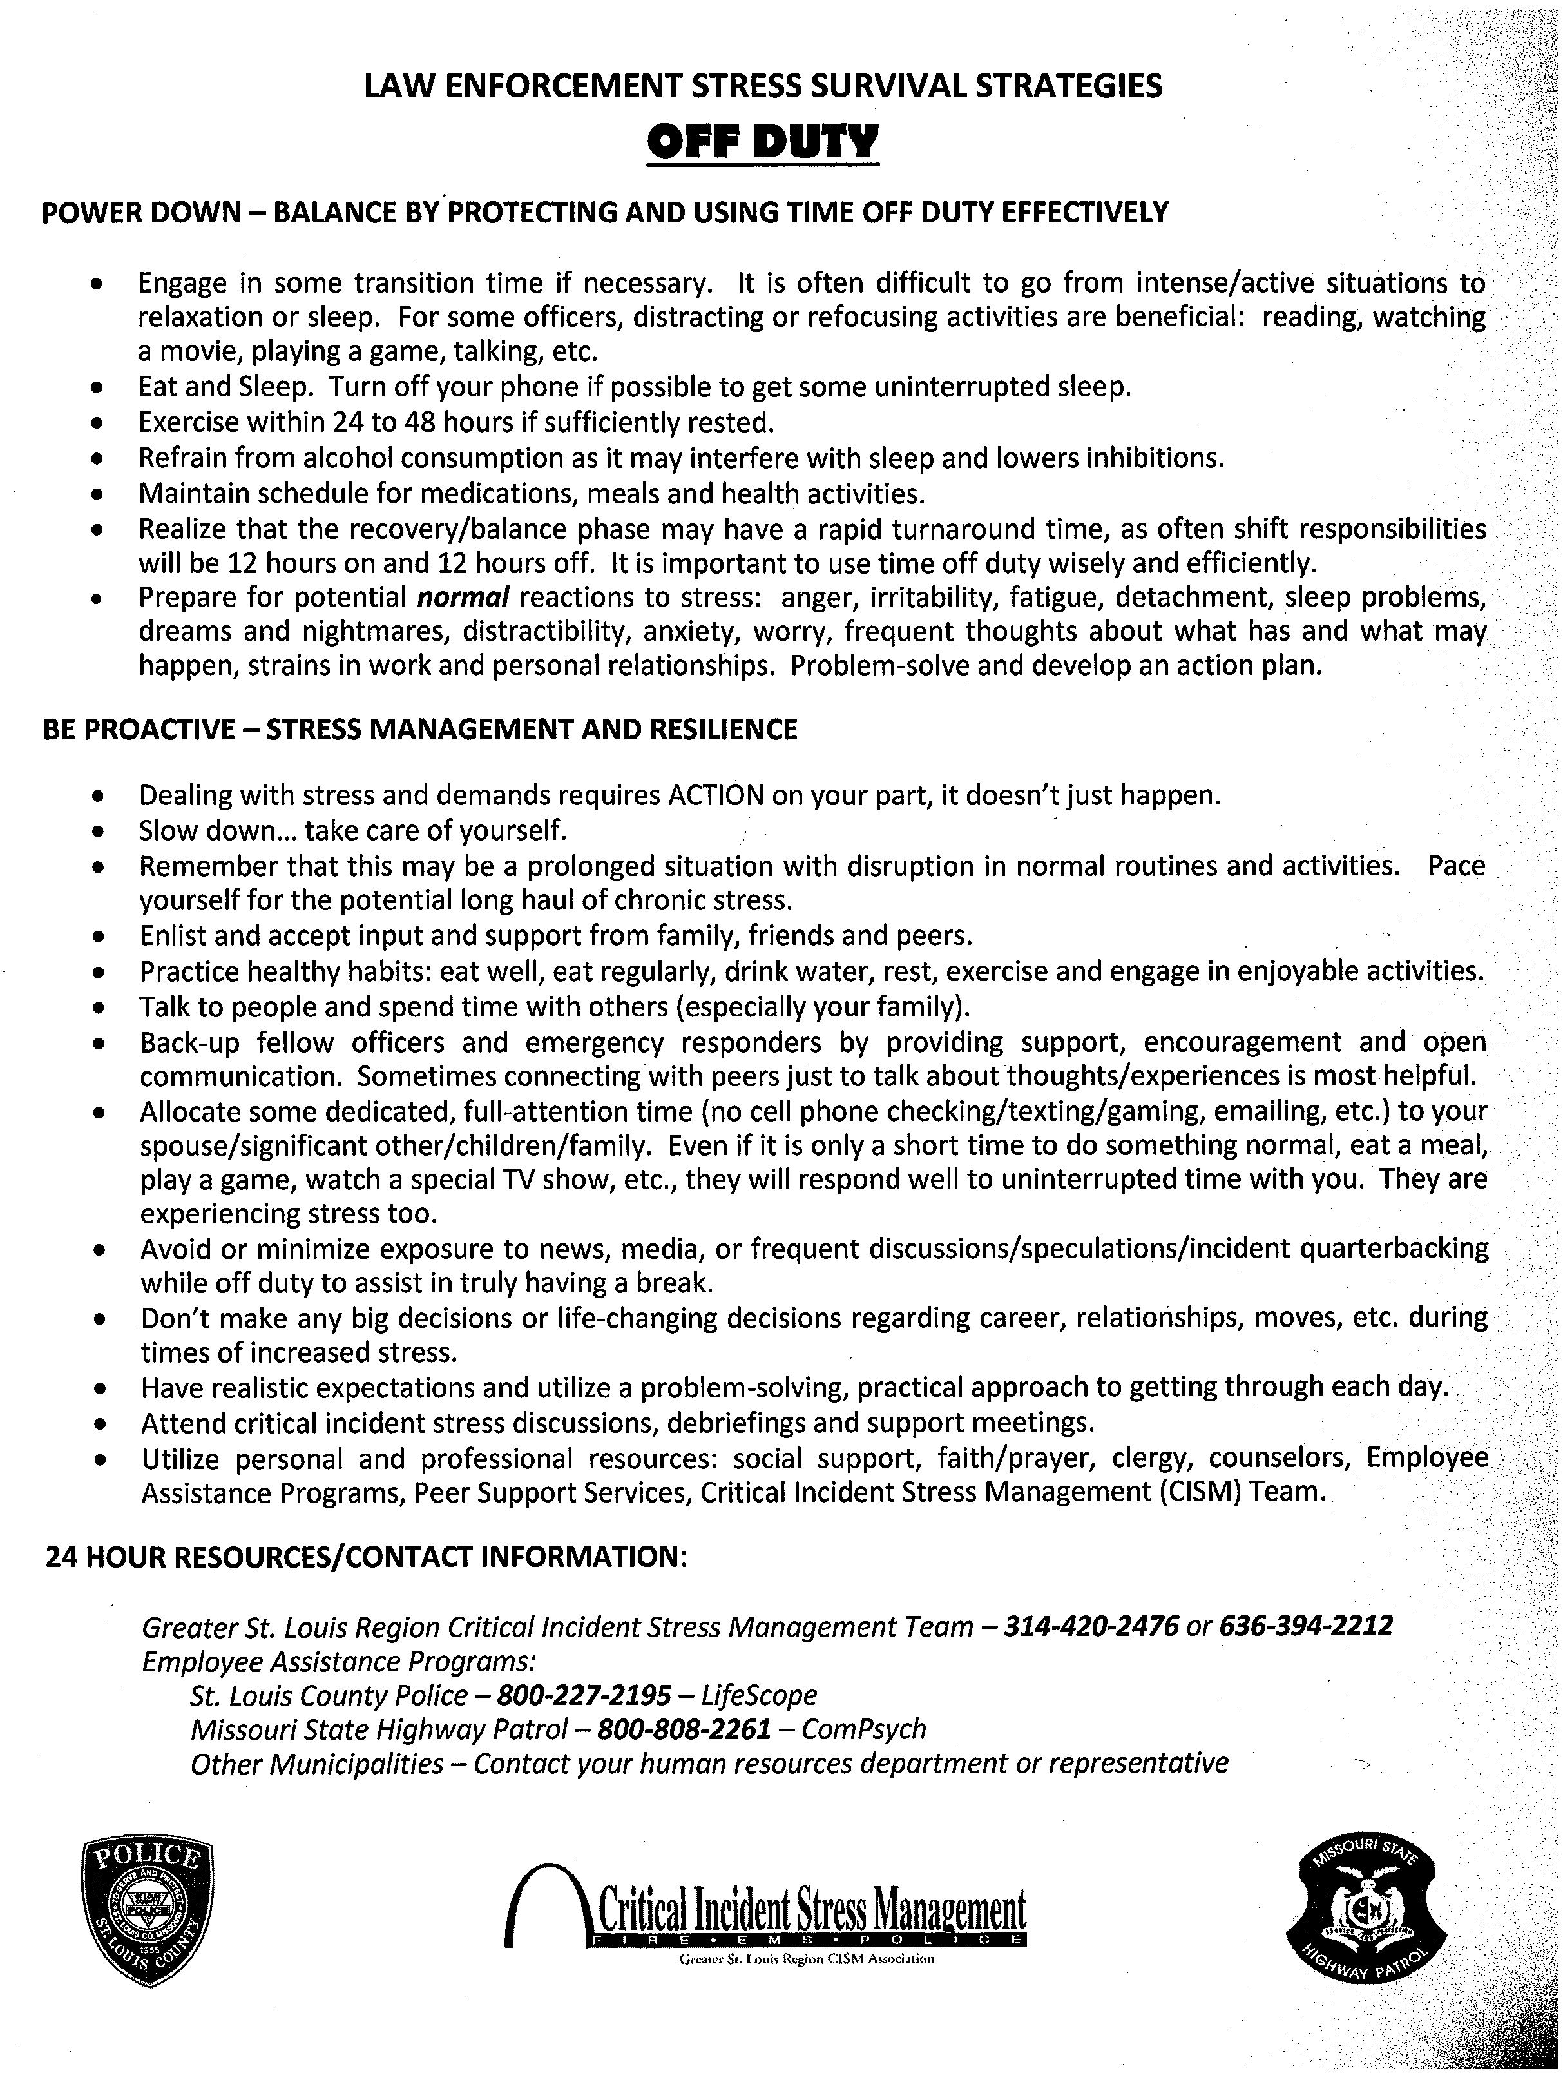
Employee Wellness (On Duty / Off Duty Handout and Educate Supervisors)
Notes:
Stolen from Connecticut State Police
New York State Police
Troy Anderson
Supervisors need to recognize signs of stress

Slide 30
Employee Wellness (Post Action Discussion / CISM)
Do we need a debrief?
Mandatory vs. Voluntary
Not a traditional traumatic event
Employee buy in
Who conducts the debrief?
St. Louis Area CISM developed modified debriefing model
01/13/2015 to 02/10/15
36 PAD’s for over 800 commissioned employees
(supervisors and officers separate)
Common Themes
Opening of each PAD
Notes:
Mandatory vs. Voluntary (Connecticut)
Not traditional traumatic event ( multi-phase event)
Traditional Mitchell model debrief – re-traumatize?
Getting employees to participate in process
Connecticut offered to assist with debrief (decided on local CISM)
Common Themes: Anger towards media, politicians and public
Frustration with command (not able to do their jobs or utilize training)
Lack of trust and support from govt leaders, command, public
Change in law enforcement as a profession
Change in attitude, morale, motivation
Opening of PAD - why? Questionnaire, personal experiences etc.
Alex/Monterey - Salinas California

Slide 31
Post Action Discussion / CISM (The Questionnaire)
756 Questionnaires returned
CISM spent 85 hours compiling data from questionnaires
Findings
Noted Stress
Self – 73%
Others Officers – 89%
Family – 83%

Slide 32
Post Action Discussion / CISM (The Questionnaire)

Slide 33
Post Action Discussion / CISM (The Questionnaire)

Slide 34
Post Action Discussion / CISM (The Questionnaire)

Slide 35
Post Action Discussion / CISM (The Questionnaire)
Reported coping strategies
Family / friend support
Just keep going
Talking to peers
Exercise
Faith
Avoid media
Feedback regarding department
Better pay
Better communication
Ride with officers, promote LE to media, include officers in problem solving
Support officers
Better scheduling
Peer support / CISM

Slide 36
Employee Wellness Employee Assistance Program
Develop Strong Partnership with EAP
Find Providers That Understand Law Enforcement Culture
Utilize EAP Training Opportunities
Educate Employees about EAP
Notes:
Met with EAP
Former cops as providers
Training
Education about EAP at In-Service Training
(Confidentiality)

Slide 37
Family Event St. Louis City Museum
Notes:
Finish Self-Care with discussion of need for a culture shift.
Start a Culture Shift Now

Slide 38
Ferguson effect - the new normal
'Ferguson Effect' Blamed for Drop in Proactive Policing. –Police Chief Sam Dotson, SLMPD
Officer fatigue and stress from months of Ferguson protests may be emboldening criminals and contributing to an uptick in crime, police officials and a criminologist say.
Chicago mayor blames city’s crime uptick on officers second-guessing themselves—Mayor Emanuel

Slide 40
QUESTIONS
Sergeant Jeremy Romo
Supervisor CIT Unit
St. Louis County Police Department
Office: 314-615-7117
Mobile: 314-581-5459
jfromo@stlouisco.com

