Slide 1
Tactical Planning To Increase Officer/Consumer Safety and Reduce Law Enforcement Liability
Sergeant Jeremy Romo
St. Louis County Police Department
Supervisor, Crisis Intervention Team Unit
Missouri State CIT Coordinator

Slide 2
OBJECTIVES
Differentiate between a CIT call and a tactical situation.
Explain what additional resources should be requested in the event of a tactical situation.
List the steps that should be taken by patrol officers during a tactical situation.
Explain containment and the difference between inner and outer perimeter.

Slide 3
OBJECTIVES
Describe an immediate action plan and explain its importance to the safe resolution of a crisis situation.
Describe the proper way to conduct an officer/citizen rescue on foot and using a vehicle.
Describe the CIT officer’s role during an incident involving a barricaded individual.
Discuss officer created jeopardy and the liability associated with the failure to manage officer created jeopardy.
Notes:
CIT is not the answer for everything.
CIT is most likely to be successful especially in extremely volatile situations when it is coupled with good officer safety tactics and proper Tactical planning.
We must be able to recognize and appreciate when a situation is beyond our capabilities to handle with normal CIT and patrol tactics.
That does not mean that we cannot contain the situation and continue crisis intervention while we explore tactical options.
Pray for the best and prepare for the worst.
Winchester Example

Slide 4
Notes:
When we show up at a call and determine that there are safety issues that will not allow CIT to resolve the situation we have attempt to resolve the situation ideally in a way that is safe for officers and the person in crisis.

Slide 5
Tactical Science Sid Heal “Field Command”
“Systematized body of knowledge covering the principles and doctrines associated with tactical operations and emergency responses”
Identifying the factors in play during a situation and applying knowledge to forecast and influence behaviors and outcomes to enhance a more satisfactory outcome.
Notes:
Must have a broad view of the situation, so you do not miss important factors that must be considered in making decisions.
No cookie cutter solution to tactical problems.
Each situation is different
Don’t confuse good luck with good tactics!!!
Formulate a Plan
.

Slide 6
TACTICAL SITUATION
An incident involving an ARMED and BARRICADED person, hostage, sniper or other situations where standard patrol tactics are not adequate to safely resolve the situation and specialized police tactics are required.
RECOGNIZE TACTICAL SITUATION AND REQUEST PROPER RESOURCES
Notes:
To resolve a Tactical Situation we employ the concept of Tactical Planning
“Field Command” Sid Heal

Slide 7
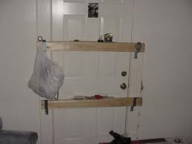
Analyzing the Barricaded Individual

Slide 8
Types of Barricaded Situations
4 types of barricade situations
Armed barricaded individual, no hostage
Armed barricaded individual, with hostage
Armed barricaded suicidal individual
Armed barricaded suicidal individual with a significant other
When is the situation beyond the capabilities of patrol officers?
Notes:
Talk about difference between high profile and low profile containment.
Risk Factors to law enforcement

Slide 9
Armed Barricaded Person No Hostage
During the commission of a crime.
Quick response by law enforcement.
Barricades for the purpose of eluding law enforcement, visions of escape to avoid apprehension.
To avoid arrest during the execution of an arrest warrant.(fugitive)
Can easily change to a barricaded suicidal person drastically changing the risk to officers.
Suicide by police.
Notes:
I am not going back to jail scenario
High Profile vs. Low Profile containment

Slide 10
Armed Barricaded Person With Hostage
Hostage- a person being held against their will for the purpose of fulfilling certain terms.
In these situations the hostage generally has no relationship to the hostage taker.

Slide 11
Purpose of Hostage Taking
Initial act is created by survival instinct brought on by a crisis state. (spontaneous)
Hostage is used for initial barrier to keep law enforcement at a safe distance.
Hostage is used as a bargaining chip to ensure safety ,to bargain for the possibility of escape and/or substantive demands.
Notes:
Substantive Demands: money, escape, political/social change.
Hostage situations present greater opportunity for police to control the incident and influence the subject’s behavior.
High profile containment is often useful
Ask when the two most dangerous times are during a hostage situation?
Initial siege
Assault by law enforcement

Slide 12
Purpose of Hostage Taking
Two most dangerous times are during the initial siege and next during an assault by law enforcement.
Hostage becomes an added barrier of protection when the hostage taker is in an extreme mode of survival.
Notes:
How do we handle a hostage situation?
Stall for time
Lower their expectations – over time their demands tend to become more realistic when they start to realize they don’t have as much control as they thought
These tactics along with subtle displays of tactical capabilities send powerful message and allow negotiator to discuss positive police actions in the form of inaction.
HIGH PROFILE CONTAINMENT

Slide 13
Armed Barricaded Suicidal Person
Barricaded due to extreme emotional problems
High levels of frustrations lead to crisis state
Action Imperative is high
Officer Safety Risk
Must manage officer created jeopardy
Be aware of suicide by police
Avoid manipulation of anxiety
Notes:
Emotional act, self destructive behavior.
Motivated by anger, rage, frustration, hurt confused or depression
Often no substantive demands or unrealistic demands
LOW PROFILE CONTAIMENT
Geno Examples:
Flash bang bean bag assault
Broken Window Example caused death (Philosophy change – my time in tact not break windows or launch gas on suicidal person

Slide 14
Armed Barricaded Suicidal Person Holding Significant Other
Homicide with suicide to follow.
Victim precipitated homicide possible.
Negotiate or Hostage Rescue
Risk factor to law enforcement is extremely high.
Notes:
What type of containment?
RISK FACTORS:
is not making demands and does not appear to need anything from police
Focus is against person held
Person being held is victim not hostage
High profile containment can make things worse
Review show of force at this point:
Limited shows of tactical capacity can help negotiations along by encouraging dialogue. It is a delicate balance.

Slide 15
Notes:
TRANSITION TO BARRIERS

Slide 16
Crisis Decision Making
“Mental Process of reaching a conclusion during a time of instability and danger relevant to resolving the situation”
Satisficing – “method of making decisions that opt for a prompt search for adequacy over a prolonged one for the optimal”
Campfire example
Notes:
Traditional Methods and procedure for making decision to solve crisis may not work with crisis decision making because speed is often as or more important than precision.
Tactical situations are dynamic and decisions delayed can be worthless because the situation has changed.
We are looking for appropriate timely solutions even if it is not optimal.
Stomp out fire
Remove flammable materials
Covering it with loose dirt

Slide 17
Factors that influence Decision Making
Experience
Emotions
Perceptions
Notes:
Experience – practical wisdom comprised of knowledge and skills attained through personal participation or observation. People who make decisions based on experience don’t start at the beginning of a problem, but where they left off the last time.
Persons with experience make better decisions quicker. Sid Heal Refers to this as RPDM – Recognition Primed Decision Making
Emotions – subjective feelings and influences that occur without conscious effort and are affected by such things as anxiety, fatigue, hunger, and pain. Emotions also influence decisions from personal dispositions, biases, and prejudices.
Perceptions – how the mind interprets a sensory stimuli

Slide 18
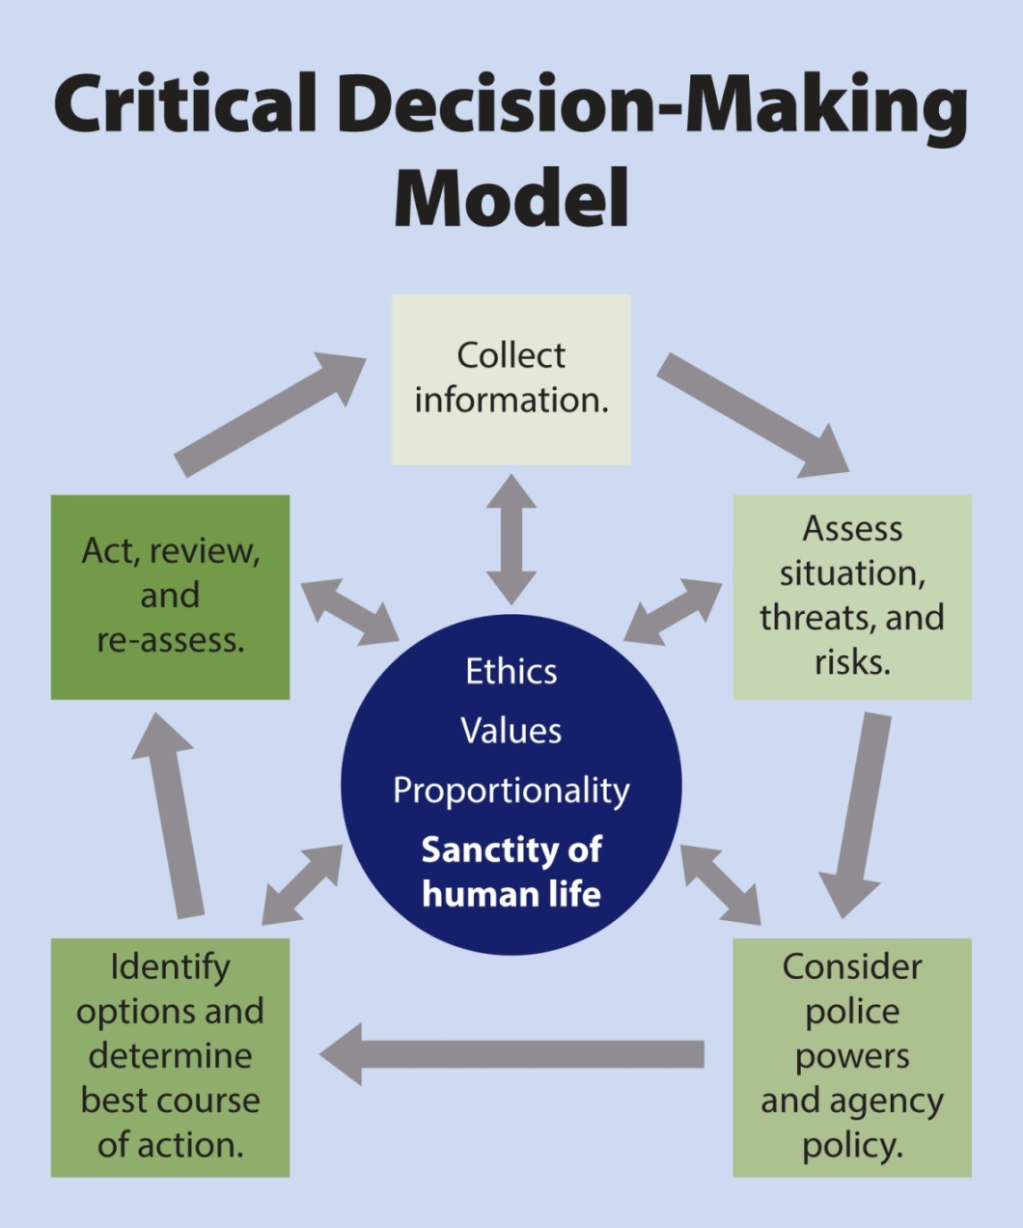
The Critical Decision- Making Model
Notes:
PERF ICAT Training December 2017
(Integrating Communications, Assessment, and Tactics)
OODA loop and Critical Decision-Making Model is something we already do. This is just putting a process to it and articulating it.
SWAT Teams use this all the time.

Slide 19
The Critical Decision-Making Model
CDM Core
Ideals that define the agency
Ethics, values, mission statement, guiding principles and priorities
Core informs/guides each step in the model
Notes:
Mission Statement
The mission of the St. Louis County Police Department is to work cooperatively with the public, and within the framework of the Constitution to enforce the laws, preserve the peace, reduce fear and provide a safe environment in our neighborhoods.
Department Values
Human life, Integrity, Laws and Constitution, excellence, accountability, cooperation, problem-solving, ourselves.
IACP Law Enforcement Code of Ethics
Primary responsibilities of a police officer, performance of the duties of a police officer, discretion, use of force, confidentiality, integrity, cooperation with other police officers and agencies, personal and professional capabilities, private life.
Proportionality - is the level of force being use proportional to the level of threat.
Guides us in every step of the Critical decision making model.

Slide 20
The Critical Decision-Making Model
Step 1: Collect Information
Ask yourself …
What do I know so far about this incident?
What else do I need to know?
What do my training and experience tell me about this type of incident?
Notes:
Gather as much intel as possible
Dispatch
Family
Friends
Neighbors
Co-workers etc.
COLLECTING INFORMATION IS AN ONGOING PROCESS THOUGHOUT INCIDENT AND WILL LEAD TO ADJUSTMENTS IN ACTIONS
MUST BE FLEXIBLE

Slide 21
The Critical Decision-Making Model
Step 2: Assess Situation, Threats & Risk
Ask yourself …
Do I need to take immediate action?
What more information do I need?
Am I trained and equipped to handle this situation myself
What is the threat/risk?
Notes:
Is there a less dangerous option?
Do I need to do this now or can it wait?
Do I have available resources that I can bring to bear that would make situation safer for everyone involved?

Slide 22
Situational Assessment
CIT calls like Tactical situations are complex problems and usually cannot be resolved with simple solutions
They should be divided into easily defined and manageable problems
Situation Assessment – identify elements and dynamics of the situation
SWOT technique
Synthesis: A + B =C
Notes:
S – Strengths
W – Weaknesses
O – Opportunities
T – Threats
Synthesis – integrating the various components and activities into a cohesive whole so that the plan is effective and efficient. Putting the right parts in the right order. A + B + C = resolution
Be flexible because A can cause changes that were not anticipated so B becomes ineffective and you have to go back to the drawing board.

Slide 23
The Critical Decision-Making Model
Step 3: Consider Police Powers & Agency Policy
Ask yourself …
What legal powers do I have to take action?
What agency policies control my response?
Are there other issues I should think about (jurisdictional matters, mutual aid, etc.)?
Notes:
Department Policies – Use of Force, Pursuit, etc.

Slide 24
The Critical Decision-Making Model
Step 4: Identify Options, Determine Best Course of Action
Ask yourself …
What am I trying to achieve?
What options do I have?
What contingencies must I consider if I choose a particular option?
Do I need to act now, or can I wait?

Slide 25
Tactical Planning Priorities
1. Establish containment and isolate the event
2. Request the appropriate Resources
3. Establish a Staging area
4. Immediate Action Plan for MOST PROBABLE events
5. Arrange for Medical Care/Ambulance staging
6. Gain intelligence/Develop communication Strategy
Notes:
Once you have established that you have a tactical situation
Inner perimeter and outer perimeter
Containment - review low profile vs. high profile containment
cover and concealment.
Purpose of Containment
Prevent spread of threat
Prevent escape of subject
Prevent entry of uninvolved or unauthorized persons into crisis site
Isolate subject
Motivate subject to comply with law enforcement request
2. Request the appropriate resources - command post, tactical unit, K9, Bomb and Arson, Medics etc.
3. Establish a staging area: Good staging area/bad staging area

Slide 26
Force Multipliers
Know your resource’s abilities, limitations and options they provide
Shield
Taser
Assault rifles
Less-lethal
K-9
Specialized Units-Tactical Operations, Arson and Explosives, Helicopter, etc.
Notes:
If you work for a muni you can still request additional resources
Multi-jurisdictional agreements
When in doubt call tactical situation.
Force multipliers can be intangible, such as training, preparedness, creativity, experience.
Don’t forget intangible force multipliers.

Slide 27
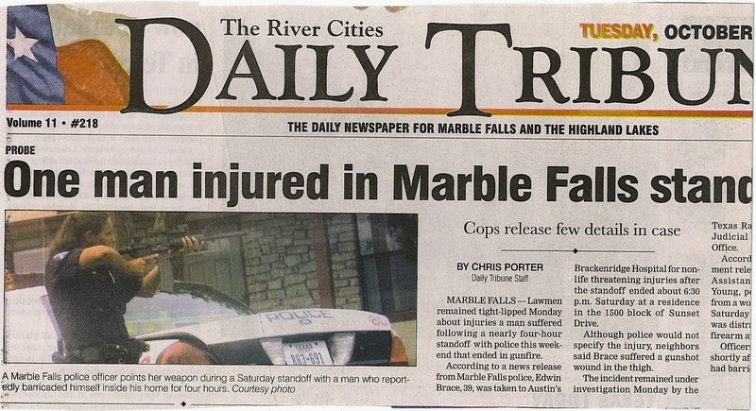
TACTICAL PLANNING
Know your resource’s abilities:

Slide 28
Three Types of Plans
Hasty Plan
Deliberate Plan
Contingency Plan
Notes:
Hasty Plan – provides an organized response for spontaneous or unintentional events and detailed planning is not possible
Deliberate Plan – a comprehensive and detailed method for accomplishing an objective. The preferred course of action. Probably not going to have a deliberate plan on CIT calls waiting for Tact.
Contingency Plan – an alternate plan that focuses thought and effort on anticipated problems that may arise

Slide 29
Tactical Planning
The art and science of envisioning a desired future and laying out effective ways of bringing it about.
Two interrelated factors of tactical planning:
Preparing for anticipated contingencies
Recognizing that all planning attempts to alter the future
Notes:
How do I want this to end and how am I going to get there?
“Seldom does a plan at the end of an operation bear more than a vague resemblance to the one at the beginning”
We have to adapt and be flexible
YOU CONTROL THE SCENE:
1. PLAN every police action to achieve an objective
2. COMMUNICATE the plan to all officers
3. CHOREOGRPAH the plan (NO SURPRISES)

Slide 30
Immediate Action Plans
Scenario Considerations and Contingency Plans:
Knowledge of subject’s goal will help predict their next action
Plan for the unexpected:
Shots Fired, Escape attempt of suspect, hostage or 3rd party unknown, Officer Down, spontaneous surrender, Aggressive Dogs, Identify Safe Areas; etc.
Notes:
Can’t think of everything
Learn from others problems – sheet over the head
Importance of debrief
Fenton 10-40 example of person under porch
Opportunity – a brief interval in time in which circumstances are temporarily favorable. According to Sid opportunities in tactical situations are elusive, sporadic and fleeting.
Take advantage of any exploitation window – period of time in which an individual or unit is at some sort of disadvantage as a result of an intentional action by us.

Slide 31
Immediate Action Plans
Should the subject surrender, at any time are you prepared?
Planned or spontaneous surrender (Jennings)
What is the nature of the surrender?
compliant, semi-compliant or hostile
Who gives the verbal challenges?
What should be said?
Where should the subject be directed?
GOOD COMMUNICATION IS ESSENTIAL DURING A SURRENDER
Notes:
ONE PERSON TALK AND GIVE COMMANDS

Slide 32
Immediate Action Plans taking someone into custody
Should be out of sight but close enough to react immediately.
Handling the subject-minimum of three officers
Lethal coverage on suspect
Hands on officer
Lethal coverage on residence or other threat areas
Manpower Permitting:
Less Lethal Officer (Taser, Impact projectiles etc.
Shield Officer
LINE IN THE SAND
Notes:
Less lethal/tazer not until lethal coverage

Slide 33
Immediate Action Plans
Notes:
Loud Verbal Commands

Slide 34
Containment-line in the sand
Notes:
Contain the situation and bring proper resources to situation
With the luxury of time we have to begin to formulate a plan.

Slide 35
Notes:
Less lethal deployments
Cop
Drunk guy

Slide 36
Two Vehicle Rescue (For officers or civilians)
Four officers in each vehicle.
VEHICLE #1
Driver: Perimeter, cover assigned field of fire
Right Front: Squad Leader (Command Rescue, deploy smoke)
Left Rear: Perimeter, cover assigned field of fire
Right Rear: Perform Rescue
VEHICLE #2
Driver: Perimeter, cover assigned field of fire
Right Front: Perimeter, cover assigned field of fire
Left Rear: Perform Rescue
Right Rear: Perimeter, cover assigned field of fire

Slide 37
Two Vehicle Rescue (For officers or civilians)
C
THREAT
V1
V2
L
D
D
SL
C
L
C
V
L

Slide 38
Two Vehicle Rescue

Slide 39
ONE VEHICLE OFFICER/CITIZEN RESCUE
Position vehicle between victim and threat
Driver - Is the Team Leader and also a carry officer.
Right Front and Right Rear – Provide lethal Coverage toward the threat.
Left Rear – Carry Victim and place in rear of patrol vehicle.

Slide 40
ONE VEHICLE OFFICER/CITIZEN RESCUE
THREAT
V1
L
L
D/TL
C
V

Slide 41
The Critical Decision-Making Model
Step 5: Act, Review and Re-assess
Execute the plan, then ask yourself …
Did I achieve the desired outcome?
Is there anything more I need to consider?
What lessons did I learn?
If the incident is not resolved, then “spin the model”

Slide 42
The Critical Decision-Making Model
“Spinning the Model”
Information collection is ongoing
As new information comes in … threats, risks and options can change
“Spinning the model” means re-assessing, fine-tuning your decision-making
Notes:
REPORT WRITING – Looking at this model will help articulate in writing what you did and why.
Protect from liability.
REVIEW CDM MODEL AGAIN

Slide 43
TACTICAL PLANNING HOW A CIT CALL GOES BAD
July 13, 2001, Lubbock Texas
Suspect Richard Robinson (47) “Distraught, belligerent and making suicidal comments ” He argues with his wife over his year long unemployment. He sets fire to furniture in his front yard, prompting a police response. Police contact him by phone and describe him as “distressed and emotional.” He is inside the home, alone. 3 hours from the initial call, police move in to “break and rake a window.”

Slide 44
Notes:
Officer citizen Rescue plan and training
How to do it and how to carry someone

Slide 45
Suicidal Individual on Ladder

Slide 46
The New Guy
Notes:
Talk about officer/citizen rescue

Slide 47
CIT OFFICER’S ROLE IN A BARRICADE SITUATION

Slide 48
CIT Officer’s Function During Tactical Situation
Verbal containment
Establishing best option for contacting subject.
By phone
Phone (yours, friends, neighbors)
Dispatcher
Face to face
Public Address System
Text messages
Email
Notes:
Verbal Containment - Review Pros and Cons?
Face to face most dangerous. Do from behind cover and have lethal coverage with you.
Do not take your gun off.
-locate avenues of escape for yourself…disengage if needed. ..deteriorates into 10-40.

Slide 49
CIT Officers role in gathering intelligence
Intelligence Gathering (Information vs. Intelligence)
All on-scene law enforcement personnel are accounted for and their positions are known.
Address verification
Phone numbers (home, cell)
Movement- what is occurring
Physical descriptors
Notes:
Discuss difference between information and intelligence:
Often used interchangeably, but are very different
Information – knowledge or news of an event or situation gained through collection of facts or data.
Intelligence – specific information related to the situation at hand. Intelligence is usually a combination of bit of information that has been put together and substantiated to form a more complete picture.
Information is raw data and Intelligence is processed data.

Slide 50
CIT Officers Role Gathering Intelligence
Who is involved?
SUBJECTS
VICTIMS
HOSTAGES
What are their condition?
Record check and criminal history
Mental health and substance abuse history?
Military history
Medical conditions
Call history at address
Info on family members, friends, and neighbors
Prior CIT reports
Prior contacts with law enforcement
Recent life stressors
Language or cultural barriers
Suicidal actions or statements
Potential for victim precipitated homicide

Slide 51
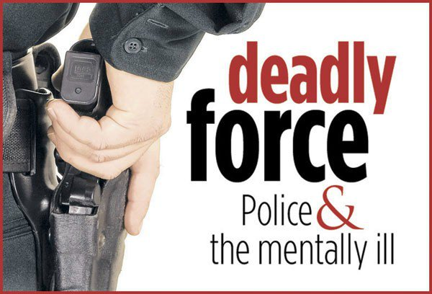
Avoiding Law Enforcement Liability When Interacting With Individuals With Behavioral Health Disorders
Notes:
Sid Heal, “Law Enforcement Tactical failures have long been a critical weakness that creates civil exposure, criminal liability, and a loss of public confidence. Some law firms now specialize in suing police agencies and multi-million dollar judgments are becoming increasingly common”.
“Even those with no expertise in tactical operations are able to assuredly identify shortcomings after an event. With hindsight, even imbeciles can be geniuses”
We cannot completely avoid using force with individuals with mental illness and substance use disorders
Proximate Cause – a factor or influence that appears clearly apparent and directly connected to the outcome.
Approximately 30,000 lawsuits a year for law enforcement agencies

Slide 52
Action Imperative Mindset
Law enforcement officer often feel a need to act in order to solve the problem
We get pressure from peers, public, media, supervisor, etc.
Sometimes taking action can result in a reaction that causes a catastrophic domino effect and results in unnecessary loss of life
KILLS CONSUMERS/CITIZENS AND OFFICERS

Slide 53
Officer Created Jeopardy
When an officer deviates from established tactics or policies and his/her actions unnecessarily place him and/or others at greater risk or harm.
Notes:
What causes OCJ?
Failure to adapt to changing conditions
Lack of knowledge
Inability to apply knowledge in a strategic and tactical way to changing conditions
False sense of urgency coupled with an impulsive response

Slide 54
Failure to Train
Deliberate Indifference
City of Canton Ohio v. Geraldine Harris
“Adequately trained officers can make mistakes. Liability can only attach where failure to train reflects deliberate indifference to the constitutional rights of citizens and deficiency must be closely related to the ultimate injury”
Training should be designed to directly correspond with recurring tasks of police work.
Notes:
Deliberate Indifference – Three part test
Excessive Risk or harm -
Knowledge of Risk -
Conscious Disregard –

Slide 55
Notes:
Impact munitions training – test and practical. Keep tests.
Tazer example
Less lethal impact areas

Slide 56
Force Avoidance
Properly evaluate the situation
Unless justified, do not put yourself in a situation which requires the use of deadly force
Officer must not force the confrontation when he/she has a position of tactical advantage.
Tactical Disengagement
Notes:
Why am I doing this now ?
Why did I not do this ten minutes ago or what if I wait another ten minutes
Are there less risky alternatives available?
Tactical Disengagement - Tactical Retreat
REPOSITION - When you show up on scene you do not step into concrete shoes.

Slide 58
Quezada v. Bernalillo County
FACTS OF THE CASE
December 20,1996 – 3 officers contact a suspicious woman sitting in her vehicle parked in a parking lot.
Woman is uncooperative, she will not identify herself or exit vehicle.
Officers observe her pick up a handgun.
Two officers take cover and one officer stays within 5 feet of the vehicle in the open.
Suspect makes suicidal statements and actions.

Slide 59
Facts of Quezada v. Bernalillo County Continued
Officers observed that suspect is drinking alcohol.
All three officers continued to give verbal commands for suspect to put the gun down and exit the vehicle.
Suspect slowly tried to drive away, but officers had blocked any exits with patrol vehicles. (Not trying to strike officers)
The one officer purposely positioned himself within five feet of suspects car window.
Officer claimed suspect pointed handgun at him so officer fired three times killing the suspect.

Slide 60
Quezada v. Bernalillo County Court Ruling
Court found that the officer voluntarily and negligently placed himself in a position of peril where he had no choice other than to use deadly force.
Court felt that officers negligence was the proximate cause of suspects death.

Slide 61
Mercado v. Orlando Facts of the Case United States Court of Appeals, 11th Circuit (April 29, 2005)
Domestic Dispute where wife calls police
Wife tells police suspect (Ramon Mercado) threatened suicide by wrapping a cord around his neck and cutting his arms multiple times with knife
Police try for 20 minutes to make contact from outside apartment unsuccessfully and then enter

Slide 62
Facts of Mercado v. Orlando cont.
Find Mercado sitting on floor crying and holding a knife to his chest. Telephone cord is still around his neck.
Officers order suspect twice (once in English and once in Spanish) to drop the knife
Suspect makes no threatening movements toward police
No verbal warnings given

Slide 63
Facts of Mercado v. Orlando cont.
15 to 30 seconds after the two verbal commands Officer #1 follows Officer #2’s order to strike the suspect with a KO1 round from a SAGE SL-6.
From 6 FEET Officer #1 fired two rounds hitting the suspect 1 time in the head. (Officer clamed to be aiming for the shoulder
Impact did not kill however, suspect skull was fractured causing numerous permanent medical problems. Suspect is disabled.
COST $1,243,876.00

Slide 64
Mercado v. Orlando Problems
2 Verbal Commands and then Deployment 15 to 30 Seconds Later?
Negotiation/CIT
Distance to target – 6 feet = 2 yards
Shot placement
Enough Officers
Action Imperative Mindset of officers

Slide 65
OPEN AIR BARRICADED SUBJECT

Slide 66
Cost of Training Vs. Cost of Litigation
Glenn v. Washington County - $2.5 million
Ostling v. City of Bainbridge Island – $1.47 million
SLOW IT DOWN IF POSSIBLE
Use a decision making model
Notes:
Glen v. Washington - Drunk kid on porch
Ostling v. City of Bainbridge Island – Over garage apartment mentally ill

Slide 67
St. Louis County Police Tactical Operations Unit
Captain Brian Ludwig
Sergeant Matt Pleviak
Sergeant Brian Schellman
Office
(636) 532-2984
St. Louis County Communications
(636) 529-8210

Slide 68
The Critical Decision-Making Model

Slide 69
CIT/Barricaded Subject Scenario
Call: Domestic Dispute between subject (Tim) and his wife (Karen). Two kids in the residence Kimberly (age 3) and Robert (age 5). Upon law enforcements arrival Tim barricades himself in residence with wife and two kids. First officer on the scene was met by Tim at the front door holding a assault rifle.
Tim: 37 year old male w/m veteran. Both legs amputated below knee. History of Depression, T.B.I., PTSD and alcohol and opiate addiction. 3 prior suicide attempts. Tim was discharged from military due to injuries sustained in I.E. D. explosion. Multiple firearms in the home.
Karen: 35 year old w/f married to Tim for 6 years. Recently filed for divorce.
Environmental Conditions – 11pm on December 13th. Currently 11 degrees with recent 4 inch snowfall.
Manpower and Equipment – 4 officers, 2 patrol rifles, 1 less lethal shotgun, 1 ballistic shield and one officer has a K-9.

Slide 70
3000 Square Foot Ranch with finished basement. 2 car garage on the 2 side of the residence. Subjects bedroom is on one/four corner of the residence. Exits are 1 side, 3 side glass sliding door and exit into garage and out the 3 side

Slide 71
The Critical Decision-Making Model

Slide 72
Notes:
Be careful when you go out there
This class is a great tool. Use it to get people help and keep yourself safe.
Not the fix for everything.

Slide 73
Sources
Applied Suicide Intervention Skills Training (2007) Behavioral Health Response, St. Louis, Missouri.
Crisis Intervention Team Training (2008) St. Louis County and Municipal Police Academy, St. Louis, Missouri.
CTS Less Lethal Instructor Certification Course (2008) St. Louis County and Municipal PoliceAcademy, St. Louis, Missouri.
Dorough, Louis, Basic Negotiations Course (2005) St. Louis County Emergency Operations Center
Dorough, Louis (2002) Compliant Surrender: A Practical Guide to Law Enforcement Negotiations. Hardbound Inc., Florissant, Missouri

Slide 74
Sources
Castellano-Hoyt, Don W. (2003) Enhancing Police Response to Persons in Mental Health Crisis. Charles C. Thomas Publisher, LTD., Springfield, Illinois.
F.B.I. Basic Negotiations Course (2006) Forest Park Community College, St. Louis Missouri
Hammond, Grant T. (2001) The Mind of War: John Boyd and American Security. Smithsonian Books, Washington D.C.
Heal, Charles (2012) Field Command. Lanturn Books, New York
McMahon, Deborah, Basic Crisis Negotiations Course (2008) Midwest Counter Drug Training Center; Camp Dodge, Iowa

Slide 75
Sources
McMahon, Deborah, Negotiating in a School Environment (2009) Midwest County Drug Training Center; Camp Dodge, Iowa.
Mental Health First Aid Training (2013) Behavioral Health Response, St. Louis, Missouri
Murphy, Dan; Sherman, Luke, Resolution of a Barricaded Incident Course (2007) National Tactical Officers Association Conference, Millwaukee, Wisconsin.
Noesner, Gary (2010) Stalling for Time: My Life As An FBI Negotiator. Random House, New York
Planning for High Risk Events Level One Course (2007) St. Louis County and Municipal PoliceAcademy, St. Louis, Missouri

Slide 76
Sources
Planning for High Risk Events Level Two Course (2008) Midwest Counter Drug Training Center, Camp Dodge, Iowa.
Planning for High Risk Events Level Three Course (2009) Midwest Counter Drug TrainingCenter, Camp Dodge, Iowa.
Veterans Crisis Intervention Team Training (2013) Veterans Administration, Kansas City, Missouri.
Whitson, Don, Less Lethal/Flash Sound Diversionary Device/Chemical Agent Certification Course (2005) National Tactical Officers Association, Kent, Ohio
Youth Crisis Intervention Team Training (2012) St. Louis County and Municipal Police Academy, St. Louis, Missouri.

Slide 77
QUESTIONS
Sergeant Jeremy Romo
Supervisor, CIT Unit
St. Louis County Police Department
Missouri State CIT Coordinator
Office: 314-615-7117
Mobile: 314-581-5459
jfromo@stlouisco.com

